Slide 1

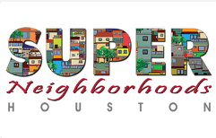
SN Grants Program 2025
a presentation by Mayor’s Assistance Office

Slide 2
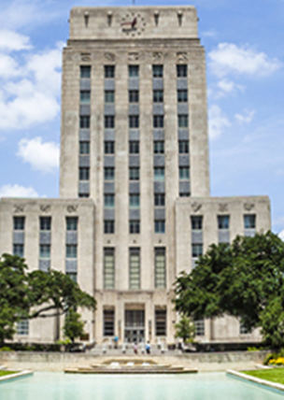
Agenda
3 | Super Neighborhood Grants Program
4 | Special Note
6 | timeline
7 | Process to apply
8 | Application
Next Slide
Click Here

Slide 3

Super neighborhood Grants Program
What is the Super Neighborhood Grants Program?
Next Slide
Click Here

Slide 4

Special note
SN Grants Program 2025
Next Slide
Click Here

Slide 5
Special note
SNGP funding will only be available via reimbursement
All receipts for the approved project must be submitted for reimbursement.
No funds can be given for the start of a project.
Cash transactions or in-kind services (food, materials, volunteers or equipment) cannot be submitted for reimbursement.
Next Slide
Click Here

Slide 6




TIMELINE
OCT 7th
Nov 29TH
Jan 6th
Jun 2nd
The grant applications are released
The grant applications are due to DON
The grants are awarded
All projects must be completed
YEAR 2025

Slide 7

The process
How to apply?
Read the SNGP guidelines
Register as a vendor
Apply
Remember
Use the SNGP Process Checklist to ensure all requirements are fulfilled
Projects may only be started once approved
MAO must have all financial and supporting documents
Next Slide
Click Here

Slide 8

Application
9 | Phase I: General Information
10 | Phase ii: Qualifying Information for Project
11 | Phase iii: Project Information
12 | FAQ
Next Slide
Click Here

Slide 9

Phase I: General Information
Basic information that covers the Super Neighborhoods
  Contact Information
  Project name
  Funds requested
  Certification from the SNC
Next Slide
Click Here
Notes:
Phase 1: General Information
The Super Neighborhood provides basic information that covers its
Contact Information
The project name
the funds requested
And the certification signatures from the SNC

Slide 10
Phase II: Qualifying Information for Project
Physical address
Ownership information
Permission
Upkeep/Maintenance
Required Documents
Signed letter of permission from owner of the proposed site
Proof of ownership of proposed site
Photo of proposed site
Next Slide
Click Here
Notes:
Phase 2: Qualifying Information for Projects
In this section, Super Neighborhoods provide the proposed project’s
physical address
the Ownership information and
the Permission to make proposed improvements
and if upkeep is required
As part of Phase 2, the Required Documents must be submitted with the application
Signed letter of permission from owner of the proposed site
Proof of ownership of proposed site
Photo of proposed site

Slide 11

Phase III: Project Information
Goal and vision
Selection and Planning
Community Engagement
City Departments Approval
Timeline
Next Slide
Click Here
Notes:
Phase 3: Project Information
Super Neighborhoods provide the goal and vision of the project
the current condition of the proposed site
The project’s selection and planning
The engagement of the neighborhood and their involvement with the project
Approval from City Departments to conduct the proposed project
And the Project Timeline

Slide 12
FAQ
Please consult the complete Super Neighborhood Grants Project Guideline for more in-depth coverage of the requirements.
Next Slide
Click Here

Slide 13
FAQ
When can we apply?
  Application packages will be accepted beginning October 7th through November 29th.
When can the project start? When must the project be completed?
  The funded part of a project can be started only AFTER a notification of application award by the City of Houston has been issued to your organization. The project must be completed with financial supporting documentation submitted by June 2, 2025
When is the deadline to submit an application?
  The deadline to submit an application packet this year is Friday, November 29, 2024, by 5pm.
Next Slide
Click Here
Notes:
I would encourage all Super Neighborhood to Please read the complete Super Neighborhood Grants Project Guideline for more in-depth coverage of the requirements.
As applying for grants is a new process for some Super Neighborhoods, we have a quick FAQ that may be helpful.
When can we apply?
Application packages will be accepted beginning January 26th , and due March 1st .
When can the project start? When must the project be completed?
The funded part of a project can be started only AFTER a notification of application award by the City of Houston has been issued to your organization. The project must be completed and financial supporting documentation submitted by June 28, 2024
When is the deadline to submit an application?
The deadline to submit an application packet this year is Friday, March 1, 2024, by 5pm.
Can the project period be extended beyond the deadline?
No. The project must be completed by June 28th.

Slide 14
FAQ
Can the project period be extended beyond the deadline?
  No. The project must be completed by June 2nd. Funding for this grant is provided through City funds and we must adhere to the city fiscal budget year which ends in June.
We already have a vendor number; do we need to reapply?
  No. If you have previously registered with the City of Houston and have a vendor number, please DO NOT use New Supplier Registration link to avoid duplication
Next Slide
Click Here
Notes:
\

Slide 15
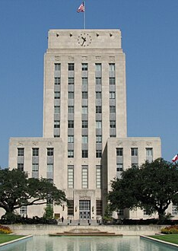
THANK YOU
MAYOR’S ASSISTANCE Office
SANDRA.CORTEZ@HOUSTONTX.GOV
https://www.houstontx.gov/superneighborhoods/index.html
This Photo by Unknown Author is licensed under CC BY-SA

