Slide 1
Pay or Play Program (POP) Technical Assistance Training for Contractors

Slide 2
Division Contact Information
Kennisha London
Deputy Director
Chrystal Boyce Division Manager
2100 Travis, 9th Floor, Houston, TX 77002
www.houstontx.gov/housing

Slide 3
HCDD POP Coordinator
Lakesha Tates
Administration Manager
Lakesha.Tates@Houstontx.gov
Office: 832-394-6345
Leslie Joseph
Administrative Coordinator
Leslie.Joseph@Houstontx.gov
Office: 832-394-0035
LaQuinta Burton
Administrative Coordinator
LaQuinta.Burton@Houstontx.gov
Office: 832-394-5385

Slide 4
Discussion Topics
POP Program Definitions
POP Program Requirements
POP Submissions in B2GNow
Final POP Compliance Review
POP FAQs
Additional Resources

Slide 5
Pay or Play Program Overview
Office of Business Opportunity oversees POP Program.
Contractors that do not provide healthcare benefits for their workforce impose a burden on the public and private agencies.
City intends to enhance fairness in the competition for contracts between bidders that choose to offer health benefits and those that do not.
See Executive Order 1-7 for more information.

Slide 6
POP PROGRAM DEFINITIONS

Slide 7
POP “Covered Contracts”
Contracts valued at or above $100,000 (prime contractors) or $200,000 (subcontractors)
Professional Service, Construction and Service type Contracts
On-Call, Work Order and Job Order Solicitations. (See Executive Order 1-7)

Slide 8
POP – Program Does Not Apply
Supply / Procurement contracts (51% or more rule)
Intergovernmental contracts/Interlocal agreements, bulk purchasing
Any contract for which the City of Houston has not expended funds, regardless of funding.
A POP 4 form approved by OBO for Exemption
Contractors that utilize self-employed, owner/operator individuals to complete services (e.g., Truck Drivers, Day Laborers, 1099, etc.) are POP exempt.

Slide 9
POP “Covered” Employees
All Employees of a “covered” contractor or subcontractor working onsite or in the office;
Employees that are over 18 years old; and
All Employees that work at least 30 hours per week with any amount of time on the “covered” contract.
All Section 3 employees on DR-17 projects must offer POP benefits.

Slide 10
Pre-Construction Meeting
POP 1 Form – POP Acknowledgement Form (Both Prime and Sub)
POP 2 Form – Certification of Compliance (Both Prime and Sub)
POP 3 Form – List of Subcontractors (Prime and Subs with Tier 2 Subcontractors)
B2G Access Form – Access form for B2GNow (all POP applicable vendors)
ALL contractors will be given access to LCP Tracker after the Pre-Construction meeting and are required to upload their POP 1-3 forms into the POP Documents folder in LCP Tracker.
Contractors are required to begin complying with POP within 30 days of your Start of Work Notice Date.

Slide 11
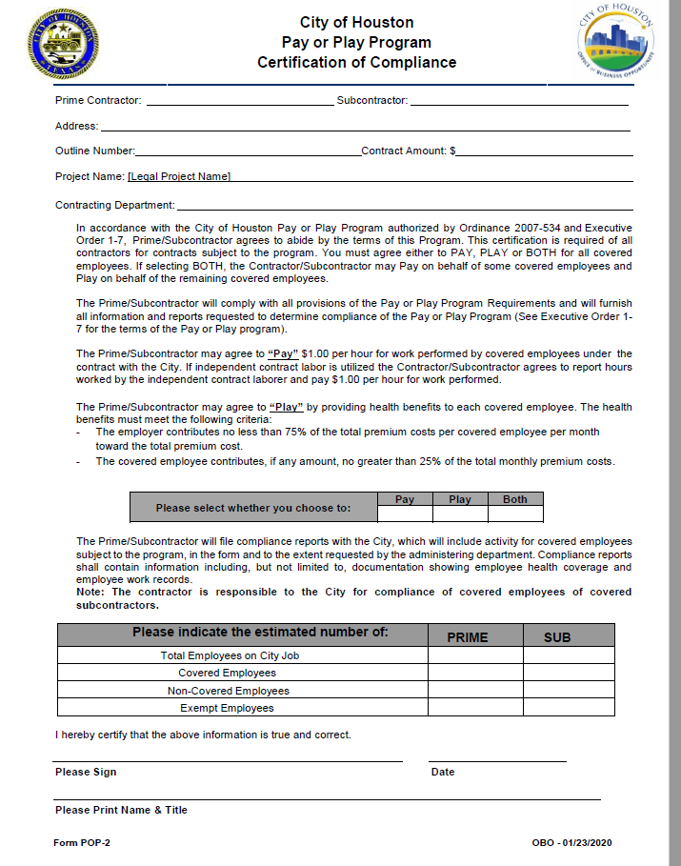
POP 2 Form (Required by Prime and Sub)

Slide 12
POP PROGRAM REQUIREMENTS

Slide 13
PAY - Weekly Workforce Audit Submissions
Vendors will "PAY" by contributing $1.00 per “covered” employee for each regular hour of work performed on a POP contract not to exceed $40.00 per employee per week.
List all active employees (including exempt employees) under the "Workforce Employee List" and enter weekly “Workforce Audit” hours in B2GNow for each “covered” employee working on the project.
Contractors must provide BOTH, the total hours worked for the contractor and the individual hours worked on the project for each covered employee. If BOTH columns are not complete your workforce audit will be rejected.
Add the hours for each employee that worked each week as follows:
Total Hours = Total number of hours the employee worked for the Contractor for that week.
Hours Worked = Total number of hours the employee worked on the specific COH project.
Invoices are created monthly from the Weekly Workforce Audit reports. Payments are made through Pay Connexion. POP will not accept partial payments; invoices must be paid in full.
HCDD may request certified payroll or time sheets for each employee to verify hours recorded in B2GNow for PAY employees.

Slide 14
PAY - Weekly Work Force Submissions
PAY Example Situations:
John is a "covered" employee who is NOT offered POP benefits:
The employer must submit weekly PAY submissions by entering John’s hours into B2G workforce audits.
John is a "covered" employee and has insurance through his spouse.
The employer should submit a completed and notarized POP 8 form with proof of healthcare insurance for John via email to the POP Coordinator for review/approval.
John is a "covered" employee and ACCEPTS the POP benefits offered to him:
John will be considered a PLAY employee, NOT a PAY employee, and hours are NOT required to be submitted.

Slide 15
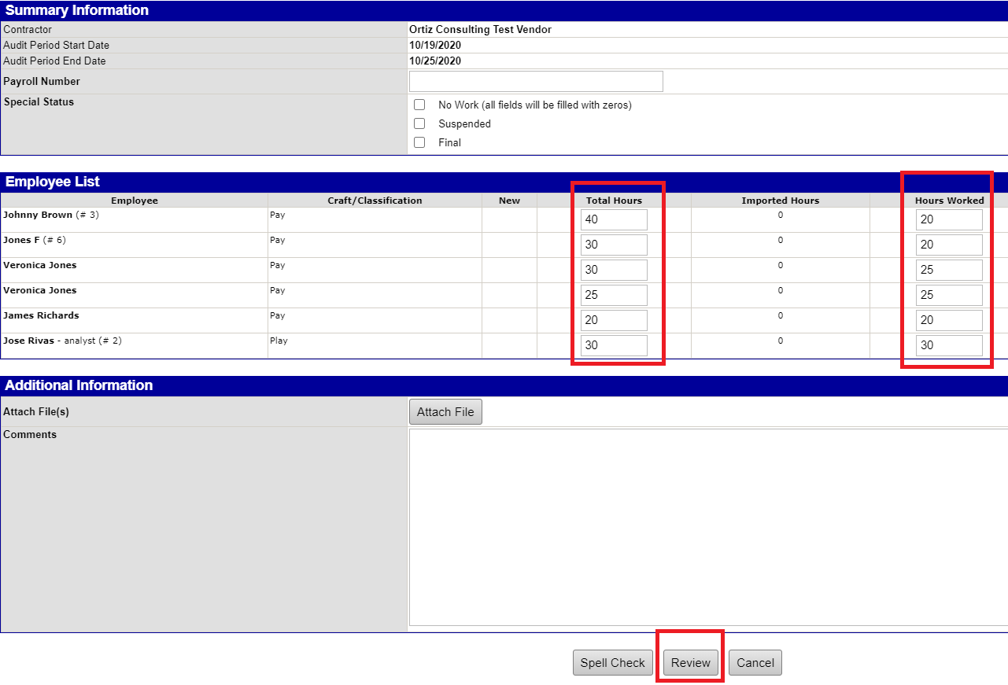
How to Submit PAY: Total and Work Hours

Slide 16
POP 8 Form - Employee Waiver Request
An Employee Can Be Considered Exempt from POP If:
The Employee is under the age of 18;
The Employee has insurance through spouse, Medicaid or Medicare (must provide proof); or
The Employee refuses the Company's Health Insurance that meets the City of Houston POP requirements.
Contractors must send the completed and notarized POP 8 form to the POP Coordinator via email for review and approval. Employees must have an OBO APPROVED POP 8 Waiver on file to be exempt. Contractors can only upload approved POP 8 forms and required documents into LCP Tracker. POP 8 forms are updated annually.

Slide 17
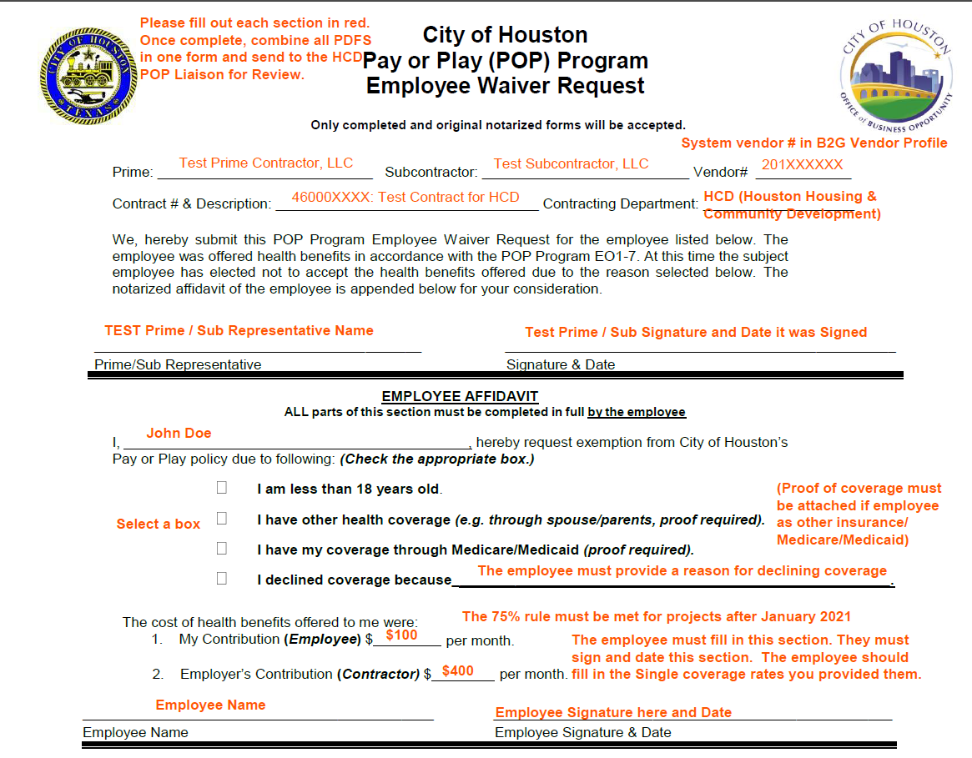
POP 8 Employee Waiver Request

Slide 18
POP 9 Form - Self- Insured Contractor Request
Contractors may request for a POP 9 – Self- Insured Contract Request form to be emailed to them if the employer is using their own money to cover their employees' claims. (only available upon request)
The POP 9 – Self-Insured Contract Request and all required documents must be emailed to the POP Administrative Coordinator for review and approval.
Contractors awarded Self-Insured status will be PLAY participants and required to report once a year.
To be considered self-insured, the contractor must have an OBO APPROVED POP 9 on file. Contractors must upload ONLY Approved POP 9 forms along with the required documents to LCP Tracker.

Slide 19
PLAY - Quarterly Work Force Submissions
Vendors will "PLAY" by providing health benefits to covered employees. Health benefits must meet or exceed the following standards: (Submissions in B2GNow)
The employer will contribute no less than 75% of the total premium cost per covered employee per month toward the total premium cost.
The employee contribution, if any amount, will be no greater than 25% of the monthly premium cost.
HCDD may request a completed Eligibility Verification form and a copy of your company’s current Pre-Printed Health Benefits Program or Employee Benefit package offered to your employees which details coverage amounts.
HCDD does not accept insurance cards as proof of healthcare coverage for quarterly submissions.
What is NOT Required:
As a PLAY elect contractor/subcontractor, you are not required to enter Weekly hours worked.
Please See the POP FAQ's for more information.

Slide 20
PLAY - Quarterly Work Force Submissions
PLAY submissions are due quarterly in B2GNow Database as follows:
1st Qtr. Months (January, February, and March) – Due on April 1
2nd Qtr. Months (April, May, and June) – Due July 1
3rd Qtr. Months (July, August, and September) – Due October 1
4th Qtr. Months (October, November and December) – Due January 1

Slide 21
PLAY – Quarterly Workforce Submissions
PLAY vendors will complete Quarterly Workforce Audits:
Verify ALL covered active employees who worked on the city project that quarter, whether onsite or in the office, are listed in the Workforce Employee List.
Upload the POP 7 form, listing those same active employees to B2GNow.
The POP 7 form must be accompanied by supporting company health documents (insurance summaries and invoices) that list the names of those employees as well as the cost of coverage for each employee for the three months during each quarterly reporting period.
All documents must be uploaded to B2GNow for the submission to be considered complete.
Annual Benefit Packages may be requested if there are questions regarding benefit coverage.
HCDD will not accept insurance cards as proof of healthcare coverage for quarterly submissions.

Slide 22
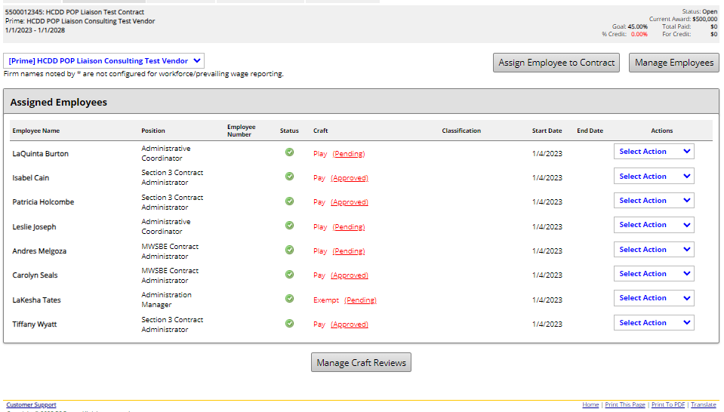
How to Submit PLAY: Quarterly Submission

Slide 23
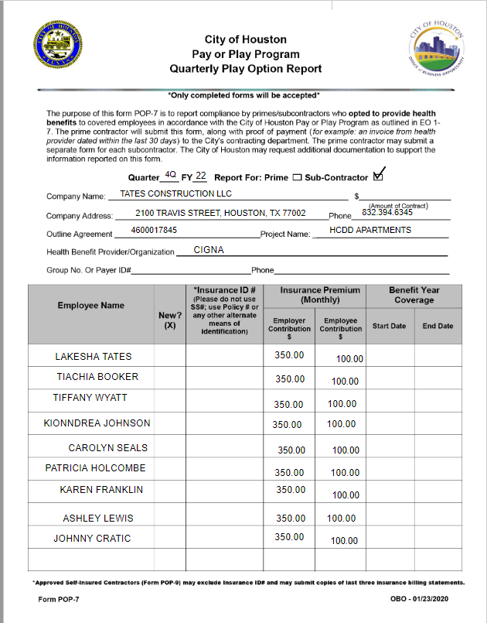
POP 7 Quarterly Play Option Report
Must be uploaded in B2GNow along with Company health insurance invoices that detail the cost of coverage for PLAY employees.

Slide 24
POP SUBMISSIONS IN B2GNOW

Slide 25
B2GNow
B2GNow is the management system for all POP workforce audit submissions.
POP 7 forms and supporting documents will be submitted as workforce audits in B2GNow quarterly.
PAY weekly workforce audits are required to be submitted in B2GNow.
Once Weekly Workforce audits are completed, monthly invoices will be generated and sent to the contractor/subcontractor.
Invoices are due 30 days after the date generated. Partial payments are not accepted.
Utilize Chase payment portal in B2GNow to pay all POP invoices. B2GNow website link - https://houston.mwdbe.com/

Slide 26
B2GNow Overview
Viewing POP Contracts in B2GNow
Adding Employees to B2GNow
Assigning Employees to a Contract
Submitting Weekly Workforce Audits (PAY)
Filling in Weekly Hourly Audits
Saving and Certifying Audits
Submitting Quarterly Workforce Audits (PLAY)
Uploading and Attaching documents for Audits
Please See the POP FAQ for more information

Slide 27
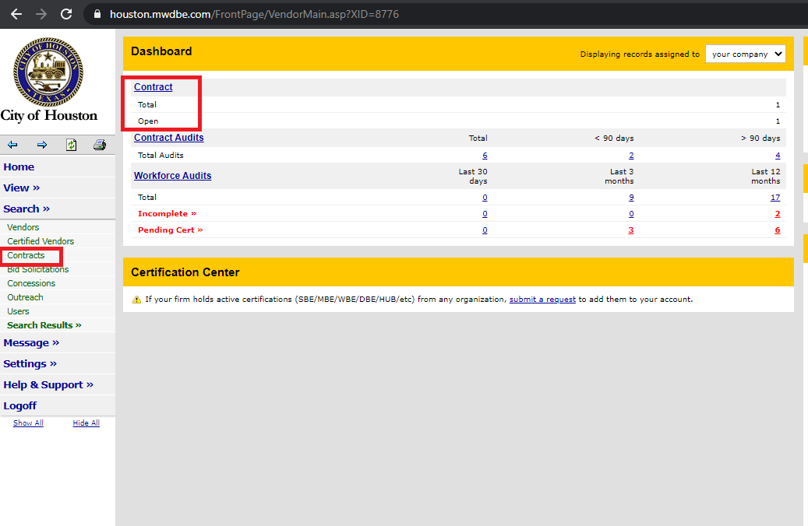
Step 1: Select POP Contract

Slide 28
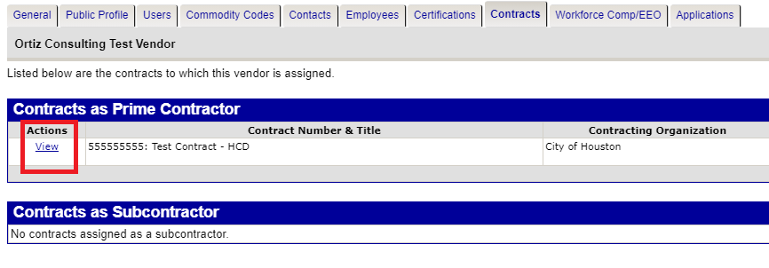
Step 1.1 : Select POP Contract

Slide 29
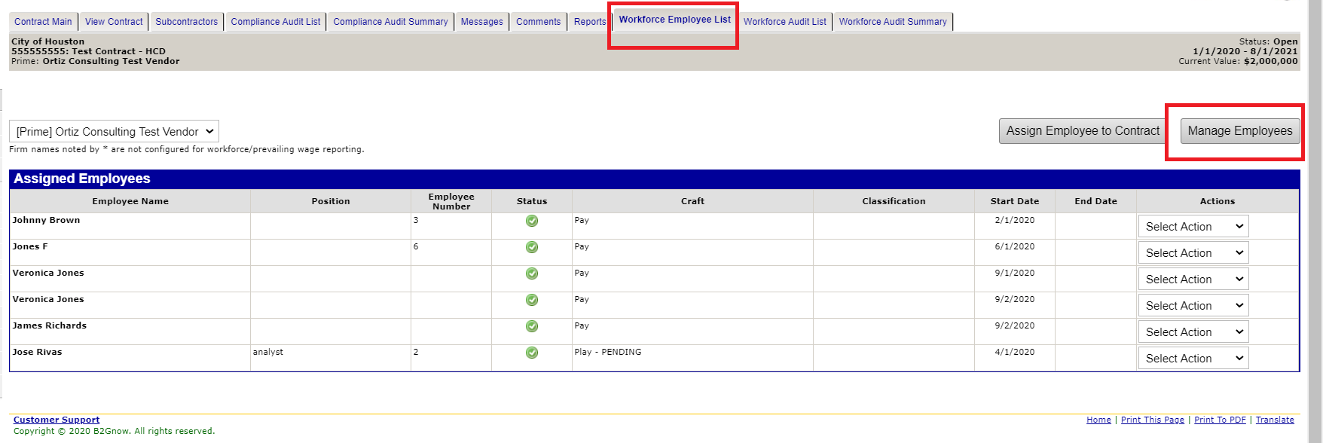
Step 2: B2GNow - Add Employees
Notes:
.

Slide 30
Step 2.1: B2GNow - Add Employees

Slide 31
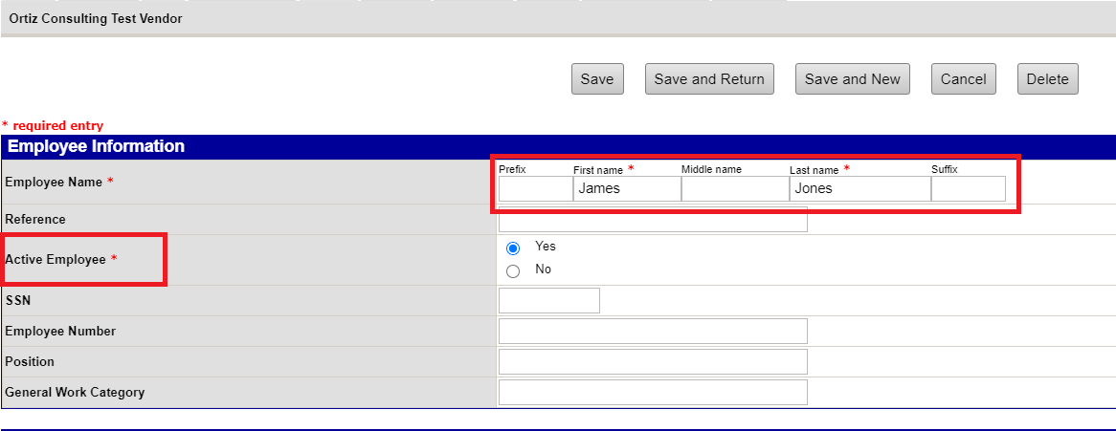
Step 2.2: B2GNow - Add Employees

Slide 32
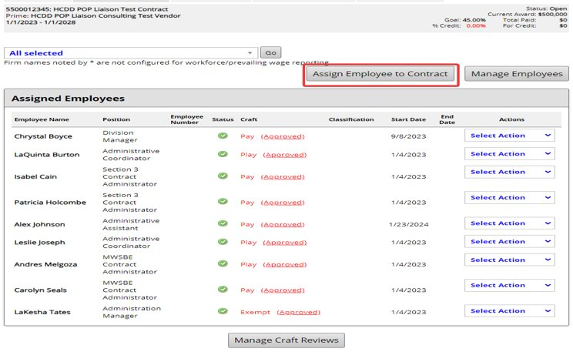
Step 3: Assign Employee

Slide 33
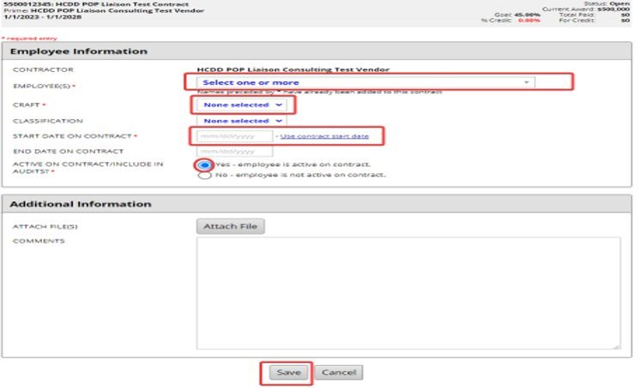
Step 3.1: B2GNow - Assign Employees

Slide 34
PAY - Weekly (Hourly) Workforce Audit Submissions

Slide 35
Step 4: PAY Workforce Audits Submissions

Slide 36
Step 4.1: PAY Workforce Audits Submissions

Slide 37
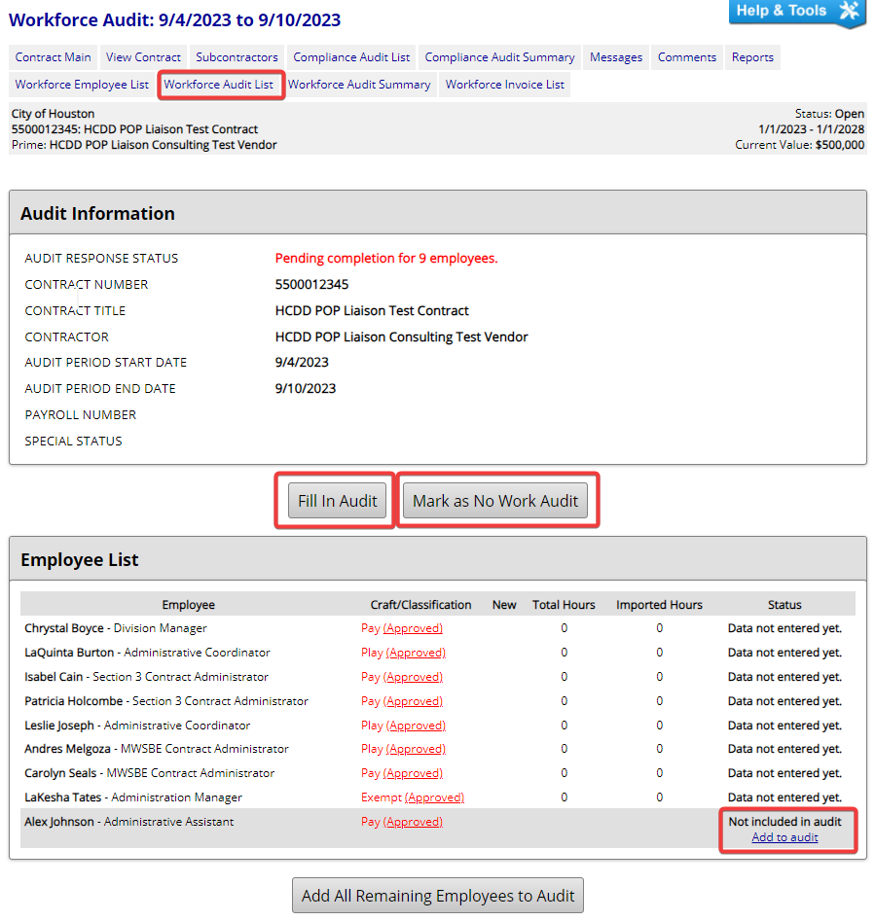
Step 5: Fill In PAY Workforce Audit

Slide 38
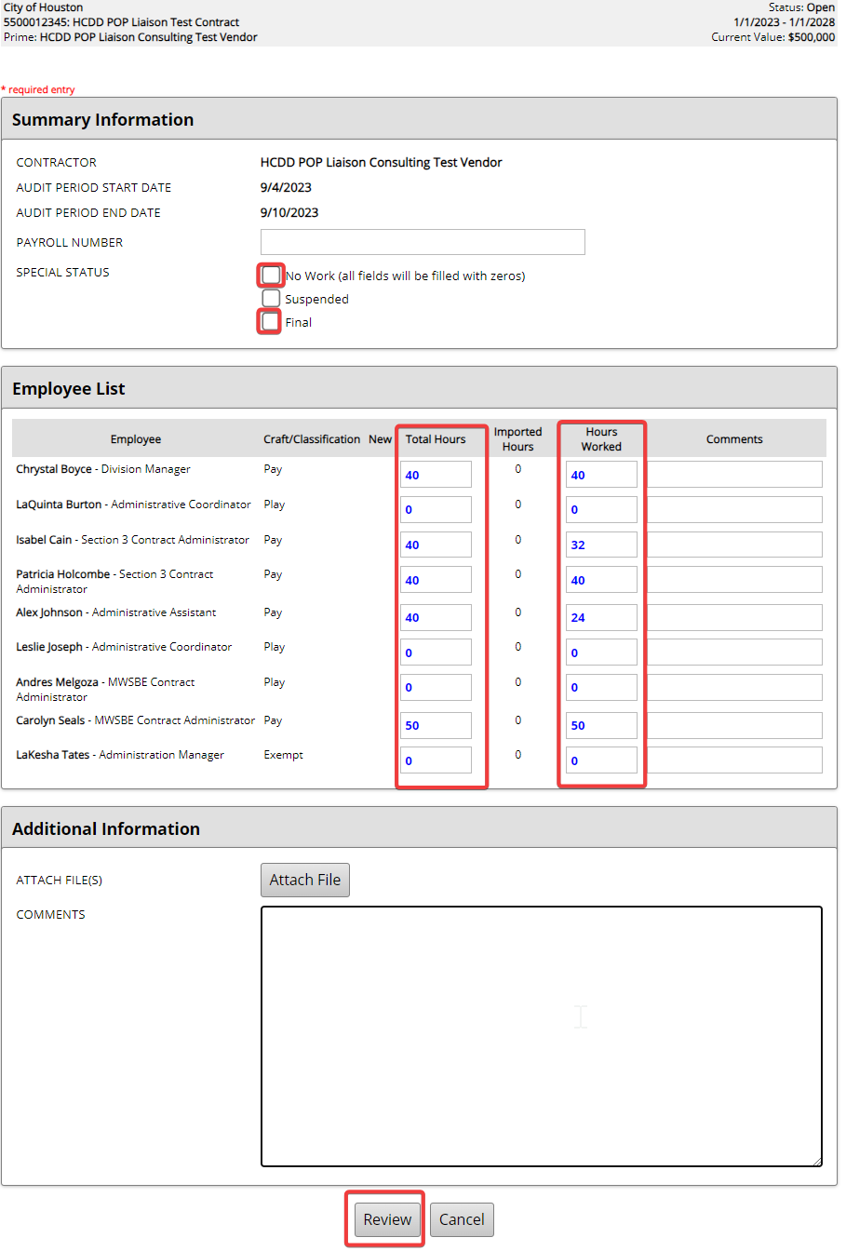
Step 6: Add Total and Work Hours

Slide 39
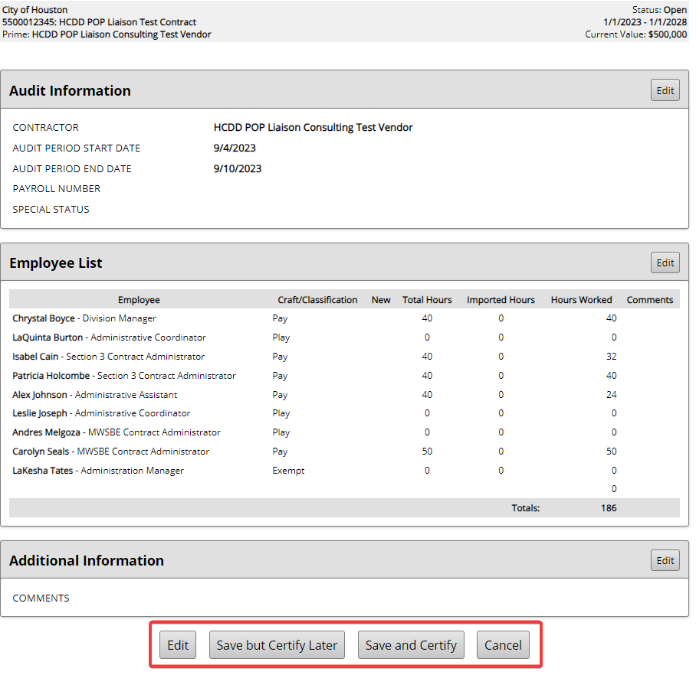
Step 7: Edit, Save, or Certify Audit

Slide 40
Step 8: Certify, Review Certification

Slide 41
PLAY - Quarterly (Insurance) Workforce Audit Submissions

Slide 42
Step 1: PLAY: Quarterly Submission

Slide 43
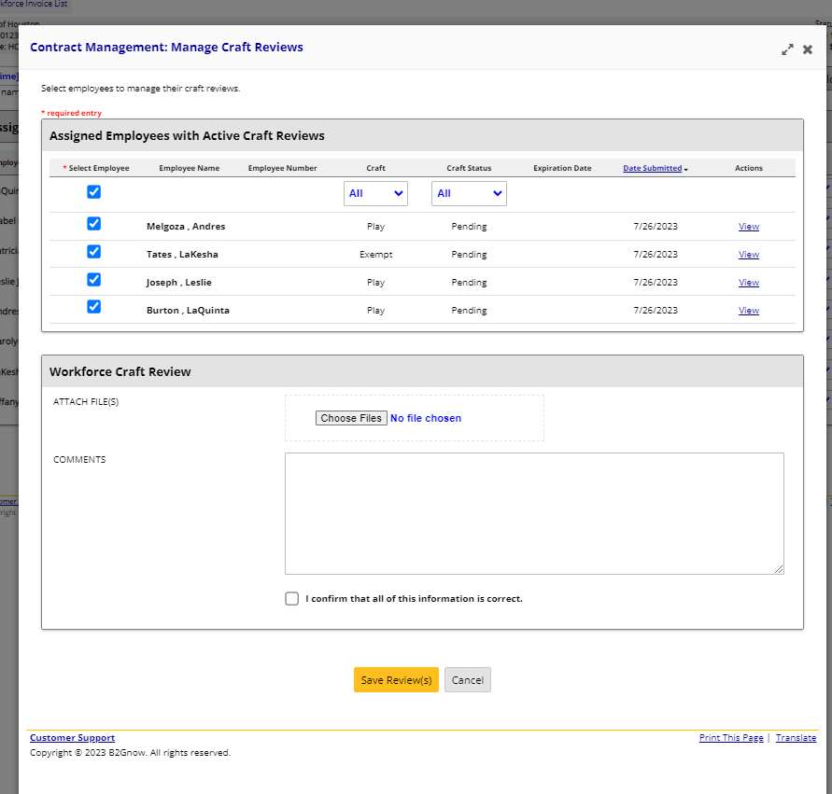
Step 2: PLAY: Quarterly Submission

Slide 44
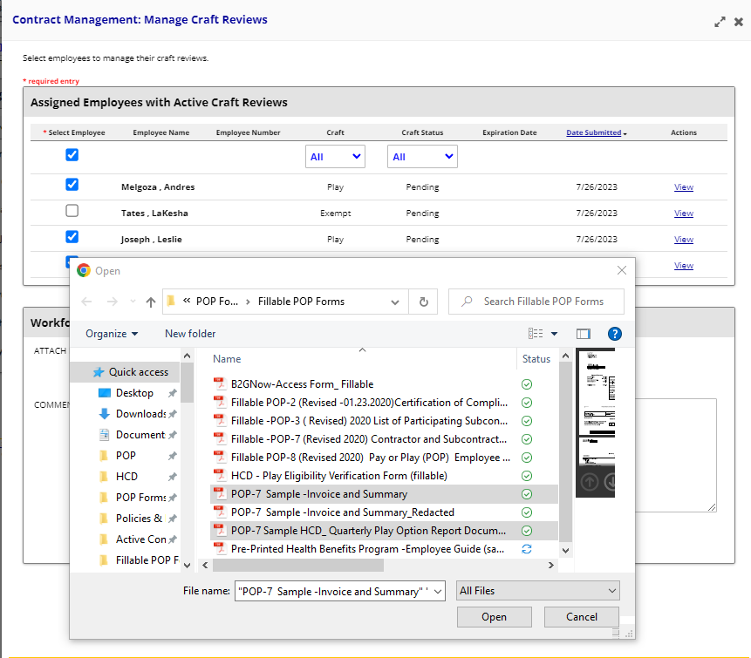
Step 3: PLAY: Quarterly Submission

Slide 45
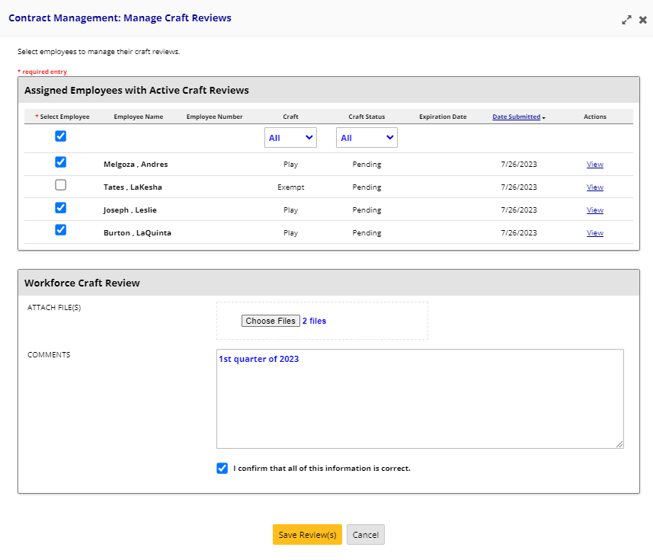
Step 4: PLAY: Quarterly Submission

Slide 46
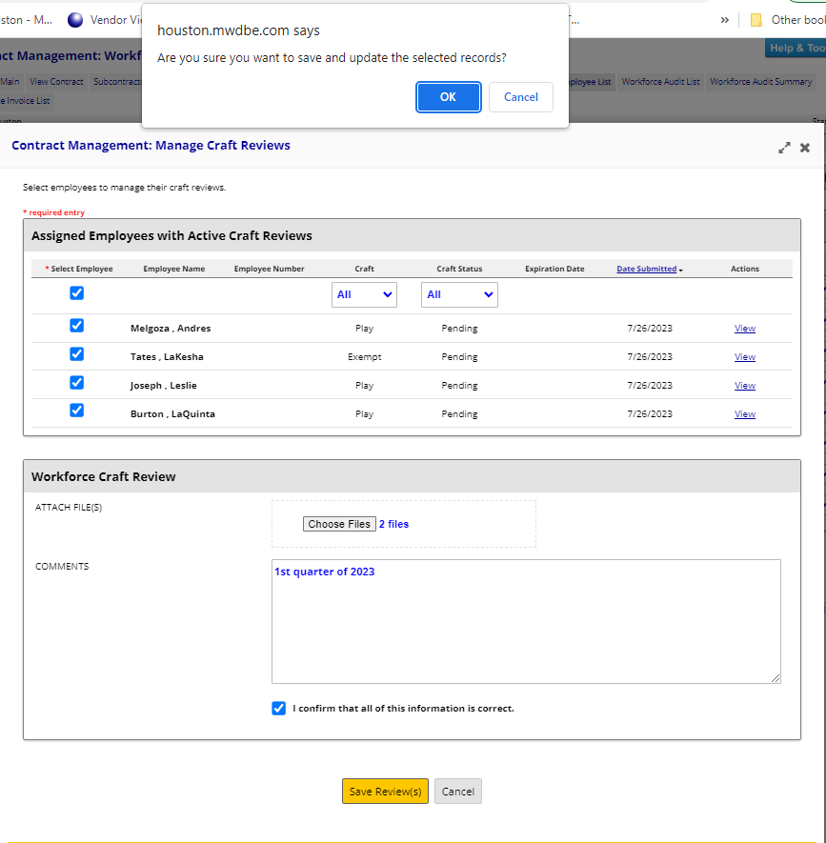
Step 5: PLAY: Quarterly Submission

Slide 47
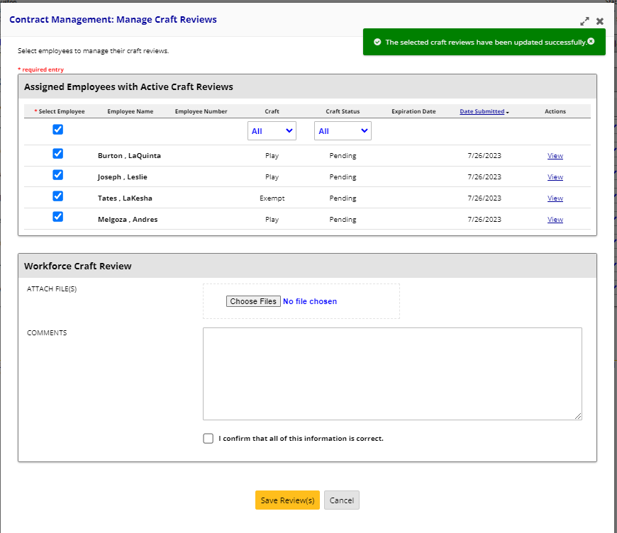
Step 6: PLAY: Quarterly Submission

Slide 48
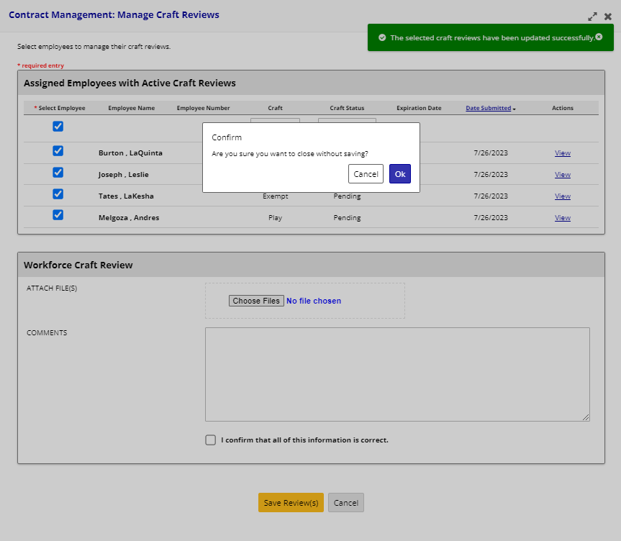
Step 7: PLAY: Quarterly Submission

Slide 49
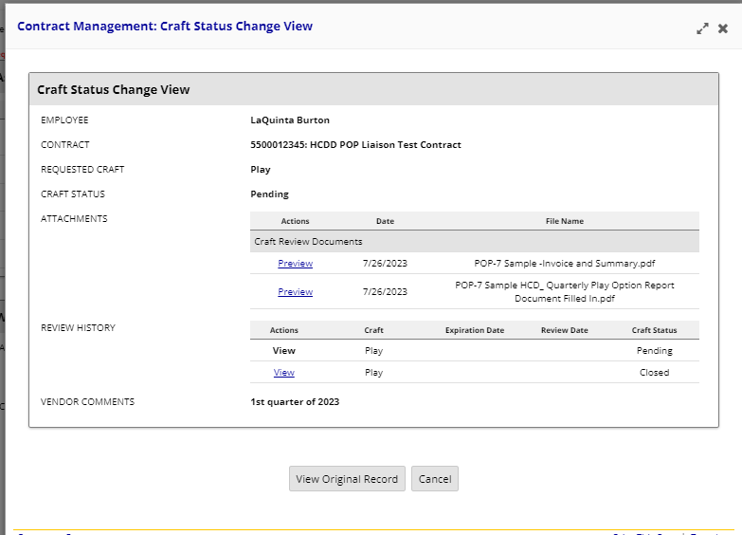
PLAY: Quarterly Submission

Slide 50
POP Monthly Compliance Status (CSR) Report:

Slide 51
Final POP Compliance Review

Slide 52
Final POP Compliance Review
POP Vendors should submit all POP documents (POP 1-3, any approved POP 8/9) prior to close-out to LCP Tracker. (Follow steps in FAQ)
All Workforce Audit submissions and all POP Invoices for each POP vendor must be paid prior to close-out.
Retainage payments, will be held due to incomplete POP Workforce Audit submissions or unpaid invoices.
SOWs and TOWs should be uploaded to LCPTracker for each subcontractor prior to project close-out.
Once a Prime/Subcontractor has completed their project, the last workforce audit submission should be labeled as “Final” in B2GNow. This will notify the HCDD POP Liaison to mark the vendor as “inactive” on the contract.

Slide 53
FAQ SECTION

Slide 54
FAQ
No. ALL employees who work on the City Contract, whether onsite or in the office, must be included in the workforce audit employee list and accounted for during the audit.
1. Are only employees working on the job site required to be listed on the workforce audit employee list?
Notes:
R

Slide 55
FAQ
Yes. You must submit a completed and notarized POP 8 form, along with proof of healthcare insurance. This is the only time a copy of an employee's insurance card will be accepted. Email the form along with the insurance card to the POP Administrator for review and approval.
2. My employee has his or her own insurance, and my company does not pay for it; does this mean he or she must submit a notarized POP 8 form for exemption?

Slide 56
FAQ
No. Please upload your Termination of Work (TOW) Notice in LCP Tracker with the date your contract is completed, and then submit FINAL in the B2GNow database during your final workforce audit week.
3. I am a subcontractor on a City of Houston POP contract, and my contract ends before the Prime Contractor finishes the job, do I still have to submit POP submissions?

Slide 57
FAQ
Yes. All subcontractors with a professional service, construction, or general service contractor whose contract amount meets or exceeds the $200,000 are required to comply with POP requirements.
4. Are subcontractors required to comply with the POP program if they are not MWSBE or Section 3?

Slide 58
FAQ
No. The POP payments are deposited to the Contractor Responsibility Fund (CRF), which shall not be used for any other purpose except to assist in providing healthcare services to uninsured persons in the Houston area.
To learn more, please see the Office of Business Opportunity website at:
https://www.houstontx.gov/execorders/1-7.pdf
5. Do any of the POP payments benefit my company?

Slide 59
ADDITIONAL RESOURCES

Slide 60
If you would like to request a copy of the POP Frequently Asked Questions, please send an email to your POP Liaison.
POP FAQ's
Where should POP Forms 1-3 be submitted?
How to submit POP 8 Form (Exemption Waiver)?
How Do I submit PLAY submissions?
How do I submit PAY Workforce Audit?
How can I pay my POP Invoice?

Slide 61
Comments & Questions

