Slide 1
WELCOME!
Pre-Award
8:30 AM – 9:20 AM
Section 3
9:30 AM – 10:20 AM
MWSBE
10:30 AM – 11:20 AM
Pay or Play
11:30 AM – 12:20 PM
We Will Begin Shortly.

Slide 2
Division Contact Information
Kennisha London
Deputy Director
Chrystal Boyce Division Manager
2100 Travis, 9th Floor, Houston, TX 77002
www.houstontx.gov/housing
Notes:
Kennisha London is the Deputy Director for the Compliance & Grants Administration Division, while Chrystal Boyce is the Division Manager for Contract Compliance.
Chrystal oversees Pre-Award Services and leads a team of professionals who administer Affordable Rental Housing Compliance, Section 3, Pay or Play, and the Minority Women Owned Small Business Enterprise (MWSBE) programs.

Slide 3
Pre-Award Services Technical Assistance Training

Slide 4
Pre-Award Services
Lakesha Tates
Administration Manager
Lakesha.Tates@Houstontx.gov
Office: 832-394-6345

Slide 5
Pre-Award Benefits
Contracting party receives detailed guidance on applicable program requirements to prevent project delays and non-compliance;
Use of Funds, Cost Allocations and pertinent contacts are provided;
Contract, Employment and Training opportunities are disseminated to local businesses and workers

Slide 6
Program Overview
Pre-Award Services ensures an effective and efficient solicitation and contract review process by review and approval of required documents related to MWSBE, Section 3 and Pay or Play requirements.

Slide 7
PRE-AWARD ACTIVITIES

Slide 8
MWBE Prime Participation
Historically, the City MWBE Program has not permitted MWBE Prime Contractors to count their self-performance towards meeting MWBE contract goals.
MWBE goals were solely met by certified MWSBE firms serving as subcontractors or by use of the certified firms in joint venture partnerships.
Policy Change: The City will now allow MWBE Primes to meet advertised goals by self-performing up to 50% of the total contract goal(s).
MWBE primes will not retain more dollars on each contract, potentially allowing them to grow and build capacity.
Implementation Timeline: Language for the application of this new policy will be explicitly included in new City solicitations. Existing contracts or solidifications already advertised will not be affected by this new policy.

Slide 9
MWBE Prime Participation
Please keep in mind the following regarding the policy change:
MWBE Primes will have to choose which goal they would like to receive credit for on construction projects (MBE or WBE).
Once a goal type for participation is selected, the Primes participation credit will be capped at the proposed percentage or the approved goal, whichever is lower.
This new policy serves to assist MWBE Primes to build their capacity, while not losing focus on ensuring MWBE subcontractor participation on City Contracts.

Slide 10
MWBE City-Wide Aspirational Goals
As you know, the City’s annual aspirational goals for the inclusion of Minority, Women-owned, and Small Business Enterprises (MWSBEs) on contracts are 34% for construction contracts, 24% for professional services contracts, and 11% for goods and services contracts. Historically, HCDD, have used these aspirational goals on goal-oriented contracts.
Effective immediately, any new procurement initiated by HCDD for goal-oriented contracts of any type must contain a contract-specific M/WBE goal or utilize HCDD approved categorical goals. HCDD approved (categorical goals) will only be applicable for construction related activities on Multifamily, Public Facilities and Single-Family awards .
Implementation Timeline: Language for the application of this new policy will be explicitly included in new City solicitations. Existing contracts or solidifications already advertised will not be affected by this new policy.

Slide 11
Minority Women Owned Small Business Enterprise (MWSBE)
MWSBE Participation Plan w/ Letters of Intent;
MUST complete Form 470 AND/OR FORM(S) 471 and 472.
*Only firms certified through the City of Houston, Office of Business Opportunity can be utilized towards goal achievement*

Slide 12
Achievement Of Goal
MBE and WBE goals are separate subcontracting goals to be met individually.
Any excess of the MBE or WBE Goal cannot be used to meet a deficient MBE or WBE goal.
Only 4% SBE can be used to meet either the MBE and/or WBE Goal, but both cannot get 4% each.
A MBE or WBE certified Prime may count its self-performance for up to 50% of the overall advertised goal. The certified MWBE Prime may count only the work in which the MWBE has performed a Commercially Useful Function. The use of a certified MWBE Prime’s self-performance to meet multiple goals (e.g., MBE and WBE) on a contract is prohibited.
Once a firm is certified as a MWSBE firm, the total dollar value of the subcontract awarded to the MWSBE firm is counted toward the Contract Goals, counting only the work in which the MWSBE has performed a Commercially Useful Function. The use of one MWSBE certified firm to meet multiple goals (e.g., MBE, WBE, SBE goals) on a contract is prohibited, unless expressly approved by OBO.
Only City of Houston Certified firms may be used to meet either the MBE Goal or WBE Goal. Visit the City’s Office of Business Opportunity Website at http://www.houstontx.gov/obo/ and click on directory link to search for COH certified vendors.
Contractor must fill in each box COMPLETELY and SIGN the document
MWSBE Participation Plan must be accompanied with Signed Letters of Intent for goal achievement.
You either turn in ONE document if you meet the Contract Goals: (Document 00470); OR
You turn in THREE documents if you cannot meet the Contract Goals: (Documents 00470, 00471, & 00472
All information must be provided in order to be deemed responsive

Slide 13
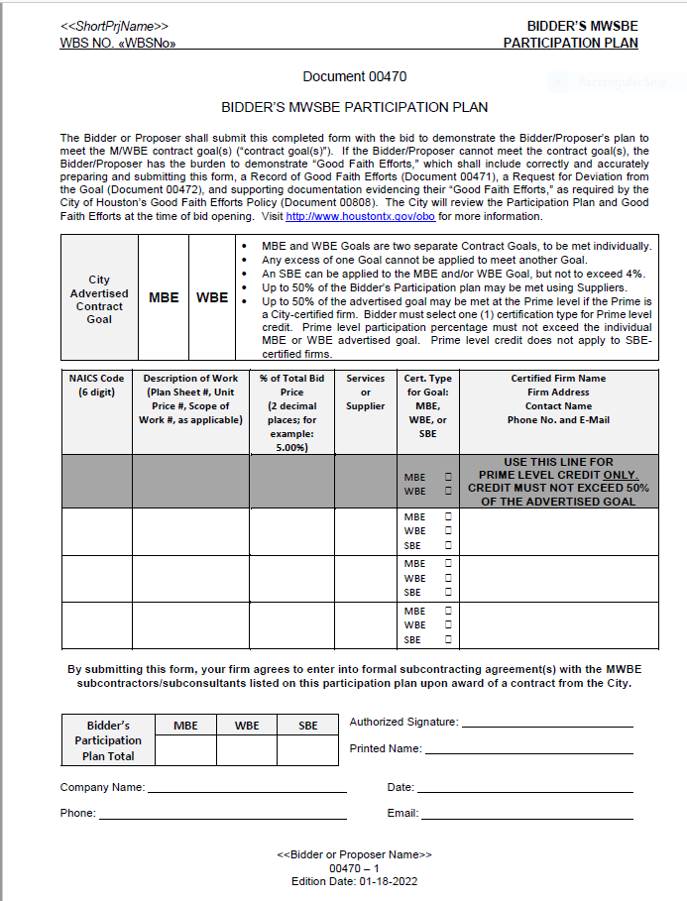
MWSBE Participation Plan Document 470
Captures MWSBE Participation that the Contractor commits to achieve for the contract.
Helps Pre-Award Administration Manager determines whether the Contractor has a plan to actually meet the goal.
Contractor is required to submit Document 470 with MWSBE Signed Letters of Intent

Slide 14
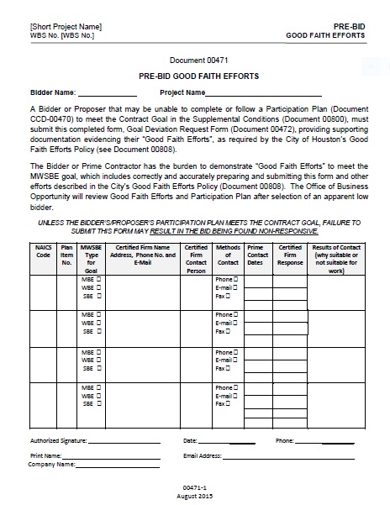
Pre-Bid Good Faith Efforts
Allows the Contractor to document Good Faith Efforts to meet the advertised MWSBE goals.
Allows the Administrating Department to see Contractor’s efforts made to find MWSBE firms.
Contractor must fully complete the bottom portion of the document.
Certified Firm Name, Address, Contact Name, Phone Number and E-mail

Slide 15
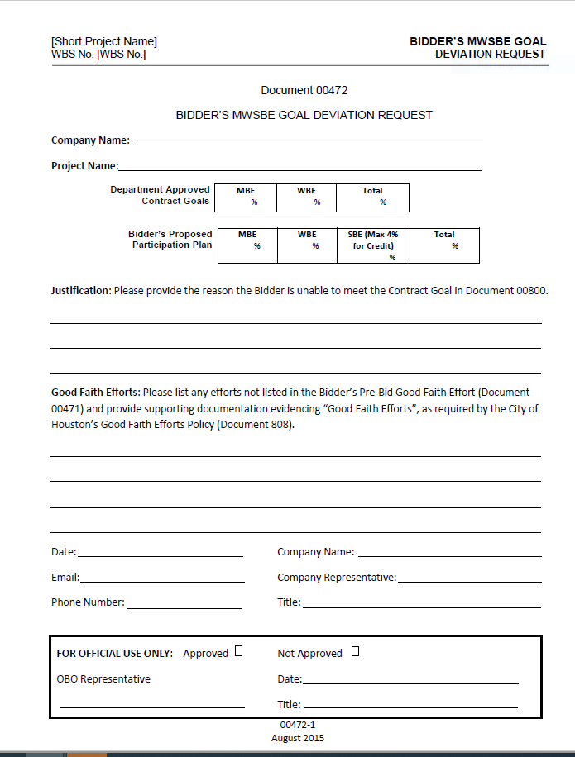
Contractor Deviation Goal Request
Allows Contractor to explain two things:
Why the Contractor was unable to meet the advertised MWSBE goals; AND
What good faith efforts the Contractor made that were not captured on Document 471 and provide additional justification.
Contractor must fully complete the bottom of the form.
Certified Firm Name, Address, Contact Name, Phone Number and E-mail

Slide 16
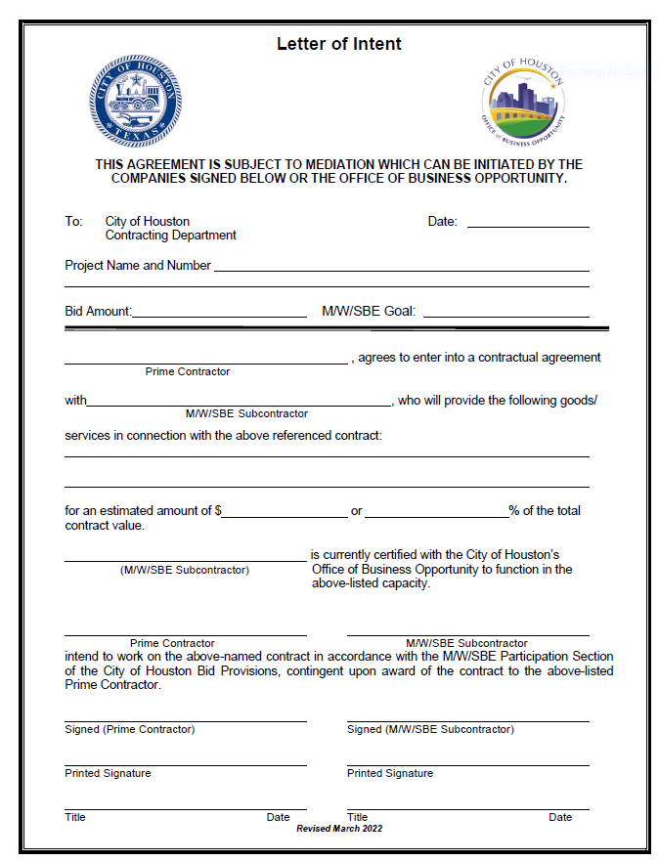
MWSBE Letter of Intent
MWSBE Letter of Intent must be accompanied with the MWSBE Participation Plan.
MWSBE Letter of Intent must be completed entirely.
The Bid Amount on MWSBE Letter of Intent should be direct construction amount from COH funding..
The MWSBE Letter of Intent for the MWSBE can include the estimated amount the GC intent to utilize for that the sub or the percentage you listed on the MWSBE Participation Plan for the certified firm.
The MWSBE Letter of Intent must be signed by the General Contractor and the MWSBE subcontractor or supplier.
All information must be provided in order to be deemed responsive

Slide 17
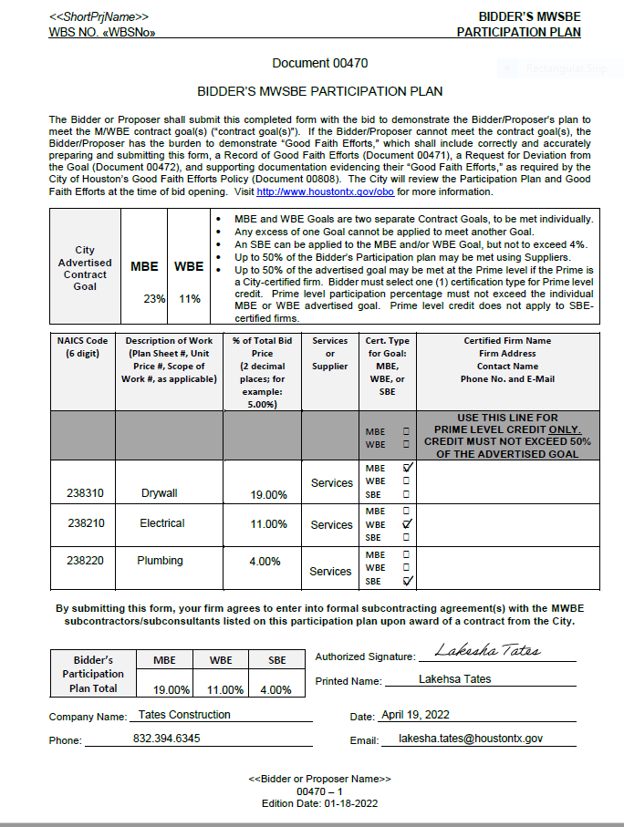
MWSBE Participation Plan Example #1

Slide 18
Calculating MWSBE Participation Example #1
Advertised Goals: 23% MBE and 11% WBE
Contractor Proposed Participation Plan:
Does this MWSBE Participation Plan meet the minimum goal requirement?
These are separate goals to be met individually!
SBE: 4% 4% of the SBE may be used to meet the MBE and/or WBE goal
MBE: 19% + 4% (from SBE) = 23%
WBE: 11% + 23% = 34%
Yes!

Slide 19
MWSBE Participation Plan Assessment
Contractor MUST submit Document 470 along with Signed Letter of Intent for each subcontractor or supplier listed for MWSBE goal achievement.
Prime Contractor must fill in each box COMPLETELY and SIGN the document.
All required documents must be provided and MWSBE Participation Plan must demonstrate meeting the minimum goal requirements in order to be deemed responsive
If MWSBE Participation Plan and Letters of Intent are deemed responsive an approval email will be disseminated to the Owner Developer, Prime Contractor and Relations Manager recommending to proceed with scheduling of Pre-Construction Meeting
If the Prime Contractor failed to demonstrate meeting the minimum MWSBE minimum goal requirements an email will be sent to the Owner Developer/Contractor and Relations Manager notifying them that the MWSBE Participation Plan is non-responsive and did not meet the minimum goal requirements.

Slide 20
MWSBE Participation Plan Assessment
If MWSBE Participation Plan does not meet the minimum goal requirements the MWSBE Participation Plan (470), Pre-Bid Good Faith Efforts (471) and MWSBE Goal Deviation (472) will be forwarded over to the Office of Business Opportunity (OBO) to evaluate your Good Faith Efforts along with any other supporting documentation.
Office of Business Opportunity standard processing time is 7-10 business days provided all information is submitted. Each time new information is requested and submitted the days restart.
Pre-Award Services is excluded in the evaluation of the non-responsive MWSBE Participation Plan submitted to OBO. OBO will be in contact with the Contractor and provide Pre-Award Services with the final recommendations.
Pre-Award required documents must be reviewed and approved prior to recommending Pre-Construction Meeting and Notice to Proceed.

Slide 21
SECTION 3

Slide 22
Section 3 Pre-Award Requirements
Section 3 Participation Plan w/ Letters of Intent;
*Only firms certified through the Housing and Community Development can be utilized towards goal achievement*
EBID Announcement – For New Contracting Opportunities (Disseminated to Directory of Section 3/MWSBE firms)
Employment Opportunity Announcement (EOA) – For “New” Employment Opportunities (Disseminated to Directory of Section 3 Workers)

Slide 23
Section 3 Numerical Goal Requirements
Any contractors with contracts in excess of $100,000 are required to meet the numerical goal requirements listed below. Compliance with goal requirements can only be achieved by subcontracting with certified Section 3 Business Concerns and employing Section 3 Workers.
Contracting & Employment Goals:
3% Soft Goal – if you require professional services (non-construction), then 3% of your non-construction(soft cost budget) should be awarded to certified Section 3 Business(es);
10% Hard Cost Goal –10% of total direct construction budget should be awarded to certified Section 3 Business(es); and
25% Section 3 Worker Benchmark - 25% or more of the total labor hours worked should be performed by Section 3 Workers, with at least 5% being performed by Targeted Section 3 Workers.
*If a contractor fails to meet numerical goal requirements, they bear the burden of demonstrating Good Faith Efforts to meet goal requirements. *Contractors must adequately document all efforts taken to comply with the requirements of Section 3 and explain why despite their efforts ―to the greatest extent feasible; the minimum numerical goals were not met. *Pre-Award Services will take each contractor’s explanation into consideration when making compliance determinations regarding the Section 3 numerical goal requirement.

Slide 24
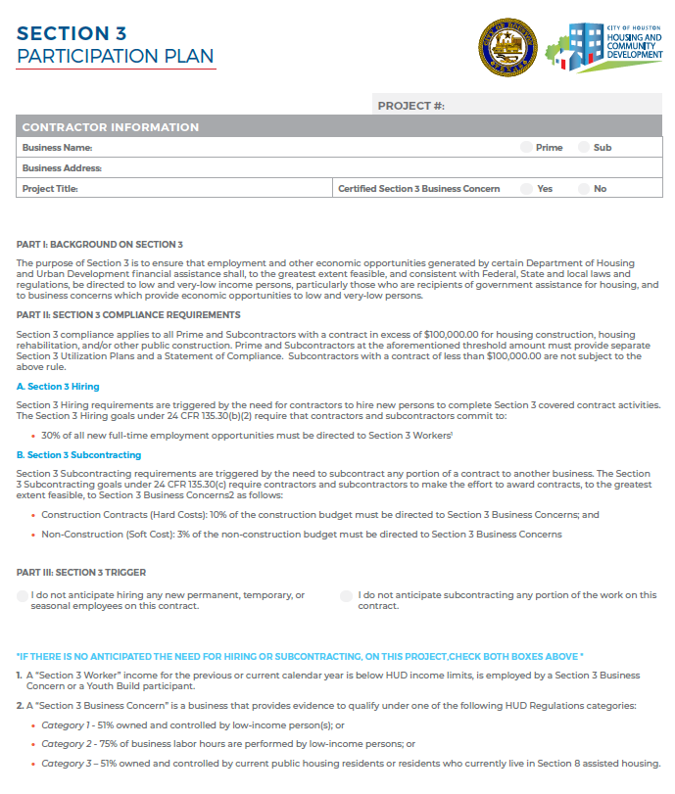
Section 3 Participation Plan
Complete the Contractor Information Section
Review the Section 3 Requirements regarding Section 3 Hiring and Subcontracting
Part III: Section 3 Trigger

Slide 25
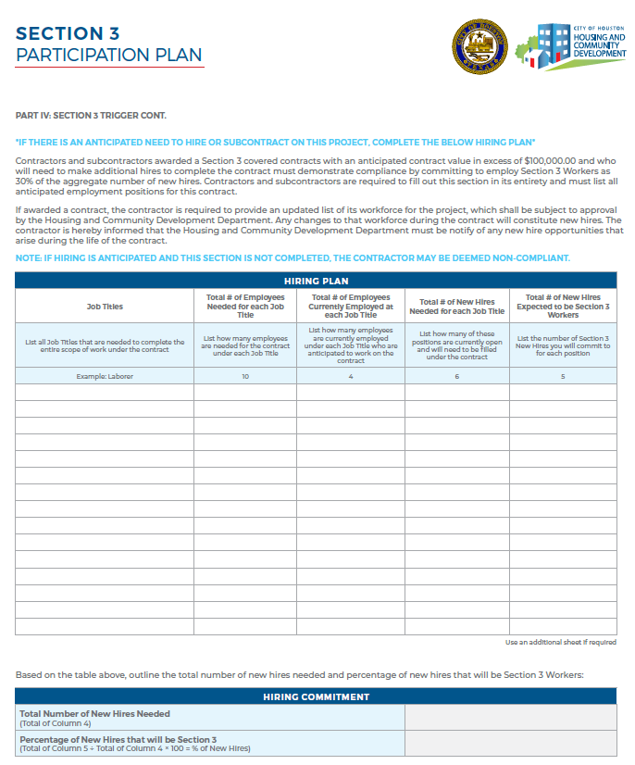
Section 3 Participation Plan
Section 3 Hiring Plan
Section 3 Hiring requirements are triggered by the need for contractors to hire new persons to complete Section 3 covered contract activities.
The General Contractor and all subcontractors are subject to comply with Section 3 requirements and regulations as outlined in 24 CFR part 75 and must commit to:
25% of all project labor hours be performed by Section 3 Workers
5% of all project labor hours be performed by Section 3 Targeted Workers
*If there is an anticipated need hiring or contracting opportunities, complete Part IV.*

Slide 26
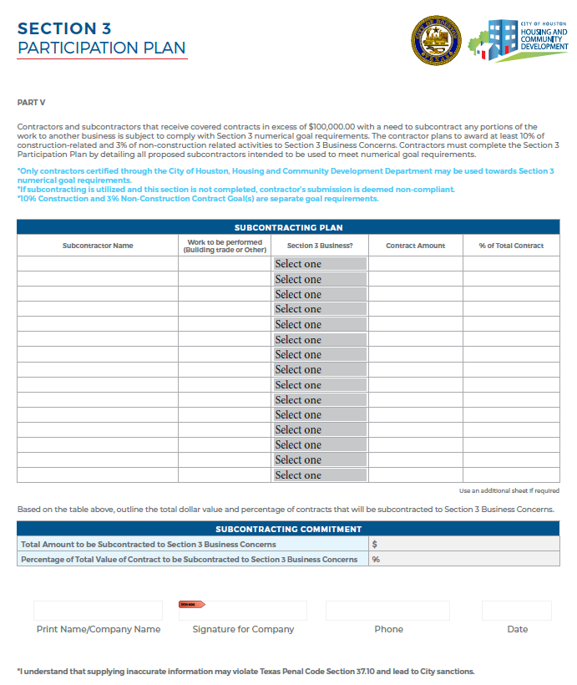
Section 3 Participation Plan
Only contractors certified through the City of Houston, Housing and Community Development Department may be used towards goal requirements.
If subcontracting is utilized and this section is not completed, contractor’s submission is deemed non-compliant.
10% Construction and 3% Soft Cost Goal(s) are separate goal requirements.
Contractor must fully complete the Subcontracting Plan and Commitment Form with Company Name, Signature of Company, Phone and Date.
Section 3 Participation Plan must be accompanied by Signed Letters of Intent.

Slide 27
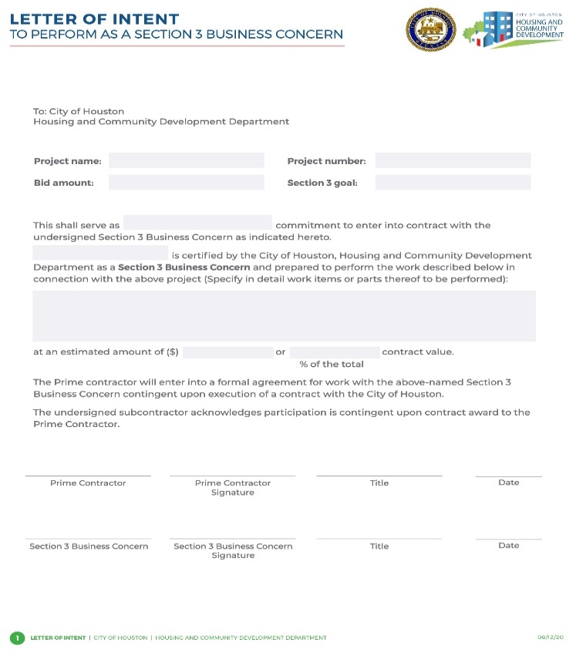
Section 3 Letter of Intent
Section 3 Letter of Intent must be accompanied with the Section 3 Participation Plan.
Section 3 Letter of Intent must be completed entirely.
Bid Amount should be your Total Hard Cost or Soft Cost Amount.
Section 3 goal should reflect 10% hard cost or 3% soft cost goal.
Prime Contractor and Section 3 Business Concern must sign and date LOIs.
If Section 3 Letters of Intent are incomplete, it will be deemed non-responsive
All information must be provided in order to be deemed responsive

Slide 28
Section 3 Participation Plan Assessment
Contractor MUST submit Section 3 Participation Plan along with Signed Letter of Intent for each subcontractor listed towards Section 3 goal achievement.
General Contractor must fill in each box COMPLETELY and SIGN the Section 3 Participation Plan.
Section 3 Letters of Intent must be completed entirely and signed by the General Contractor and subcontractors
All required documents must be provided, and the General Contractor must submit a plan that demonstrates Good Faith Efforts in meeting numerical goal requirements in order to be deemed responsive
If the Section 3 Plan and Letters of Intent are deemed responsive, notification of approval will be sent to the Relations Manager and involved parties recommending proceeding with scheduling of Pre-Construction Meeting and project activities.
If the Prime Contractor failed to demonstrate Good Faith Efforts in meeting minimum Section 3 numerical goal requirements, notification will be sent to all involved parties that the Section 3 Participation Plan was non-responsive and notice to proceed with project activities is NOT recommended until further notice.

Slide 29
Section 3 Participation Plan Assessment
Section 3 Participation Plan(s) that do not demonstrate Good Faith Efforts towards meeting minimum goal requirements will attempt to be cured by Pre-Award Services and the Prime Contractor within 7-10 business days.
After meeting with the General Contractor to cure the Section 3 Participation Plan, the Administration Manager will allow the Prime to resubmit a revised Section 3 Participation Plan within 7 business days.
If a cured revised Section 3 Participation Plan is submitted and approved the Pre-Award Services will recommend proceeding with project activity.
If Section 3 compliance with numerical goals requirements are not demonstrated prior to project activity by the Prime, efforts to achieve compliance must be made throughout the duration of the project.
A final determination of recommendation to proceed is pending certification completion by eligible firms. Should the Prime and/or any subcontractor fail to demonstrate Good Faith Efforts, to the Greatest Extent Feasible to meet program requirements, non-compliance will be included in city program records.
Section 3 Pre-Award required documents must be reviewed and approved prior to scheduling a Pre-Construction Meeting and issuance of a Notice to Proceed.

Slide 30
E-Bid Announcements Requirements
E-Bid Announcement must be sent to the Pre-Award Administration Manager for review and approval at the earliest phase of the project.
Contractors shall submit an E-Bid Announcement that list(s) scope of work, minimum qualifications, contact information and a bid due date (minimum is two weeks).
Pre-Award Services will disseminate to Section 3 Businesses in HCDD Section 3 Directory and to MWSBE firms in the COH Certified Directory.

Slide 31
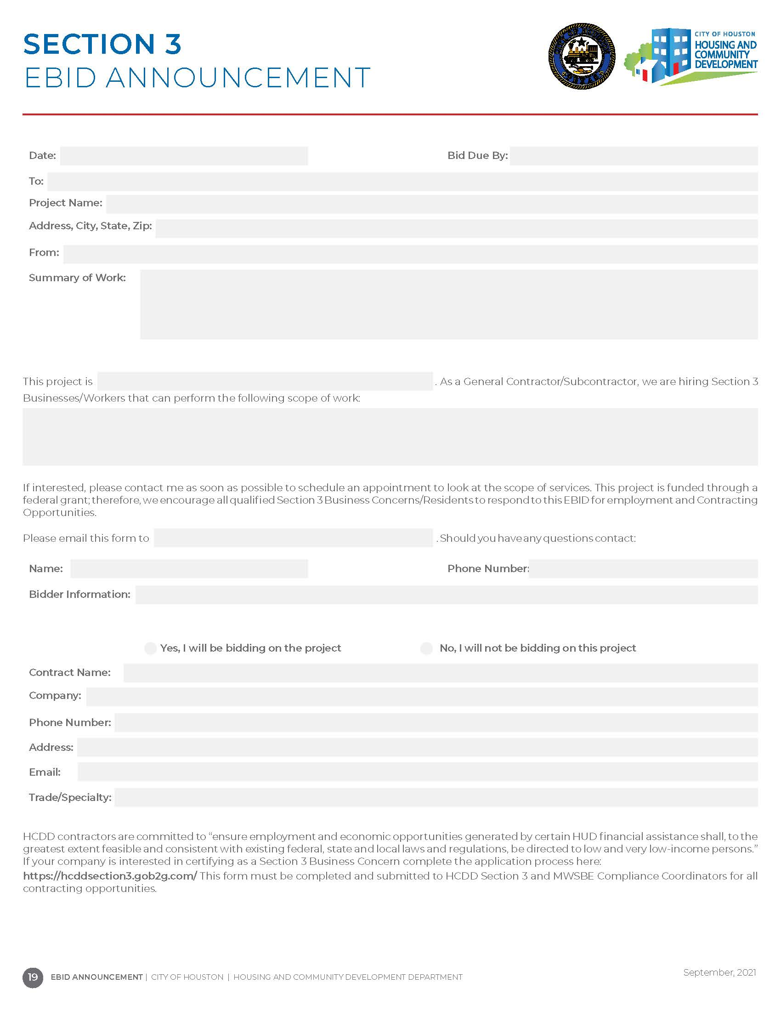
Section 3 E-Bid Announcement

Slide 32
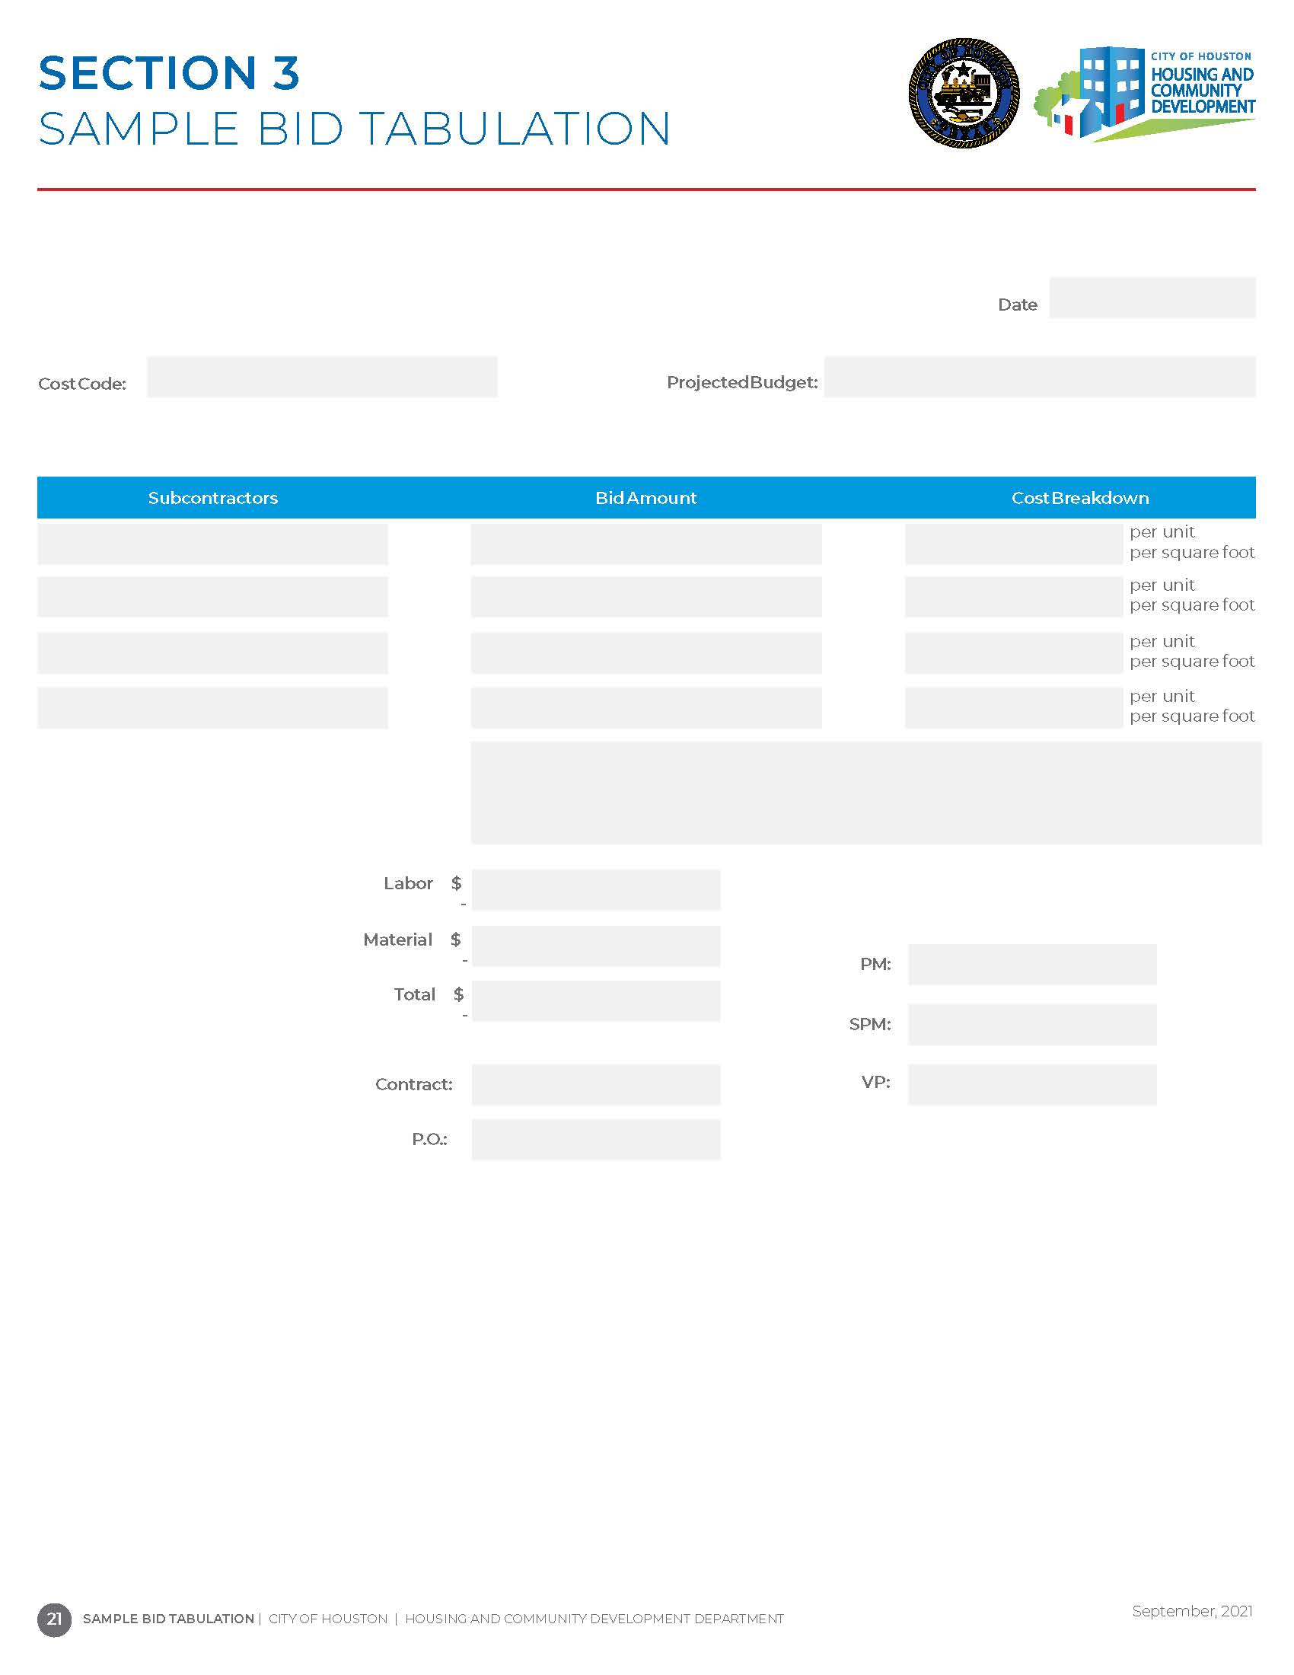
Section 3 Bid Tabulation
At the end of the solicitation period, the Prime/General Contractor must submit a Bid-Tabulation to the Pre-Award Administration Manager after all bids are received.
The Bid-Tabulation must indicate which awarded contracts were to Section 3 Business Concerns, if any, OR indicate that a bid was not received from a Section 3 Business Concern, OR if the successful candidate was not a Section 3 Business Concern, a Letter of Explanation (LOE) must be submitted by the Prime/General Contractor detailing the reason(s) for not selecting the qualified Section 3 Business Concern.

Slide 33
Employment Opportunity Announcement (EOA) Requirements
For any new employment opportunities, an Employment Opportunity Announcement should be directed to Section 3 Worker.
The Employment Opportunity Announcement must be provided to the Pre-Award Administration Manager for review and approval prior to disseminating to the Section 3 Worker Directory.
The Pre-Award Administration Manager should be notified of the results of the successful candidate.
Results should include:
Name of the New Hire;
Section 3 Classification;
Explanation, if opportunity did not result in a selection of a Section 3 Worker.
If the employee is not a Section 3 Worker and is not eligible for certification, a letter of explanation should be submitted to the Pre-Award Administration Manager detailing the reason for not directing opportunities to a Section 3 Worker

Slide 34
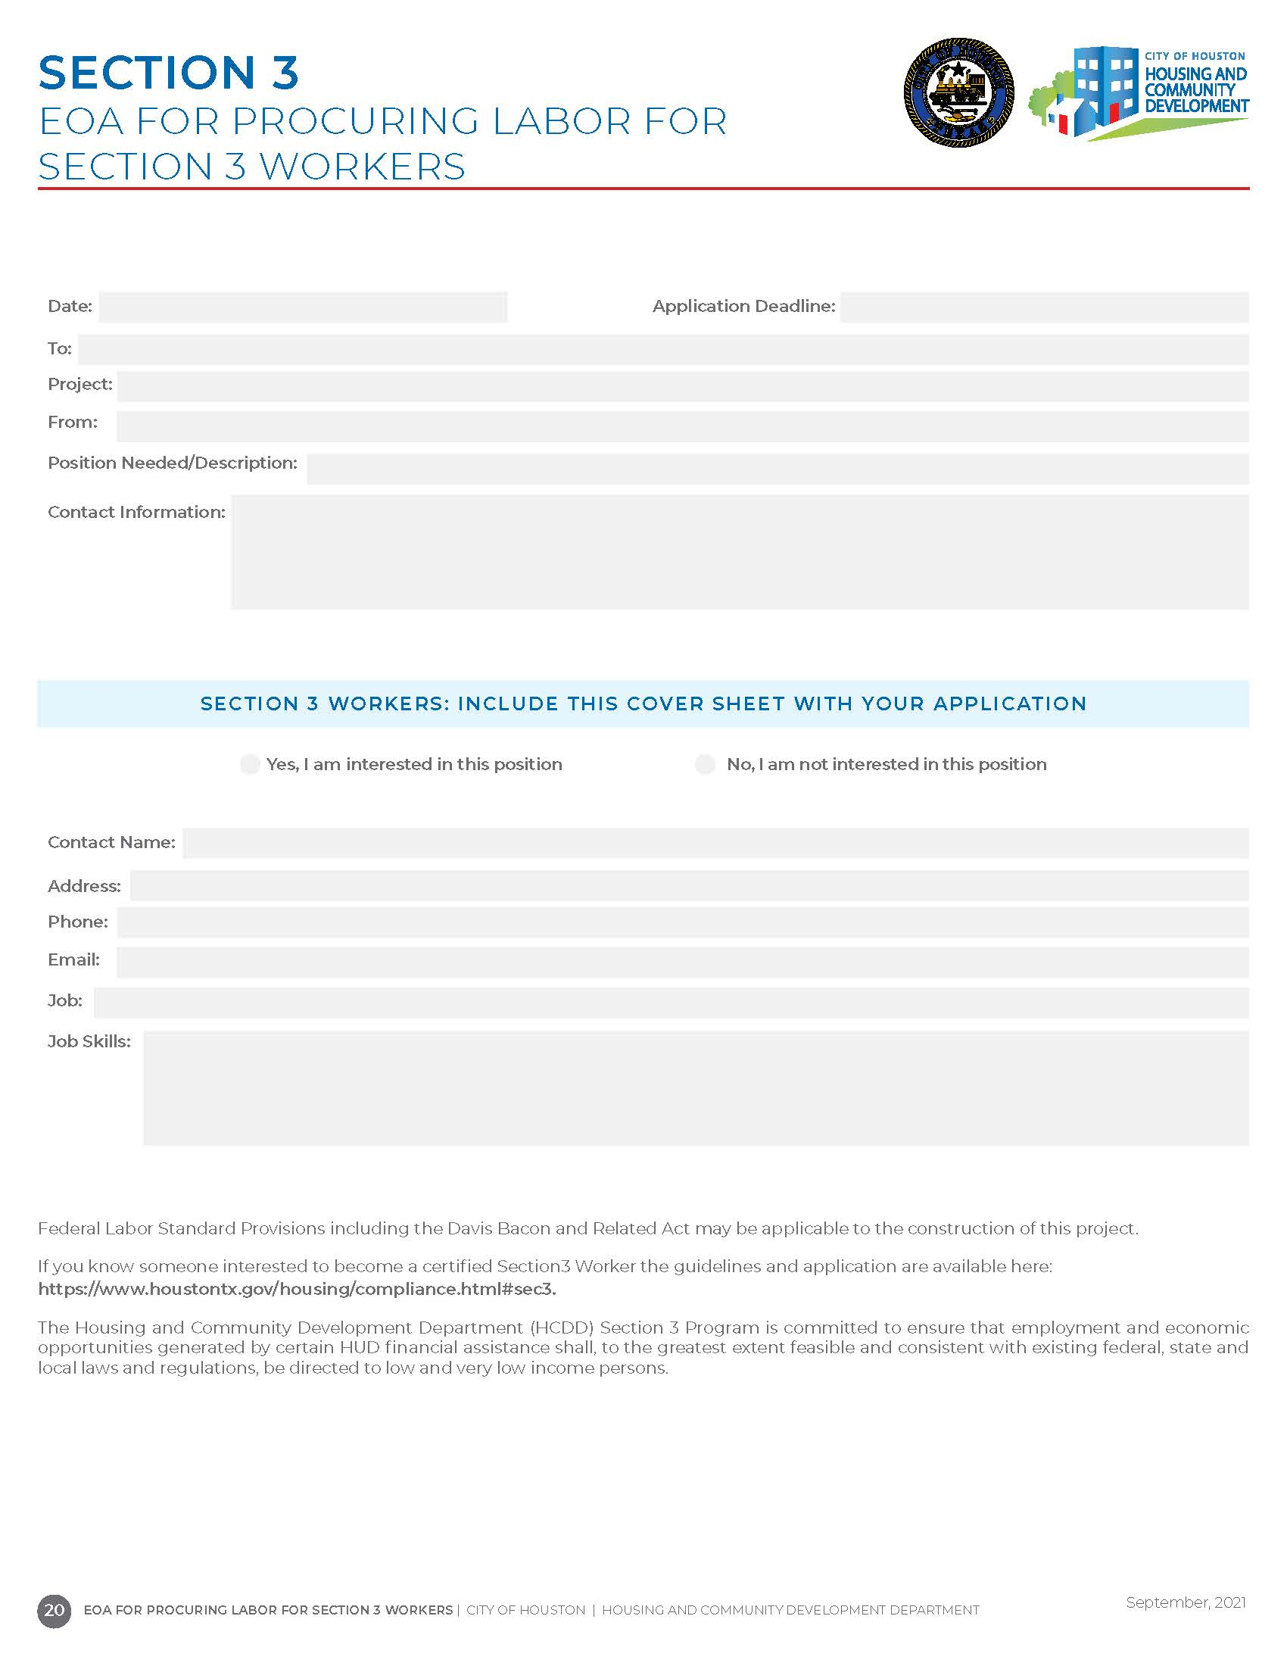
Employment Opportunity Announcement

Slide 35
PAY OR PLAY

Slide 36
Pay or Play
Article VI, Section 7a, of the City Charter of the City of Houston; and City of Houston Code of Ordinance, Chapter 15 Executive Order 1-7
Notes:
The Pay or Play Program (POP Program) creates a more
level playing field and enhances fairness in the bid process between competing contractors
that choose to offer health benefits to their workforce and those who do not. The program also
recognizes and accounts for the fact that there are cost associated with health care of the
uninsured citizens of the Houston and Harris County area. Contracts valued at or above $100,000.00 (contract) and $200,000.00 (sub-contract)
including contingencies, amendments, supplemental terms and/or change orders are require to comply with POP requirements.

Slide 37
Pay or Play Pre-Award Documents
POP-1 Pay or Play Acknowledge Form;
POP-2 Pay or Play Certification of Compliance with Pay or Play Program
POP-3 Pay or Play Program List of Subcontractors
B2GNOW Management System Access Form
*Pay or Play Pre-Award documents must be submitted for reviewal and approval prior to scheduling of Pre-Construction Meeting and Notice to Proceed.

Slide 38
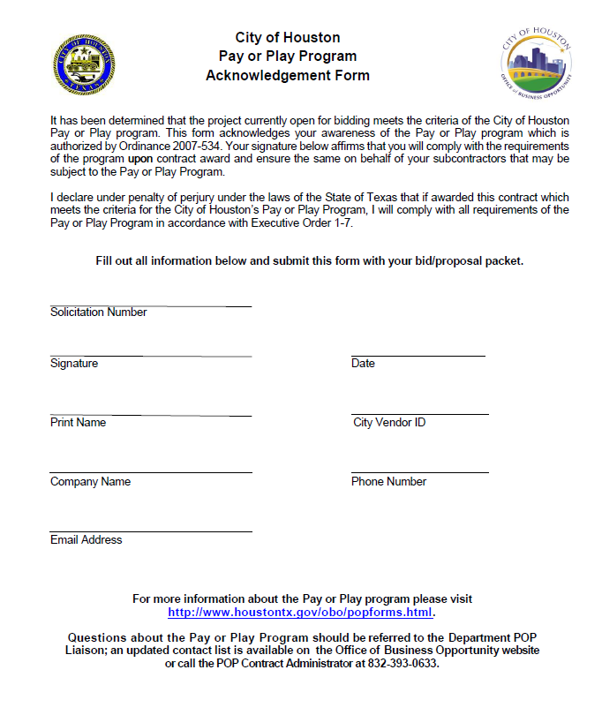
Form POP-1 Pay or Play Acknowledgement
Contractor acknowledges POP Program and agrees to comply if they are the successful contractor.
Contractor must complete and submit with Pre-Award required documents.

Slide 39
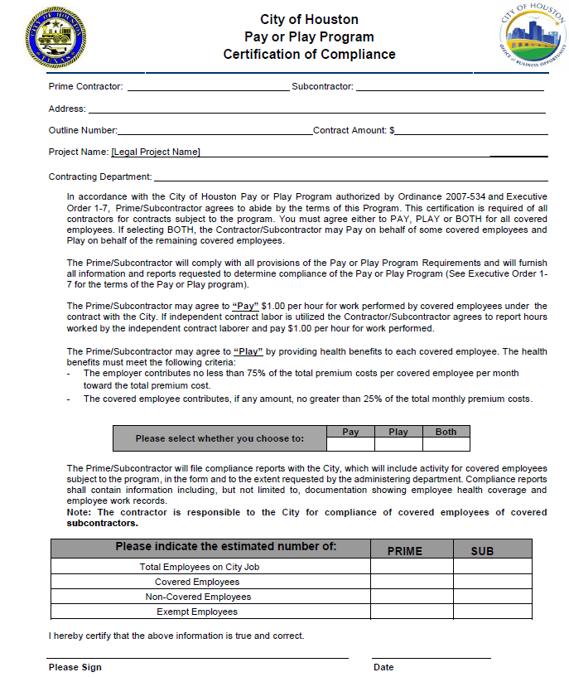
Form POP-2 Certification of Compliance
Contractor chooses how they will participate in the POP Program.
POP-2 must be completed and submitted by the Contractor.

Slide 40
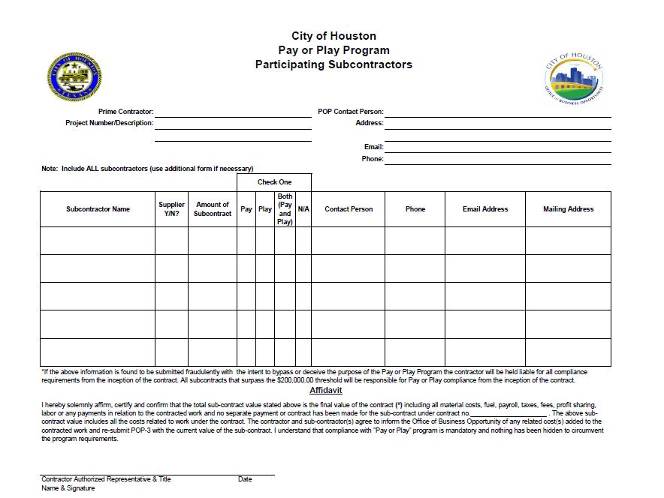
Form POP-3 List of all subcontractors
List of all subs participating on the project.
Filled out and submitted by the Prime Contractor.

Slide 41
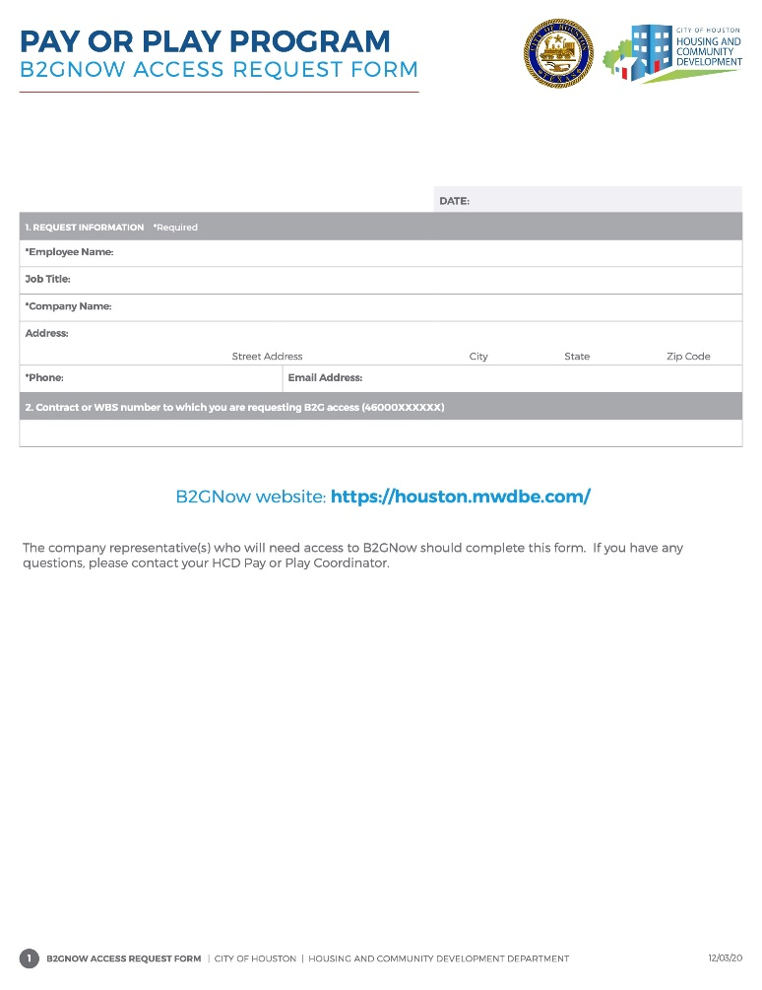
POP Required Form
B2GNOW Access Request Form
Contractor is required to complete the B2GNOW form in its entirety for providing access to the system for POP compliance requirements.

Slide 42
Solicitation Language
Before advertising for a General Contractor or subcontracting, review of solicitation content and attachments must be submitted for review to ensure applicable program requirements are included.

Slide 43
REQUIRED SOLICITATION DOCUMENTS

Slide 44
Solicitation Language
Example Solicitation Language for Prime Contractor:
MWSBE: Contractor shall comply with the City’s Minority and Women Business Enterprise (“MWBE”) programs as set out in Chapter 15, Article V of the City of Houston Code of Ordinances and the applicable Office of Business Opportunity’s (“OBO”) Policies and Procedures. Contractor shall make good faith efforts to award subcontracts or supply agreements in at least ­­­­_____% of the value of this Agreement to MWBEs (“Stated MWBE goal”). If the Contractor is a certified MBE or WBE, Contractor may count toward goals the work that it commits to perform with its own work force, capped at 50% of the total advertised goal. Contractor acknowledges that it has reviewed the requirements for good faith efforts on file with OBO and will comply with them.
Section 3 Program: The work to be performed under this Contract is subject to the requirements of Section 3 of the Housing and Urban Development Act of 1968, as amended (12 USC §1701u) ("Section 3"). The purpose of Section 3 is to ensure that employment and other economic opportunities generated by HUD assistance or HUD-assisted developments covered by Section 3 shall, to the greatest extent feasible, be directed to low- and very low-income persons, including persons who are recipients of HUD assistance for housing, with a preference for both targeted workers living in the service area or neighborhood of the Development and YouthBuild participants, as defined at 24 CFR Part 75 ("Section 3 Regulations").

Slide 45
Solicitation Language
Pay Or Play
Contractors shall comply with the City's Pay or Play Program, as set out in Executive Order No. 1-7, the requirements and terms of which are incorporated into this RFP for all purposes. Contractors have reviewed the requirements of Executive Order No. 1-7 at http://www.houstontx.gov/obo/popforms.html The Contractors should demonstrate that they have the willingness and ability to comply with the City's Contractors' Pay of Play Program.

Slide 46
Updated Contract Requirements in 2 CFR 200.322
Effective April 7, 2022, updated provisions are required to be included in contracts for General Contractors, subcontractors and lower tier contractors. Agreement terms will be expected to reference the provision in the contract and include as an exhibit. Executed agreements dated April 7, 2022 and forward will be reviewed for compliance with this guidance.
DOMESTIC PREFERENCES (2 C.F.R. § 200.322) *NEW*
PROHIBITION OF CERTAIN TELECOMMUNICATION TECHNOLOGY *NEW*

Slide 47
Prime Contract Required Documents
The Prime Contract must reference and include the following documents regarding Local, State, and Federal Compliance Requirements:
Federal Labor Standards Provisions -Minority, Women and Small Business Enterprises, Section 3 Regulations, Pay or Play (updated August 2021)
Contract Compliance Forms -Minority, Women and Small Business Enterprises Section 3 Regulation (updated February 23, 2022)
Document 808: Requirements for the City of Houston Program for Minority, Women, and Small Business Enterprises (MWSBE) (updated January 11, 2022)
City of Houston Good Faith Efforts Policy (updated January 14, 2022)
Workforce Provisions Appendix 15 (applicable only on CDBG-DR17 Multifamily awards)
*A draft copy of all construction contracts must be provided to the Pre-Award Administration Manager for reviewal and approval of required compliance language and documents for applicable programs.

Slide 48
Pre-Award Compliance Red Flags
Signed Letters of Intent are not submitted with Participation Plan;
Failure to have the Section 3 Business or MWSBE firm sign the Letters of Intent;
Listing firms on a Section 3 Participation Plan that do not have an active certification with City of Houston, Housing and Community Development Department;
Listing firms on a MWSBE Participation Plan that do not have an active certification with City of Houston, Office of Business Opportunity;
Contractor substitutes SBE participation of more than 4% of the MBE goal, the WBE goal or portions of the MBE goal and WBE goal;
Contractor failed to demonstrate meeting ALL Section 3 numerical goal requirements;
Listing MWSBEs and Section 3 Business Concerns for goal credit without notification;
Failure to submit Pre-Award required documents for review and approval in timely manner.

Slide 49
FAQS

Slide 50
FAQS
When are Pre-Award Documents required to be submitted?
Before a pre-construction meeting and/or issuance of a Notice to Proceed is recommended, Pre-Award documents must be approved.
Who do we submit the Pre-Award Documents to?
Pre-Award submissions should be sent via email to Administration Manager, Lakesha Tates at Lakesha.Tates@houstontx.gov
What are the next steps following submission of Pre-Award documents?
The Administration Manager will review documents for completion and compliance before recommendation to proceed based on the responsiveness of required documents.
If the MWSBE Participation Plan is deemed non-responsive what is the next step?
Your MWSBE Participation Plan will be forwarded along with documents 471, 472 and all other supporting documents to the Office of Business Opportunity to review and cure your plan within 7 – 14 business days. Communication regarding a non-responsive MWSBE Participation Plan will be between an Office of Business Opportunity and the Prime Contractor. The Office of Business Opportunity will notify the Administration Manager and Prime Contractor of the Good Faith Efforts Determination and recommendations.
If the Section 3 Participation Plan is deemed non-responsive what is the next step?
Good Faith Efforts documentation will be reviewed and evaluated by the Administration Manager. A meeting will be scheduled with all parties in effort to cure the Section 3 Plan within 7-14 business days.

Slide 51
FAQS
What are the City Wide Aspirational MWSBE goal requirements?
Construction related contracts are advertised with a 34% MWBE goal (MBE 23%, WBE 11%) with SBE substitution not to exceed 4% (Construction only). Only firms certified through the City of Houston, Office of Business Opportunity can be counted towards participation goals. For more information on City of Houston certified firms, visit https://houston.mwdbe.com/.
What are the approved HCDD categorical goals on construction related projects? Multifamily Projects with an 38% MWBE Total Goal = 30% MBE and 8% WBE. Public Facilities with an 35% MWBE Total Goal = 26% MBE and 9% WBE and Single-Family with a 29% MWBE Total Goal = 29% MBE and 8%.
What are the Section 3 numerical goal requirements?
10% of the “Hard Cost” Construction budget and 3% of the “Soft Cost” budget for non-construction related activities should be directed to Section 3 Business Concerns and 25% Section 3 Worker Benchmark-25% or more of the total labor hours worked should be performed by Section 3 Workers, with at least 5% being performed by Targeted Section 3 Workers
To receive credit towards Section 3 numerical goal requirements, businesses, and workers must be certified through the Housing and Community Development Dept (HCDD). For access to HCDD Section 3 Business Concern and Worker Directories, visit:
Business: https://hcddsection3.gob2g.com Workers: https://houstontx.gov/housing/section3.html
We also encourage self-certification through HUD Section 3 Business Registry, however; certification through HUD Business registry is not acceptable to meet numerical goals on HCDD awarded contracts.

Slide 52
FAQS
How are Pre-Award Good Faith Efforts Evaluated?
Evaluation is based on a case-by-case basis to determine if the contractor complied with the City of Houston, Good Faith Efforts policy. https://www.houstontx.gov/obo/docsandforms/goodfaithefforts
Can dual credit be received if a contractor is Section 3/MWSBE certified?
Yes, if a contractor is certified as a MWSBE firm through the Office of Business Opportunity and meet Section 3 certification requirements, dual credit can be received.
When should the EBID and Employment Opportunity Announcement (EOA) Announcement be disseminated?
“New” Contracting and Employment opportunities should be sent to the Administration Manager for dissemination in the form of EBID and EOA’s to Section 3 Businesses and Workers. Bids should be solicitated from all businesses including (Section 3 and MWSBE firms).

Slide 53
Comments & Questions

