Slide 1
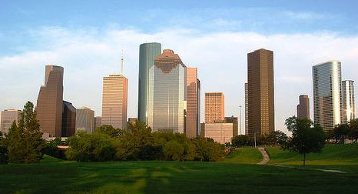
DEPARTMENT OF NEIGHBORHOODS
Departmental Update
FEBRUARY 2018
Regulation & Neighborhood Affairs (RNA) committee
Council Member Robert Gallegos, Chair

Slide 2
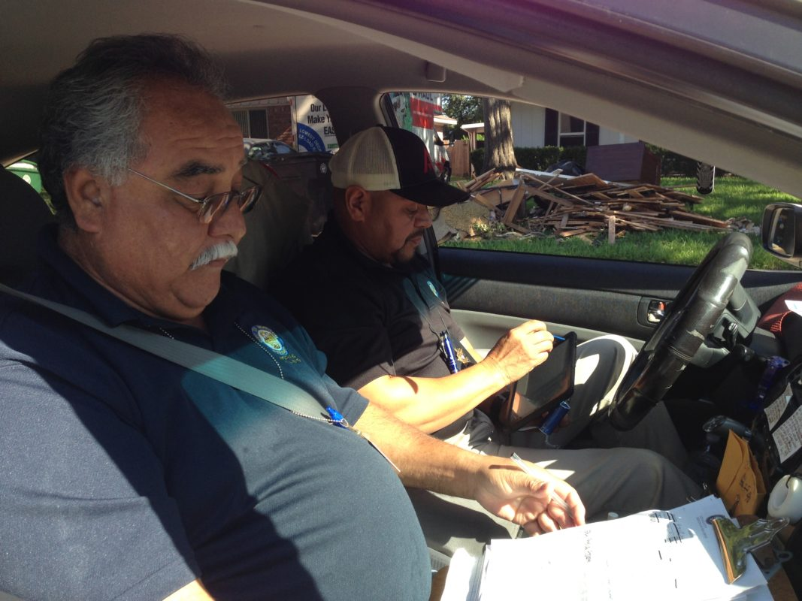
HURRICANE HARVEY
RESPONSE & RECOVERY TIMELINE
On August 29, 2017, Department of Neighborhoods’ executive management convened with key staff from the Houston Office of Emergency Management to coordinate the dispatch of Department of Neighborhoods (DON) inspectors.
DON inspectors began damage assessments Thursday August 31, 2017. All damage assessments were conducted via third party software ActsofT.
Inspectors surveyed debris pick up city wide to alert the Mayor’s Office of existing areas needing debris pickup.
Total Windshield Assessments Conducted between 8/31/17 – 9/19/17: 26,452
Photo Credit: www.houstonpublicmedia.org

Slide 3
HURRICANE HARVEY
DAMAGE ASSESSMENTS BY CATEGORY
FEMA Categories of Damage:
Affected: Some shingle damage, cosmetic, damage to an attached structure (ex. porch), repairable
Minor: Non-structural damage to walls, non-structural damage to roof, less than 18 inches of water in essential living space, repairable
Major: Failure or partial failure of roof, walls, foundation; 18 inches of water in essential living space, or above electrical outlets; repairable
Destroyed: Total loss, complete failure of structure, not repairable

Slide 4
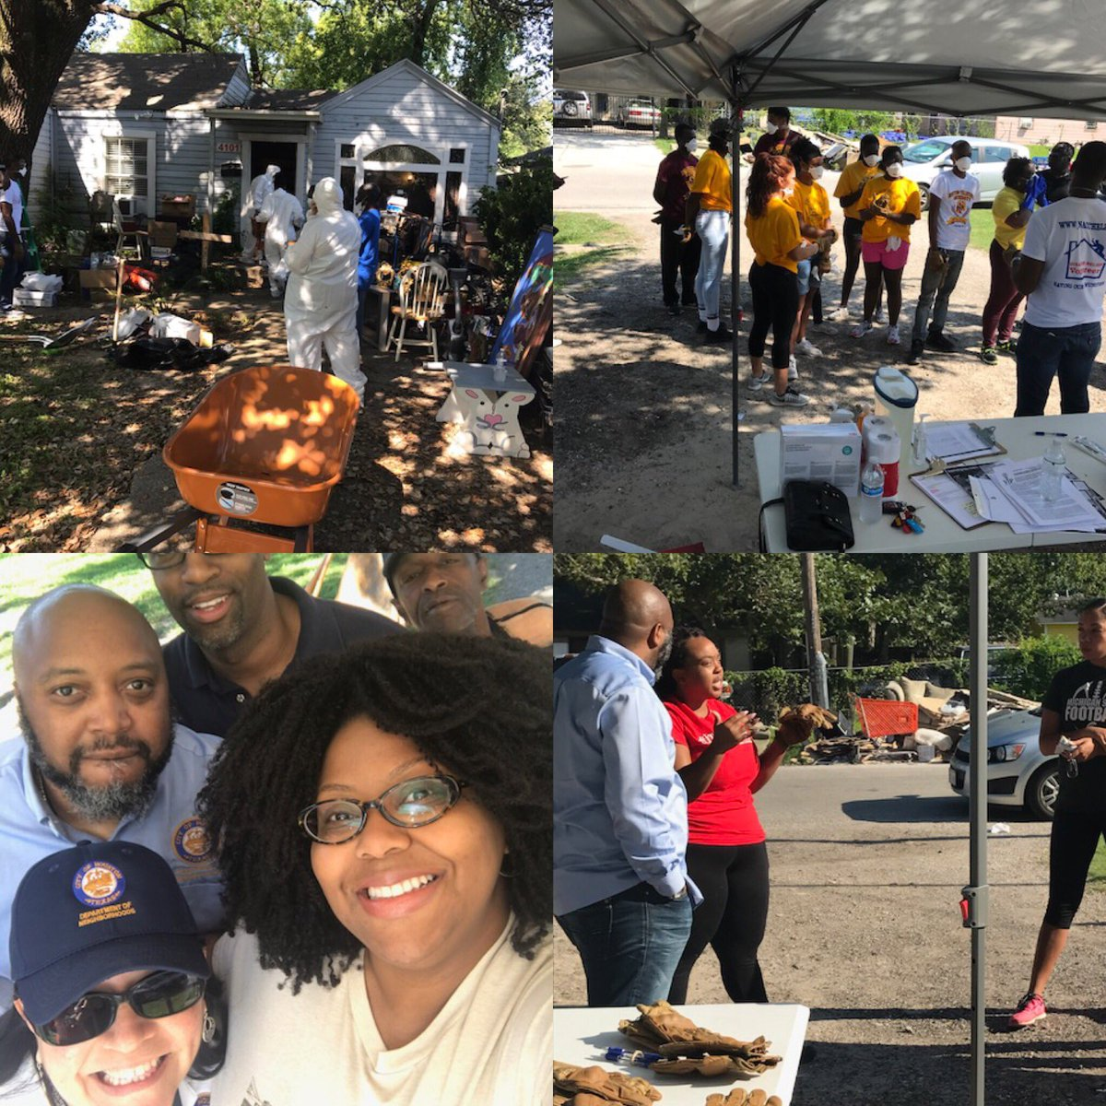
HURRICANE HARVEY
RESPONSE & RECOVERY TIMELINE
Beginning August 31, 2017, the Citizen’s Assistance Office as well as the Director’s Office assisted with the coordination of resource disbursement at the George R. Brown Center and the Toyota Center. CAO also canvassed areas in Harvey’s aftermath to determine the needs and connect with citizens with Harvey related concerns.
DON also assisted in the management of volunteer coordination through the Mayor’s Anti-Gang Office (MAGO). Each Saturday in the month of September 2017, MAGO assisted First Daughter, Ashley Turner, in her ”Millennial Muck Outs”, a volunteer event to muck and gut families homes that were affected by Hurricane Harvey.
The Office of New Americans and Immigrant Communities assisted OEM (Office of Emergency Management) in translating critical information needed for non-English speaking communities.
Photo Credit: HoustonNeighborhoods (Twitter)

Slide 5
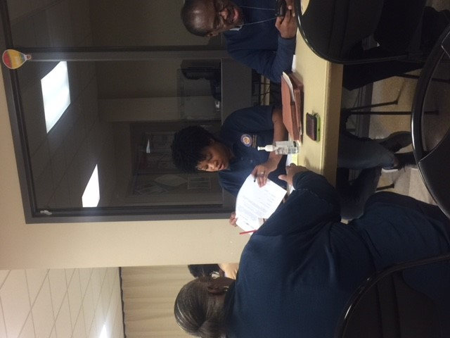
HURRICANE HARVEY
NEIGHBORHOOD RECOVERY CENTERS
CITY OF HOUSTON LOCATIONS:
Acres Homes Multi-Service Center
Northeast Multi-Service Center
West End Multi-Service Center
Kashmere Multi-Service Center
BAKERRIPLEY LOCATIONS:
East Aldine
Edgebrook
Greenspoint
Gulfton
HarbachRipley (SE- Golfcrest/Bellfort/Reveille/Greater Hobby)
Pasadena
MEMORIAL ASSISTANCE MINISTRIES
Spring Branch Community Health Center
Photo: Kashmere Multi-Service Center

Slide 6
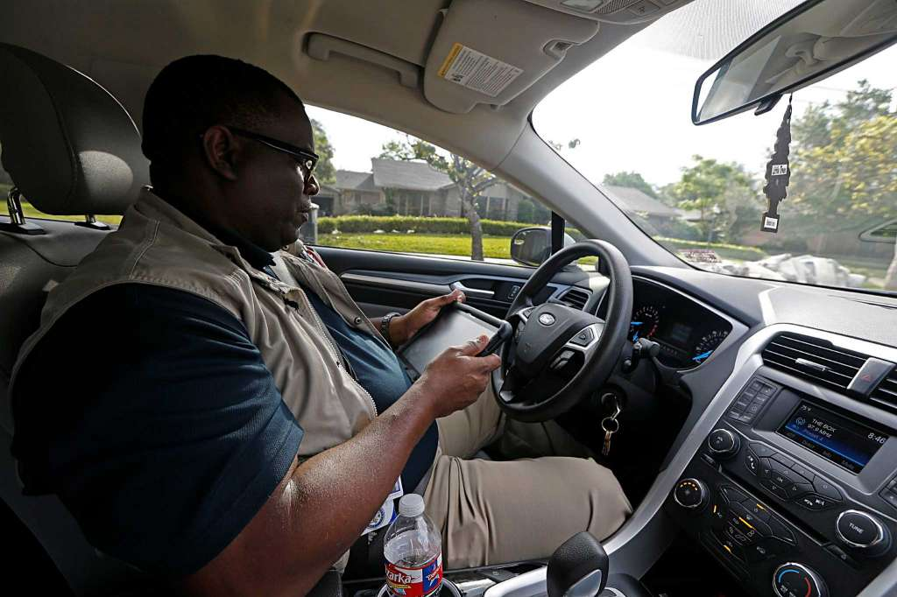
Inspections & Public Service
INFOR UPDATE
Photo Credit: http://www.houstonchronicle.com

Slide 7
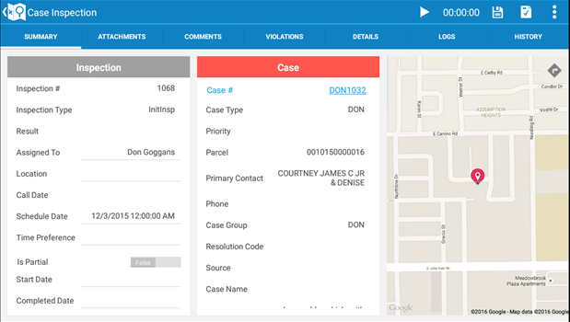
TECHNOLOGY
INFOR PHASE 2:
DON – Infor Phase 2 Application Enhancements:
Address the 13 enhancements to the existing IPS back office and mobile implementation as outlined in the SOW. The objective is to enhance the current functionality and address the areas of inefficiency
Accomplishments and Status Update:
GIS parcel update process and update completed
  Final testing/issue resolution in progress
Completed second detailed review of design document
  Pending final sign off
No major issues have been reported

Slide 8

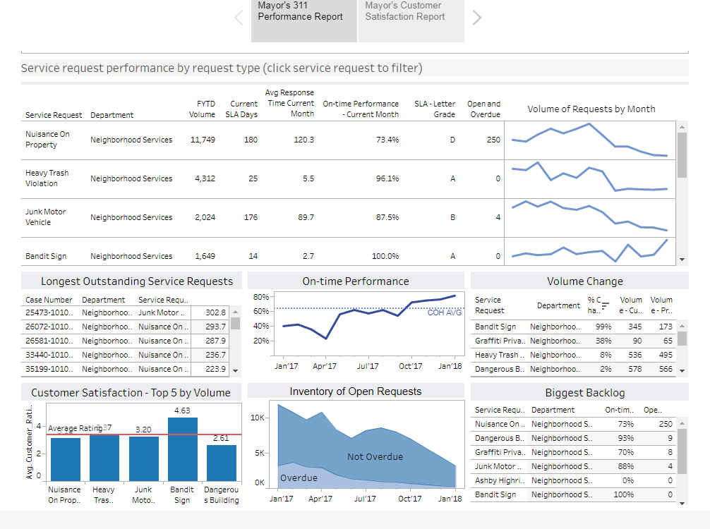



Performance Measures

Slide 9
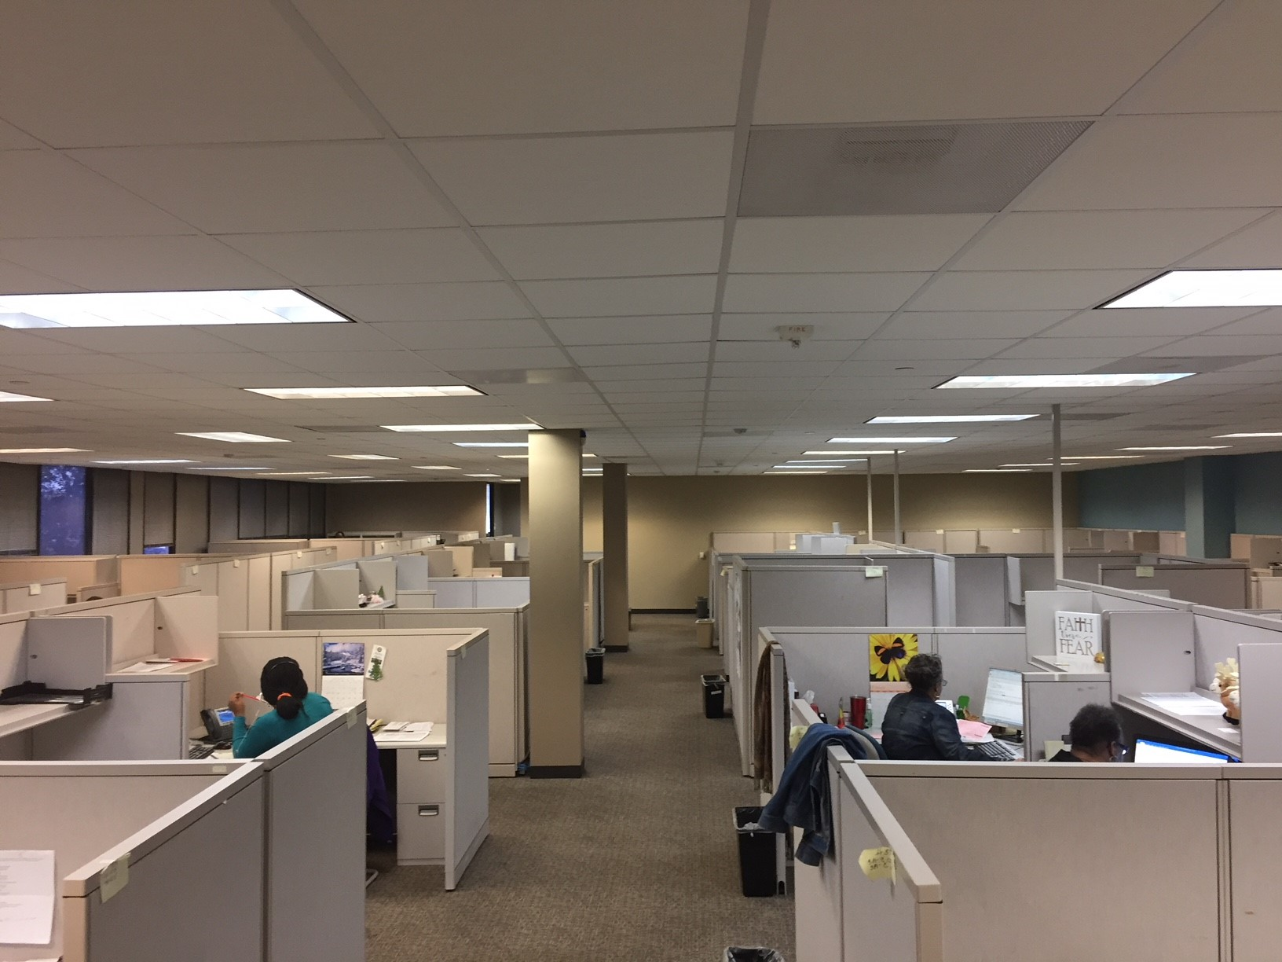
Inspections & Public Service
Call Center
7125 Ardmore

Slide 10

MISSION OF NEW CALL CENTER
To increase customer satisfaction
Improve perception of the citizens within the City of Houston
Bring violations in to compliance more promptly
Maximize tax payer dollars

Slide 11

Hours of Operation
Monday through Friday 8 a.m. to 6 p.m.
Saturday and Sunday
8 a.m. to 12 p.m.

Slide 12
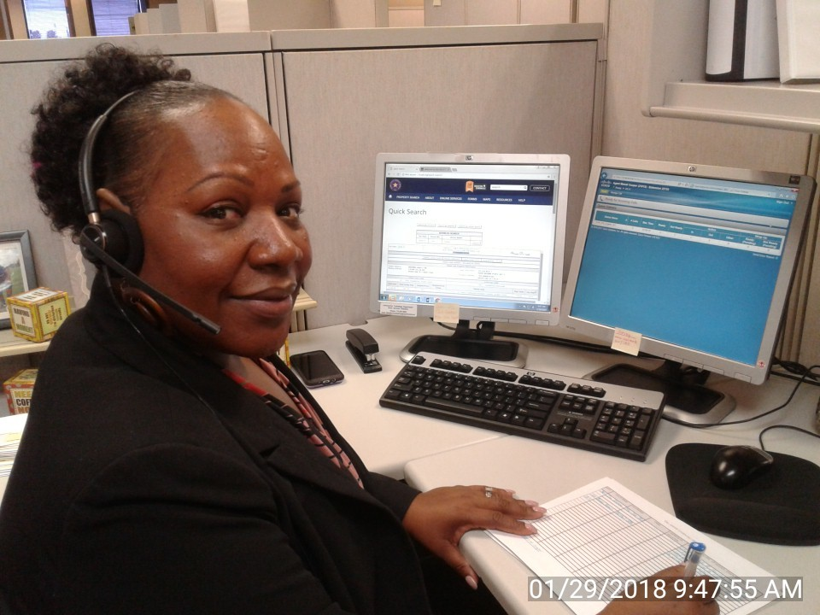
The Call Center Staff
The Call Center is made up of thirteen Customer Service Representatives, two of these employees are bilingual.
Employees are fully trained in the inspection application, INFOR, Chapter 10 Code of Ordinances and CISCO phone systems.

Slide 13
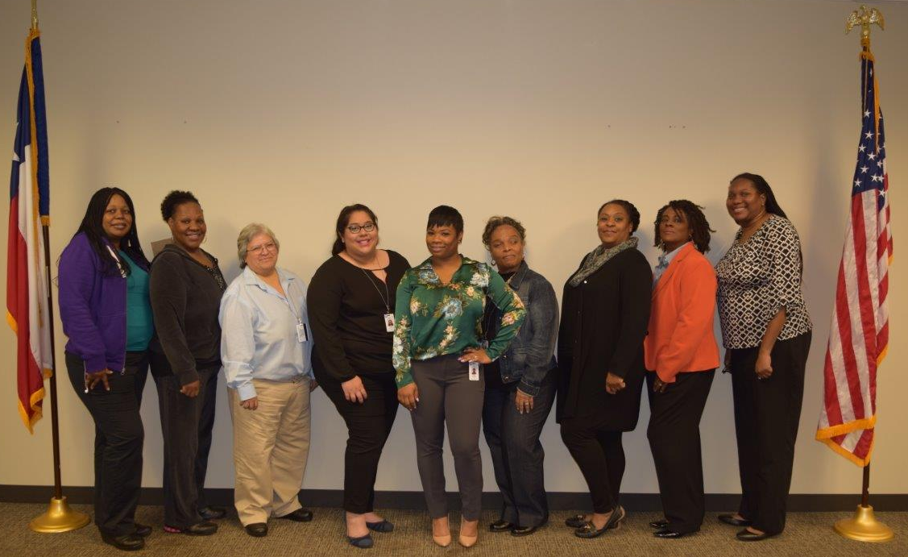
CALL CENTER TEAM MEMBERS

Slide 14
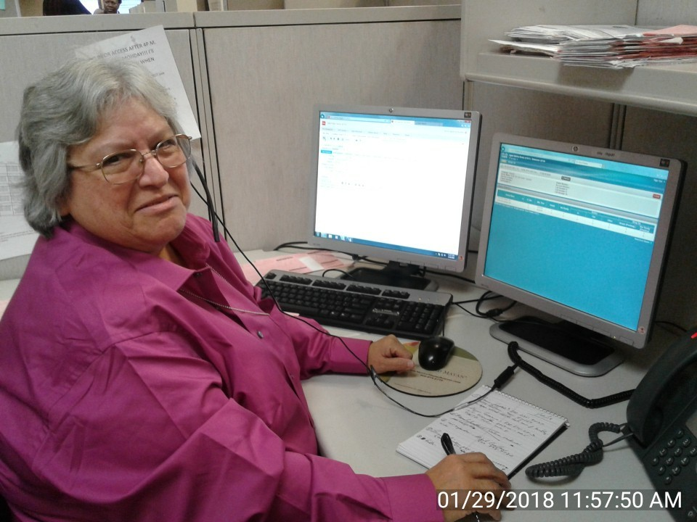
Incoming calls for Hearing Department
Call center will assess specifics of callers needs to properly direct their call to the correct area.
Hearings
Liens
Open Records & Document Release
Extensions

Slide 15

Fielding incoming calls
Incoming calls for all other concerns are assessed by our Call Center staff for personal assistance
Explanation of violation notice is given to citizen with information from INFOR system.
Explanation of procedures to complainants about abatement process.
Explanation to citizen about procedures on issued citations.
Create new service requests, if necessary.
Help inspectors when they need assistance in the field.

Slide 16


Owner and Tenant Communication
Owner and tenant compliance calls
Violations that have not been complied, the Call Center will attempt to make contact with the owner or tenant of the property.
They will notate case files of any contact that is made to help inspectors get citizen compliance.

Slide 17

Customer Satisfaction Calls
311 Survey
Citizens that called 311,completed survey at the end the call and scored their experience as a 3 or less, will receive a follow up phone call from the Call Center.
The Call Center will assess any further action that needs to be taken to address their concerns.

Slide 18
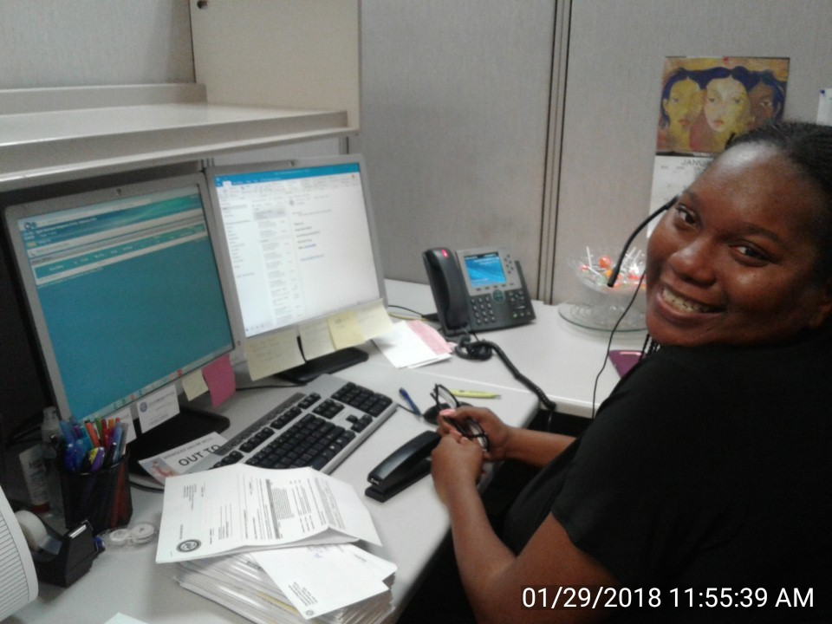
Additional Duties of Call Center
Notate case files of return to sender or undeliverable mail.
Creating citation packets for inspectors based on subpoenas.
Handling front desk operations of Inspections of Public Services office.
Handling all the mail services for the Department of Inspections and Public Service, which includes delivery of inspectors packets.

Slide 19
Responsibilities of the Call Center

Slide 20
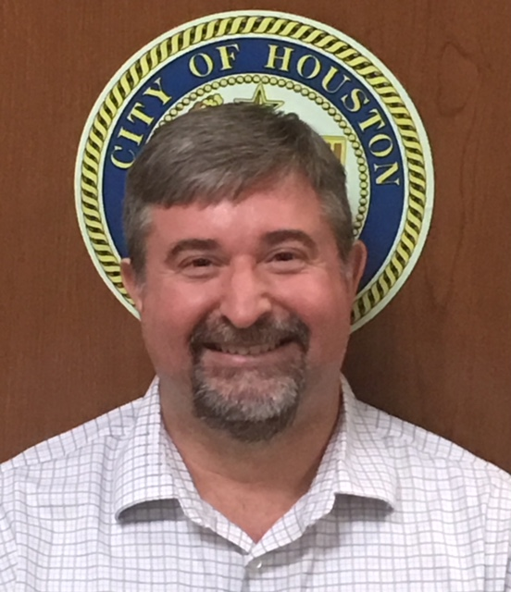
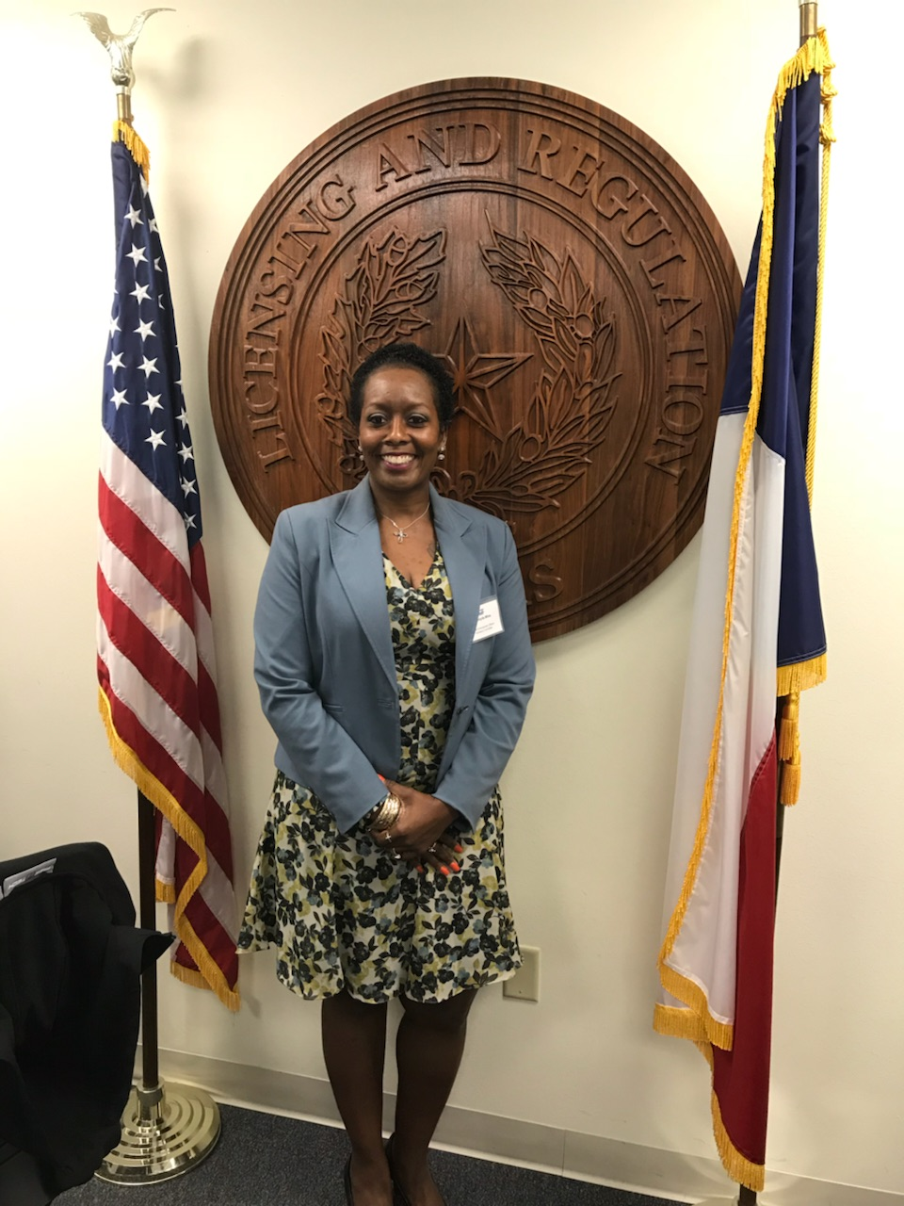
New Division Managers
Shohn Davison – Inspections
Christylla Miles – Back Office & Training

Slide 21
Council Liaisons - Updated
Mr. Alvin Byrd (Cell) 281-914-1950 (Office) 832-393-0887 | Mrs. Mayra Hypolite (Cell) 713-408-0538 (Office) 832-394-0701 | Mr. Rashad Cave (Cell) 832-723-2202 (Office) 832-393-0970
CM Stardig- District A | CM Boykins- District D | Mayor Pro Tem Cohen-District C
V. Mayor Pro Tem Davis District B | CM Gallegos- District I | CM Travis- District G
CM-Martin District E | CM- Cisneros District H | CM Edwards-At Large
CM Le- District F | CM Laster- District J | CM Christie-At Large
CM Knox- At Large | CM Kubosh- At Large | CM Green District K
CM Robinson-At Large

Slide 22


