Slide 1


SIDEWALK PROGRAMS
DEPARTMENT OF PUBLIC WORKS & ENGINEERING
CAROL ELLINGER HADDOCK, P.E., ACTING DIRECTOR
JULY 2017

Slide 2
SIDEWALKS
NEW + REBUILT
            Pedestrian Accessibility Review (PAR)
        Safe School
        Major Thoroughfare
        Privately Funded

Slide 3
City Funded
(historic sidewalk programs)

Slide 4
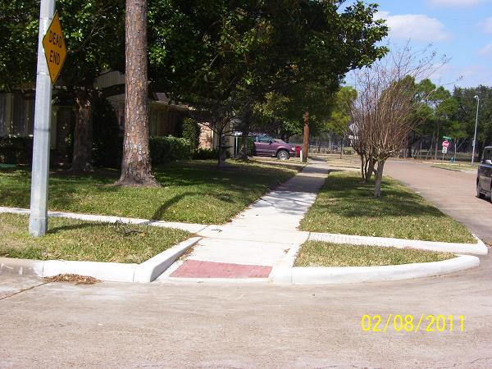
Pedestrian
Accessibility Review
Mayor’s Office
Public Works
One-Year Timeframe
Safe Paths to:
      Bus
      Job / School
      Doctor
      Bank / Shopping

Slide 5
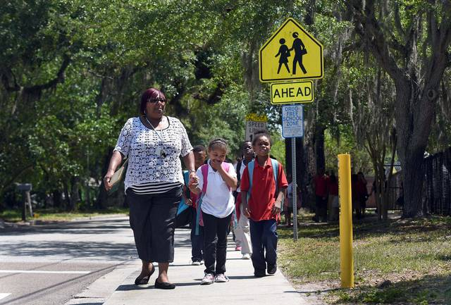
Safe Routes to Schools
Within Four Blocks of School
3 - 4 Year Wait
Safe Paths to:
      Elementary Schools
      Middle Schools
      High Schools
      Charter Schools

Slide 6
Major Thoroghfares (without Sidewalks)
New Sidewalks
5 Blocks Max
NOT in CIP for Reconstruction
5 Year Wait
Safe Paths to:
      Bus
      High Travel Area
      Shopping

Slide 7
Challenges
FUNDING
CITY
ORDINANCE
PHYSICAL
LIMITATIONS
  requests > funding
  only for NEW sidewalks*
  (not existing broken ones)
  * Except for PAR
  mature trees, ditches, utility poles, narrow rights-of-way
  (in oldest areas of town)

Slide 8
Opportunities
REPLACE
BROKEN
SIDEWALKS
CURBS, GUTTERS AND CULVERTS
  May require Ordinance change
  Include in New Construction Contracts

Slide 9
Privately Funded
(recently created program)

Slide 10
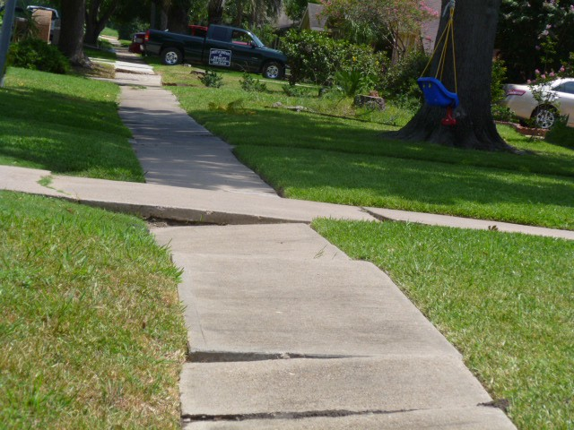
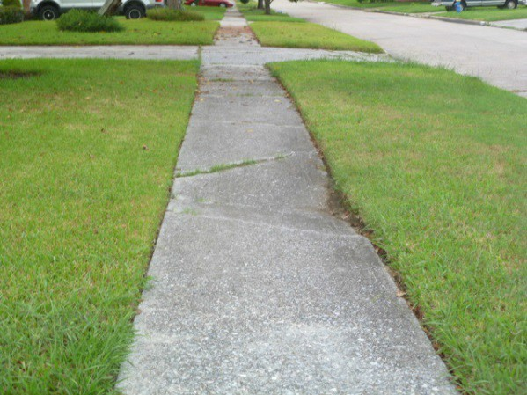
Privately Funded Sidewalks
Public Right-of-Way
Property Owner
      Responsible for Cost
      Provided Cost Estimate
      Right to Inspect
City
      Selects Contractors
      Competitive Bidding
      Manages Construction

Slide 11
Process
owner applies
Public Works prepares cost estimate
owner
approves & pays
sidewalk
constructed
(1 year warranty)

Slide 12
155
105
2
Applications
Cost Estimates Provided
Approved & Constructed

Slide 13
$5000
AVERAGE COST ESTIMATE

Slide 14
Challenges
COST TO
OWNER
CONTRACTORS
COST TO
CITY
  2-3 times higher
  these are small projects
  no funding recovered after cost estimate

Slide 15
Next Steps
CITY FUNDED
SIDEWALKS
PRIVATELY
FUNDED
SIDEWALKS
  look for grants + matching funds
  discontinue program

Slide 16
THANK YOU
Questions?

