Slide 1
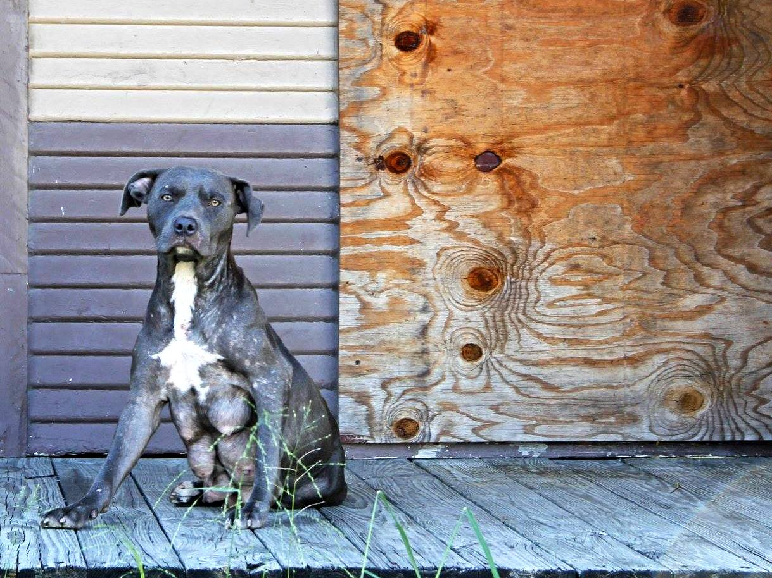

Unity for a Solution:
An animal welfare collaboration

Slide 2
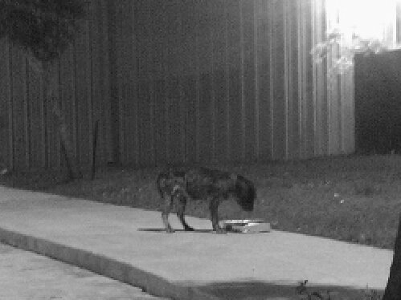
Houston has an animal welfare crisis
BARC - over a million homeless animals on Houston’s streets
UT School of Public Health - over 50% of residents consider stray animals a major neighborhood concern in East Houston-Settegast, Near Northside-Fifth Ward, Third Ward, East End, Gulfgate and Sunnyside
The problem is worsened by the lack of vetting and/or spay neuter resources in communities with the most homeless or stray animals
Historically, the city of Houston has provided less funding for animal welfare than any other metropolitan area in Texas

Slide 3
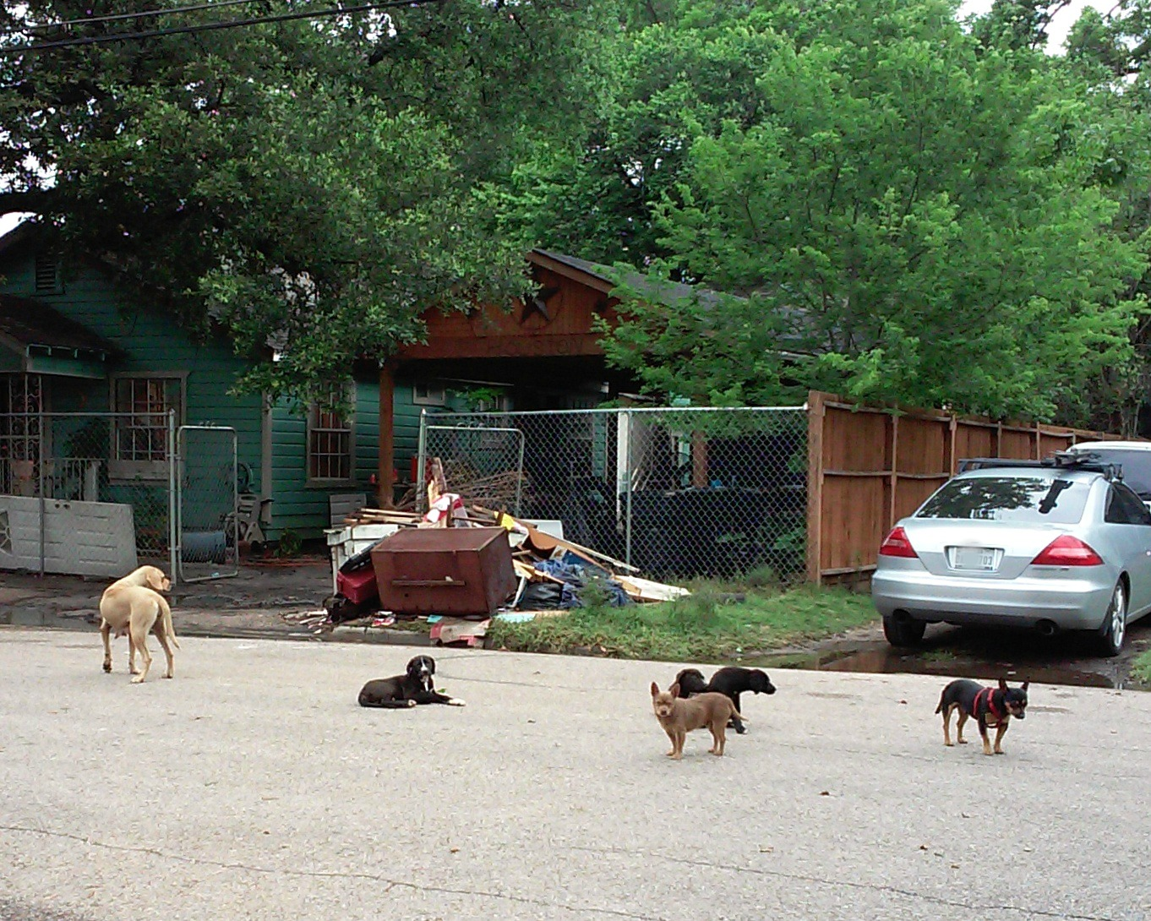
Unity for a Solution was formed in 2013 to address the crisis by raising awareness and increasing free and low cost spay neuter options for pets, especially in low income areas.
We are a collaboration of animal welfare groups, businesses and civic associations and currently have over 50 partners.

Slide 4





Unity’s steering committee is composed of representatives from several of the member organizations

Slide 5
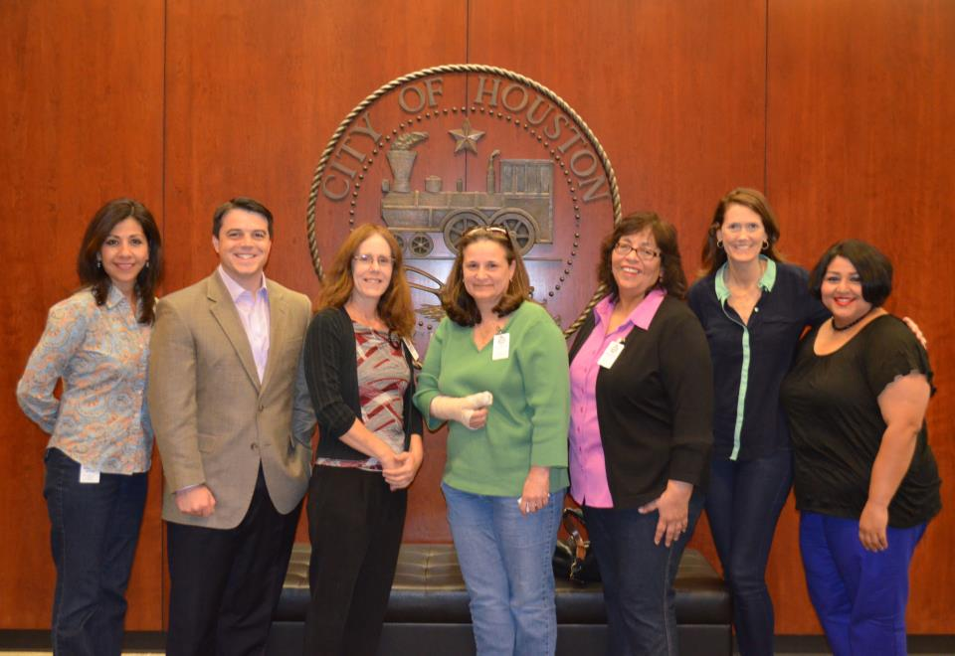
We work with our elected officials and their staffs to bring more attention to the problem and get more city resources to address it.

Slide 6
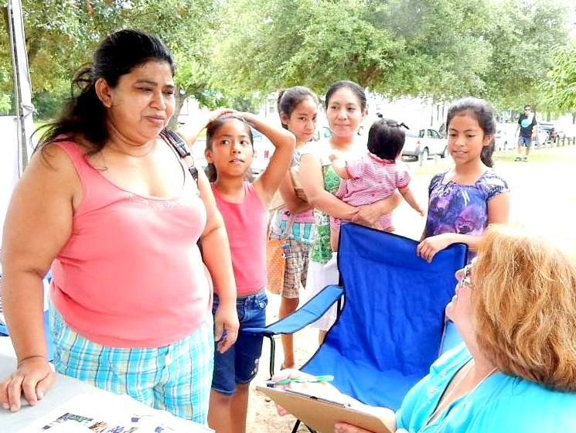
Our community outreach focuses on areas with the most need. We talk to residents and sign up their pets for free spay, neuter and vaccinations. To date, we have fixed and vetted over 1,000 animals.

Slide 7
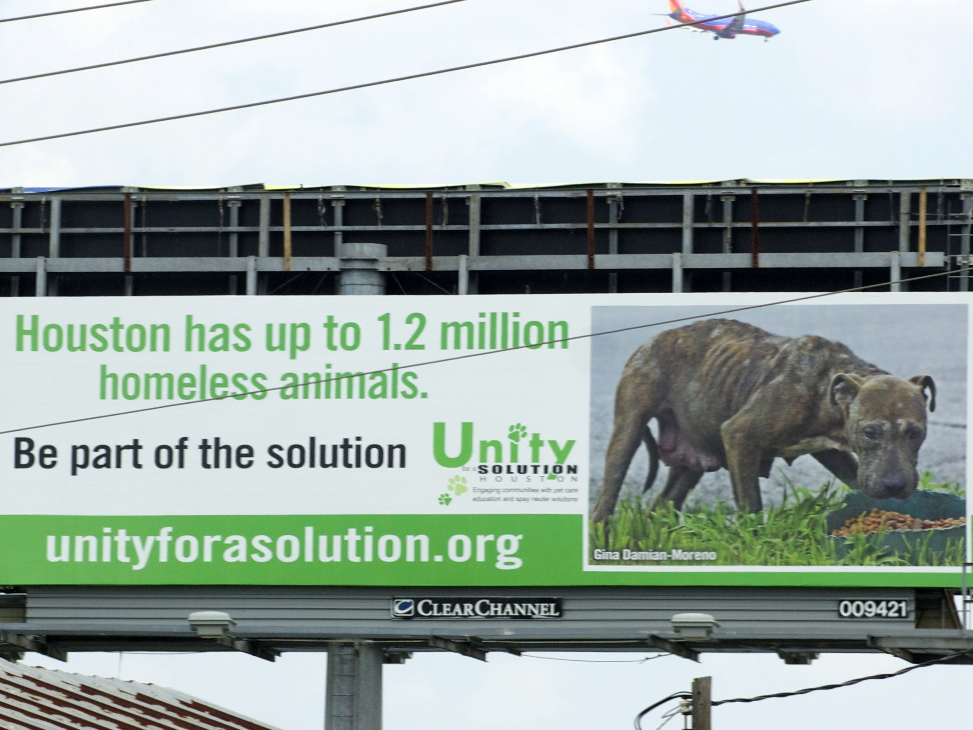
Our awareness efforts include informing the general public about Houston’s animal overpopulation crisis. Many residents are still unaware of the problem.

Slide 8
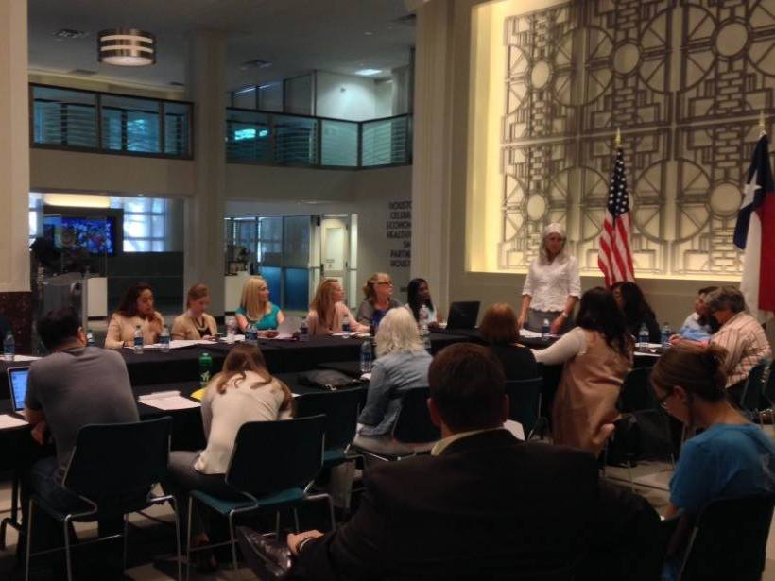
Our biggest project to date is Big Fix Houston. Last fall, CM Karla Cisneros brought us together to work on a large scale spay, neuter and education campaign for February 2017. Participants include Unity, BARC, Emancipet, Houston Humane Society, Texas Litter Control and several private vet clinics.

Slide 9
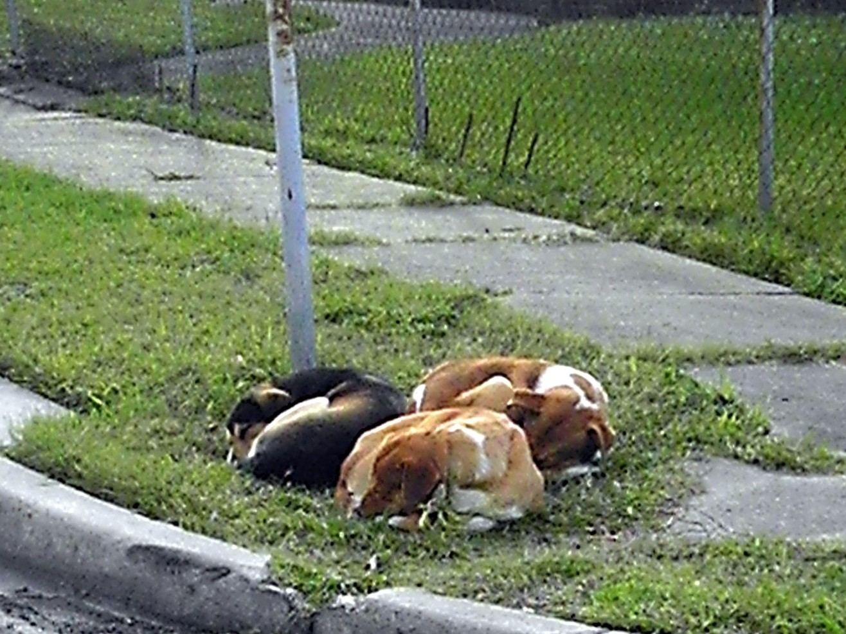
We’re hoping to provide free spay, neuter and vaccinations to pets in areas with the most complaints about stray and homeless animals and/or the fewest spay neuter options
Our focus includes the Third Ward, Fifth Ward, Near Northside, Near Hobby, Sunnyside, South Park, East End, Denver Harbor, Acres Homes and Independence Heights

Slide 10
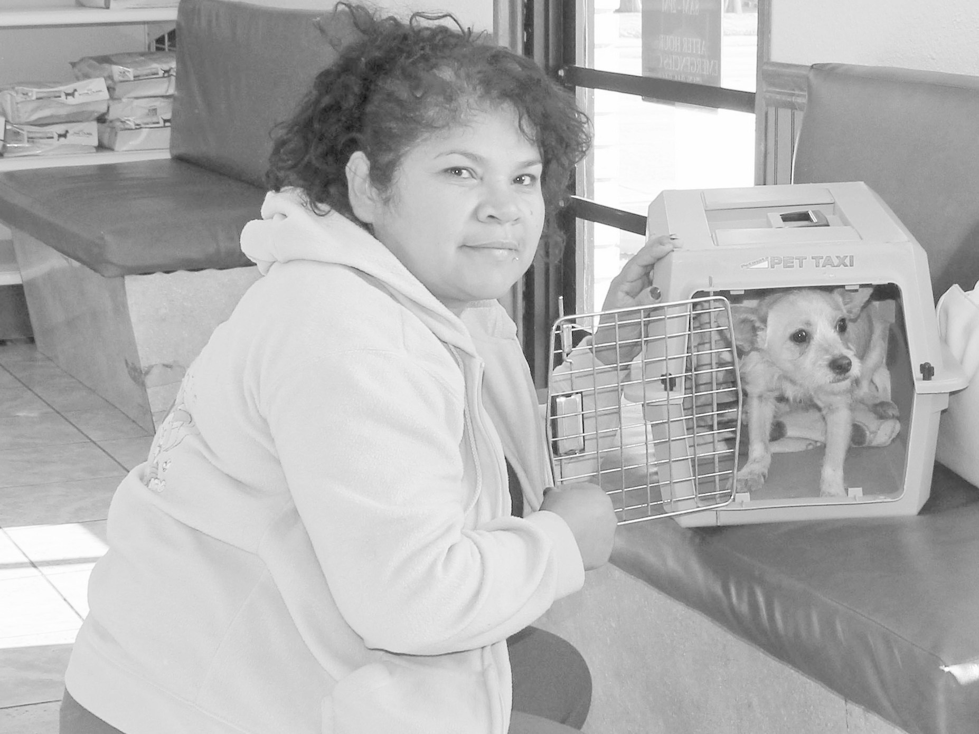
We’re raising $100,000 in private donations to pay for about 1,000 surgeries
CM Cisneros & CM Gallegos have pledged their support which helps us serve more in their districts

Slide 11
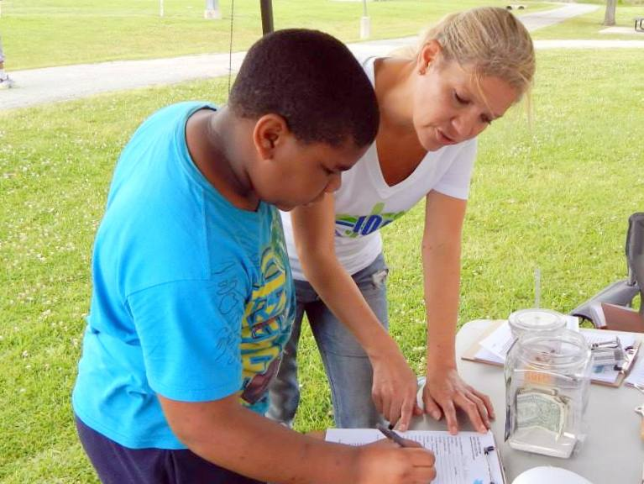
On February 11th, Unity partners will go into parks in their communities to sign up pets. Surgeries will be done later in the month at participating vet service providers.

Slide 12
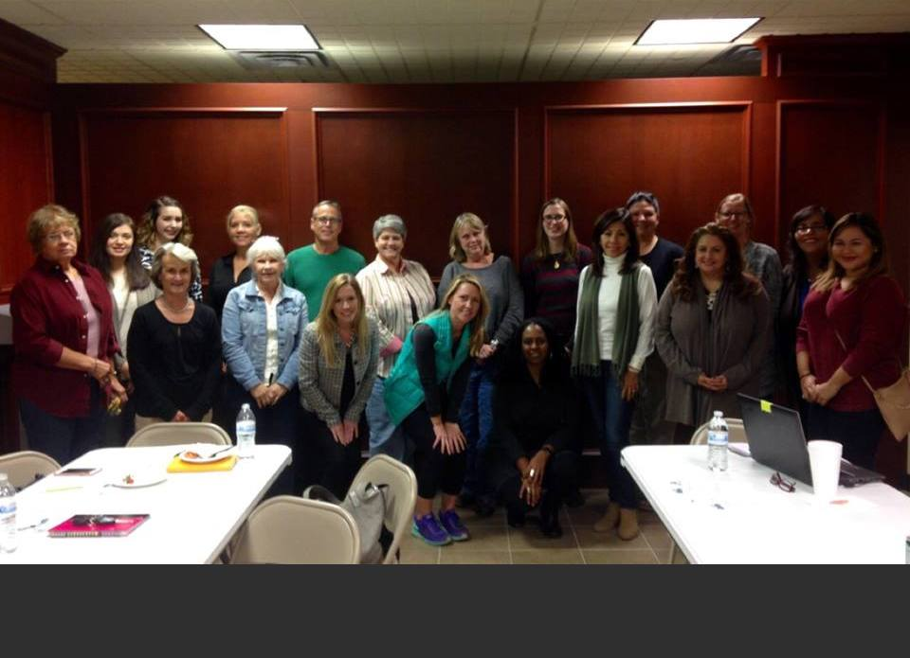
This is the first collaborative effort of its kind in Houston and we
are optimistic about what it represents for the future. We hope
to make Big Fix Houston a recurring annual event.

Slide 13


www.unityforasolution.org
www.bigfixhouston.org

