Slide 1

Mayor’s Office of Government Relations
Report on Zika funding for Solid Waste Programs
Bill Kelly, Director
June 16, 2016

Slide 2
85th Session of the Texas Legislature
Proposal Form
City Department: Solid Waste Management
Subject matter: Solid waste disposal fee
Statutory reference: TXHSC 361.013; TAC 330.673
Brief summary of proposal: To raise the solid waste disposal fee per ton paid by landfill owners and operators to the State,
back to $1.25 per ton.
Background information, including an example(s) of how current State law has negatively affected the COH: The 2013
legislature with the passing of HB 7 reduced the $1.25/ton tip fee paid to the state by landfill owners to $0.94/ton. In addition, the fund
allocation was changed, from 50% to TCEQ for solid waste program administration, and 50% back to COGs for the Solid Waste
Reduction grant programs to 66.7% to TCEQ, of which 33.3% of that amount is now used for the grant program.
The City of Houston SWMD has received over $3M since 1993 from the grant program for solid waste reduction and recycling
programs (the City of Houston as a whole has received more as HPD and HPARD routinely receive funding for illegal dumping and
recycling in parks). The amount of available funding to the grant program has been severely reduced by this legislation, and therefore
the SWMD opportunity to receive monies through the grant program has been reduced. SWMD would like to see the fee and funding
levels restored to the previous amounts.
In addition, the fund balance for Fund 5000, the solid waste fund, is over $140M presently. The monies cannot be utilized for anything
other than solid waste programs, but do not necessarily have to be spent, and therefore have been used for balancing purposes. With
the Zika virus crisis ever evolving, these funds could be used to help clean up and eliminate scrap tire piles within the state.
Potential partners: Other local governments in H-GAC or in TX that do not own their own landfill
Potential opposition: landfill owners and operators
Estimated financial impact (if applicable): An exact amount is difficult to estimate, but the City is losing the opportunity for funds as
the funds in the grant program have been so greatly reduced.

Slide 3
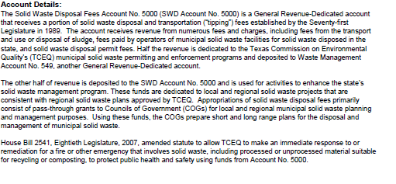

Summary of History of Fund 5000
Source: Texas Legislative Budget Board
November 5, 2012 Report

Slide 4
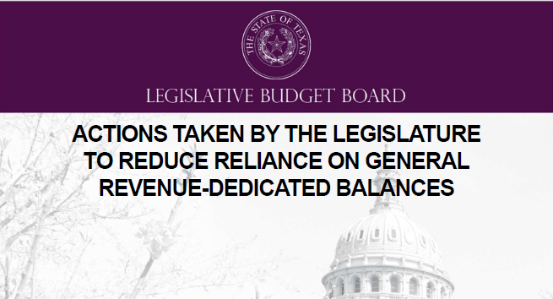

Source: Texas Legislative Budget Board
May 18, 2016 Report

Slide 5
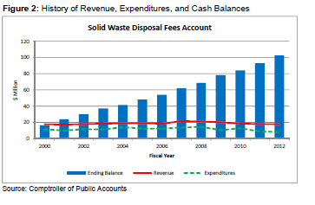
Expenditures, Revenue, and Ending Balances for Fund 5000

Slide 6
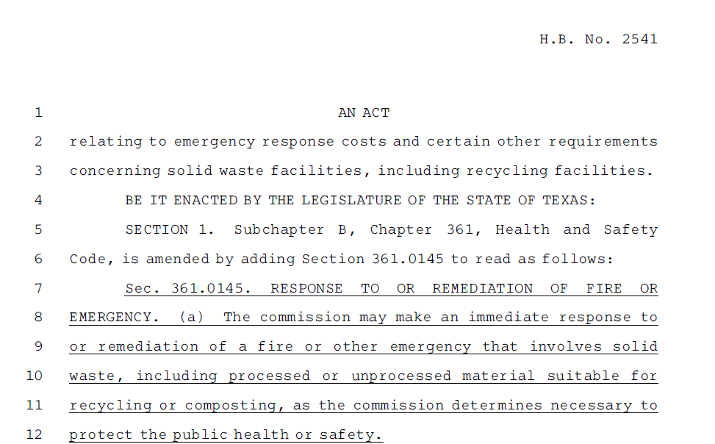
House Bill 2542 from 80th Legislative Session in 2007

Slide 7
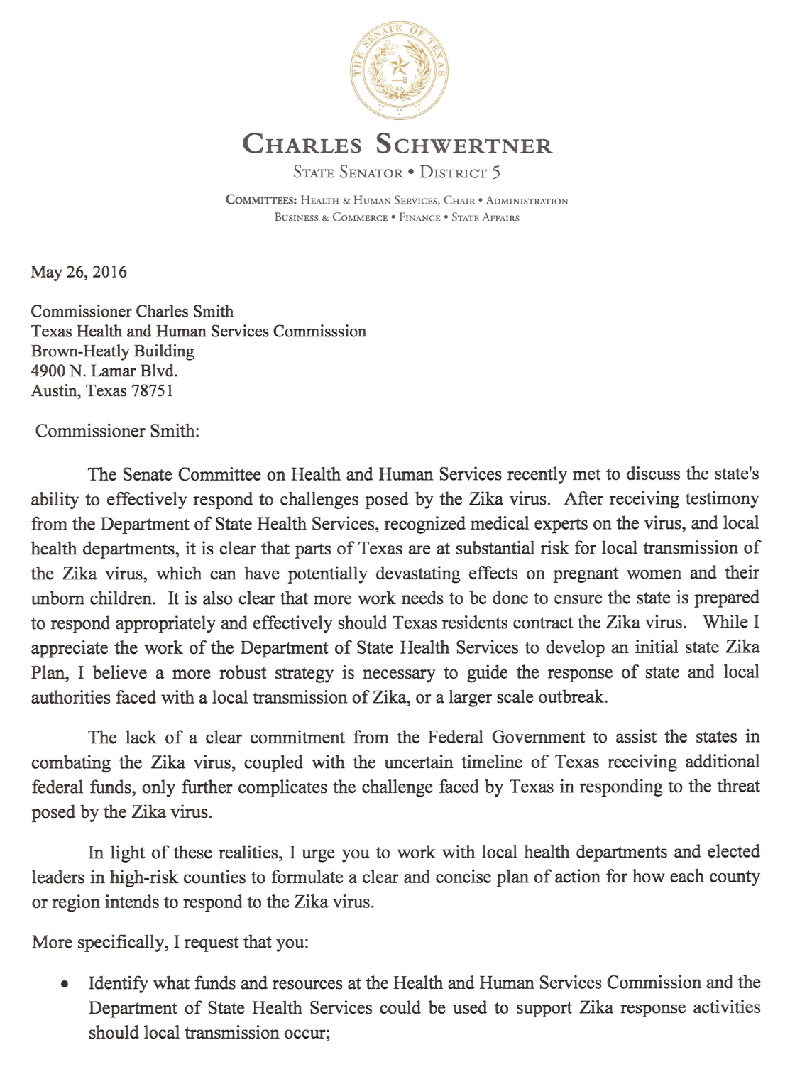
“After receiving testimony from the Department of State Health Services, recognized medical experts on the virus, and local health departments, it is clear that parts of Texas are at substantial risk for local transmission of the Zika virus, which can have potentially devastating effects on pregnant women and their unborn children.”
Senator Charles Schwertner

Slide 8
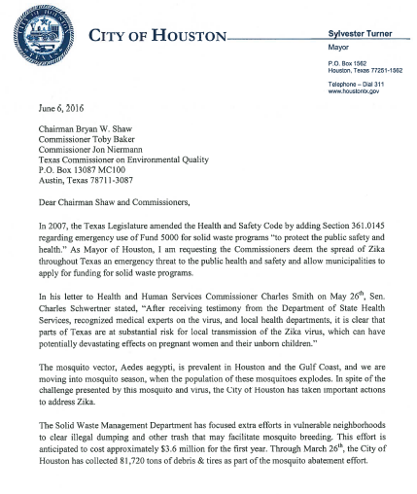
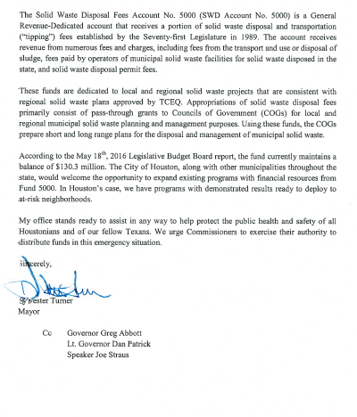
Letter from Mayor Turner to TCEQ Commissioners regarding Fund 5000

Slide 9
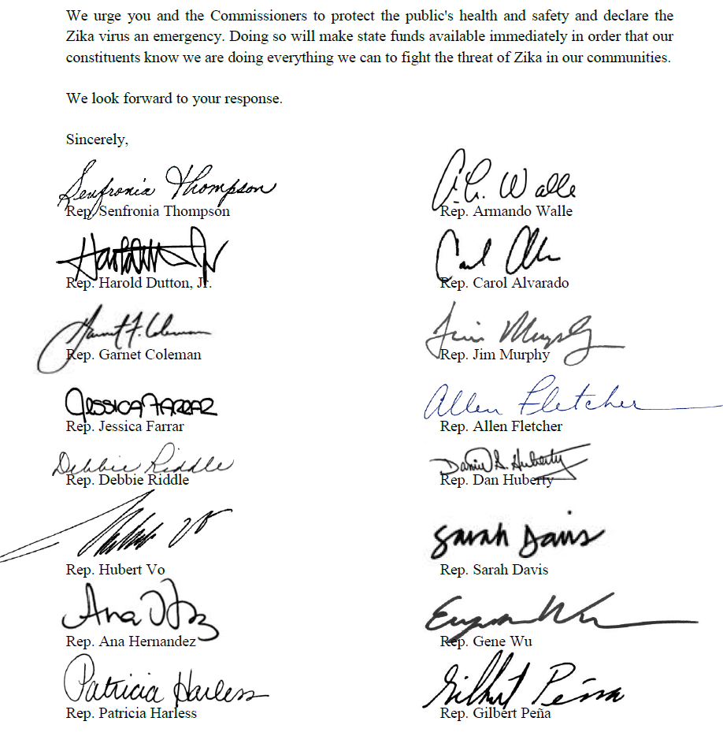
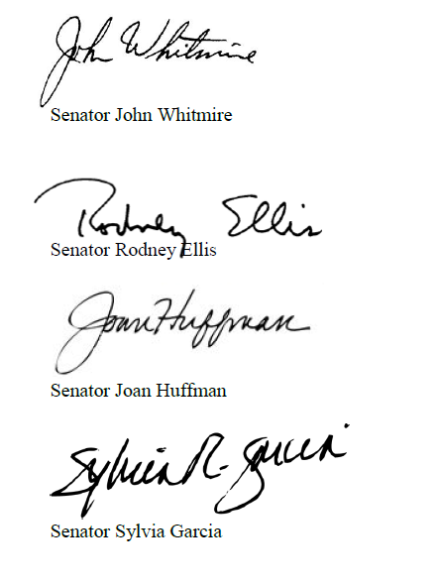
Signatures from the Harris County Delegation Supporting Mayor Turner’s Request

Slide 10
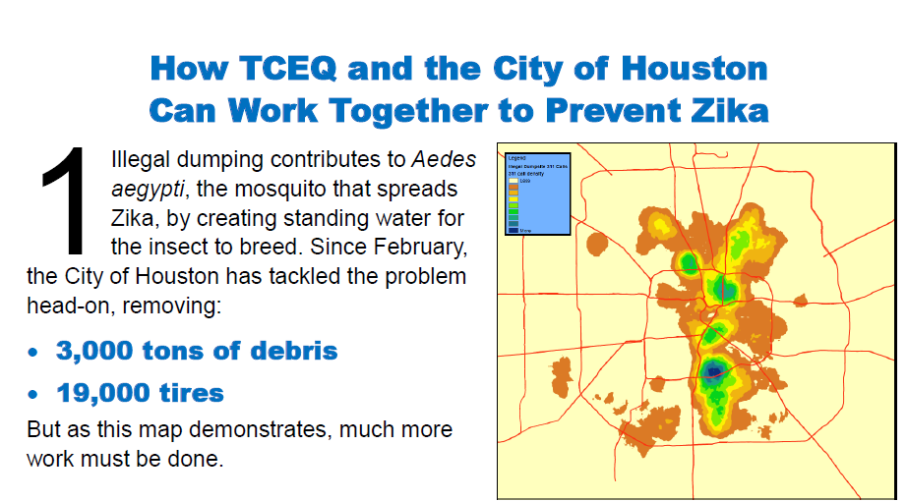
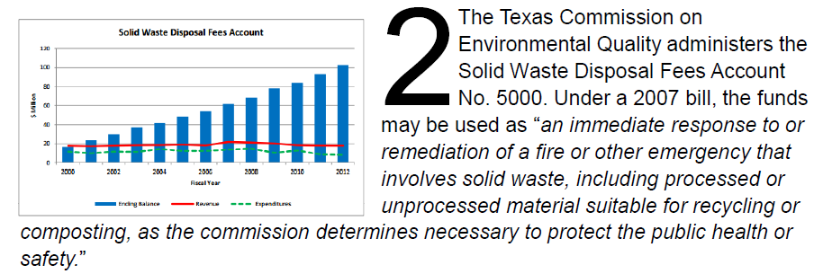

Slide 11
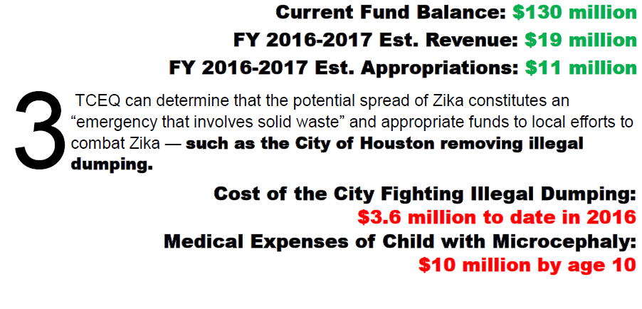

Slide 12
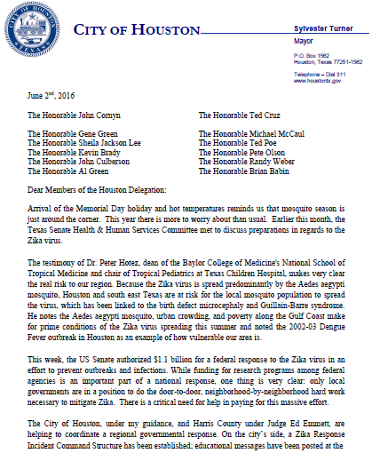
Letter from Mayor Turner to Houston Congressional Delegation
“Making sure the $1.1 billion in federal aid for Zika is distributed to local entities that can scale up their work is critical in getting the best return for our tax dollars.
Local government will be providing the response; local government is where the money should go.”
Mayor Sylvester Turner
.

