Slide 1
Outdoor Digital
Emergency Messaging

Slide 2
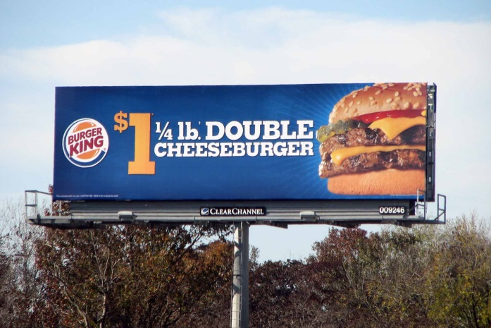
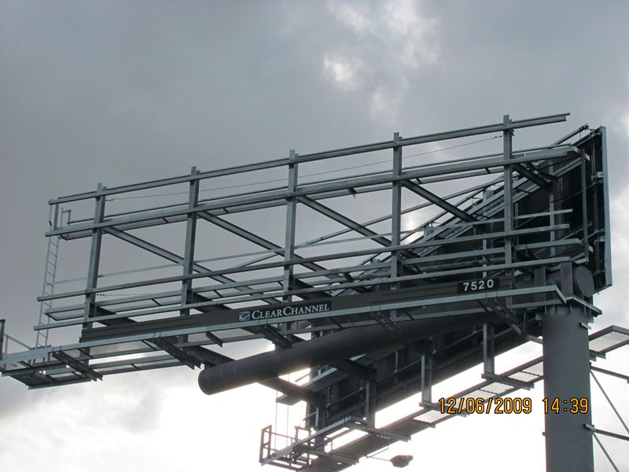
Traditional Board
Single sheet recyclable PE vinyl.
Stretched across metal substrate.
Crew climbs structure and installs PE vinyl.

Slide 3

Digital Unit
Static messages show once every
8 seconds
Units are programmed remotely (web based)
No Movement.
No Motion.
No Video.

Slide 4
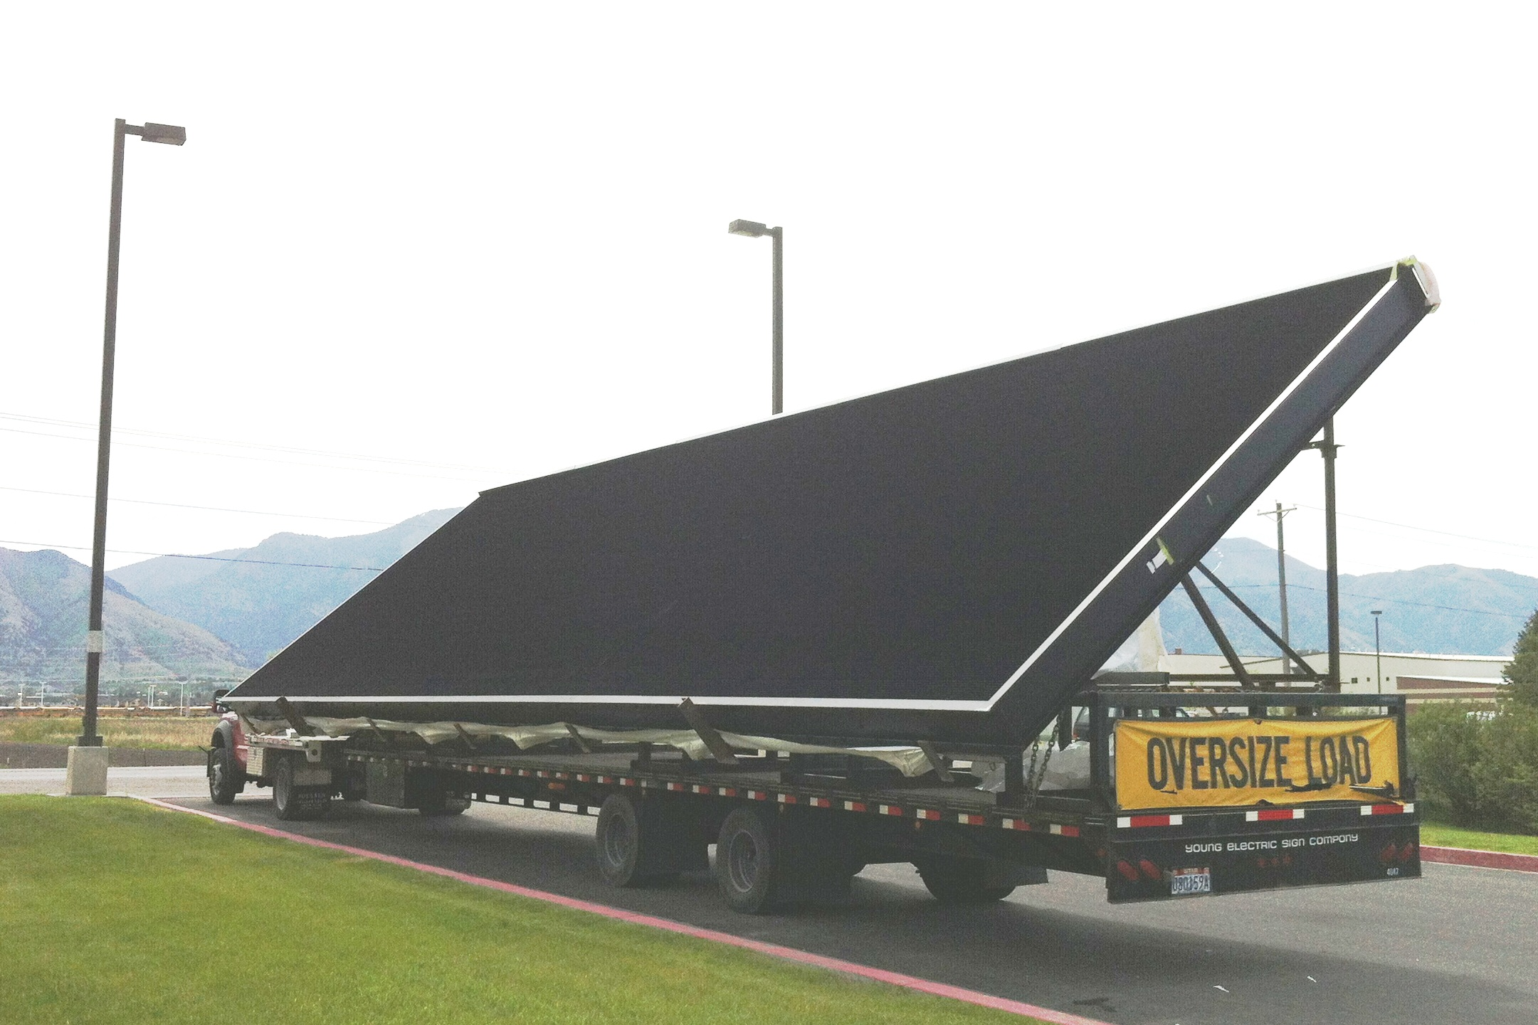

1 Foot Deep
LED Cabinet
Notes:
Now we simply hang a new, LED cabinet typically one foot deep, on a sign and change copy electronically and remotely. We are taking some of the technology each of you has on your desktops today and using it on our signs.

Slide 5
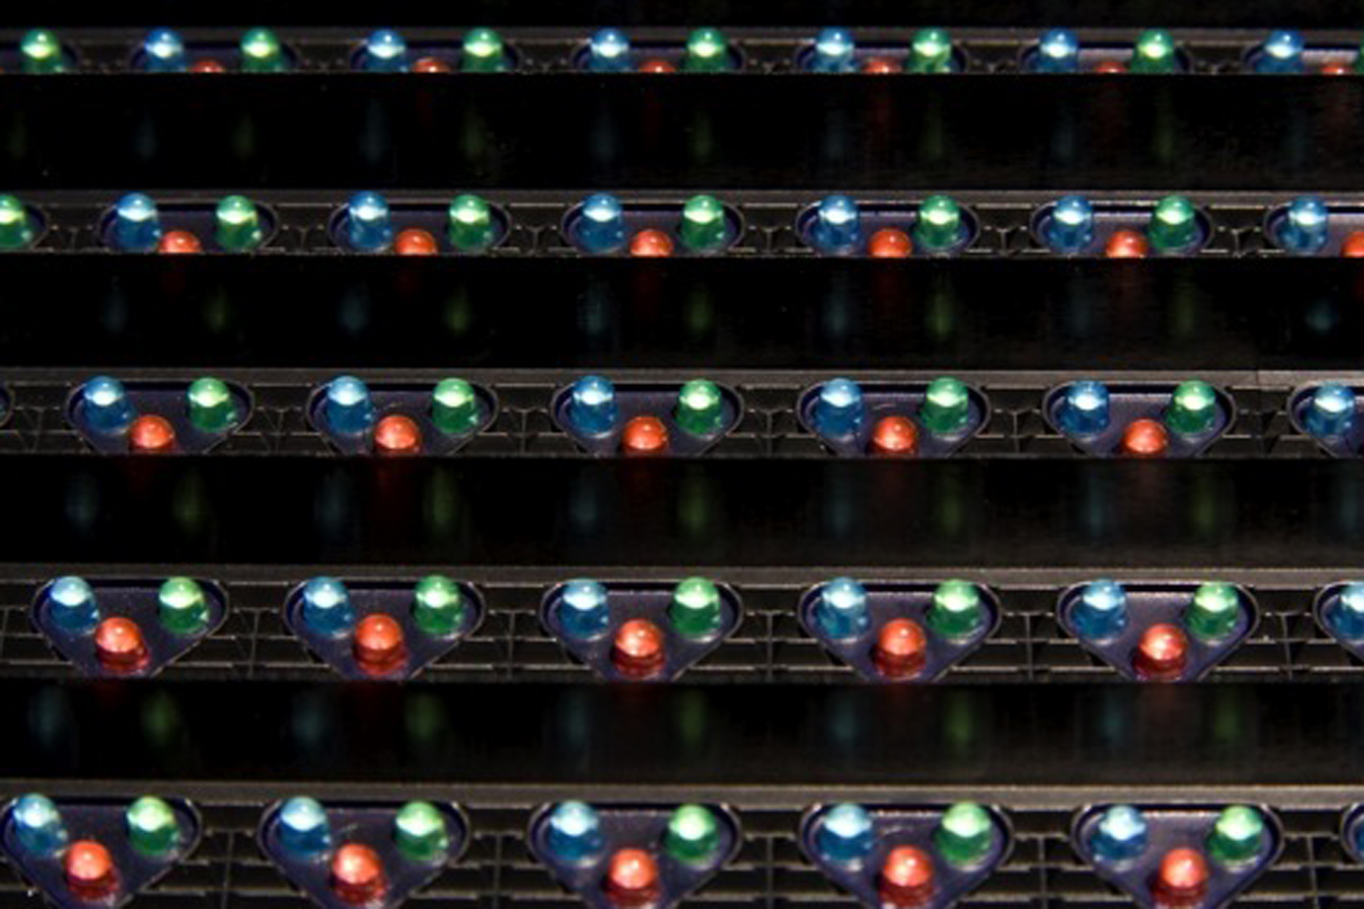
LED Pixels
Notes:
A red, blue and green LED clustered together form one “pixel.”
This is what a LED billboard looks like up close—like a big Light Bright.
With the distance they are viewed from the road, the eye does not pick up on the spaces between LED pixels. Notice the horizontal louvers. We will discuss what those do later.

Slide 6
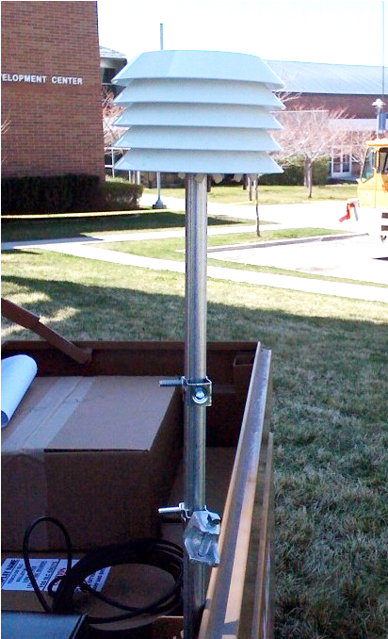
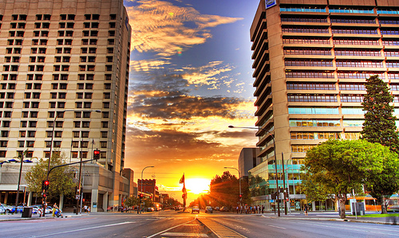
Dimming Capability
Illumination controlled based on environmental conditions.

Slide 7
Gulf Coast Emergency Communications Network

Slide 8
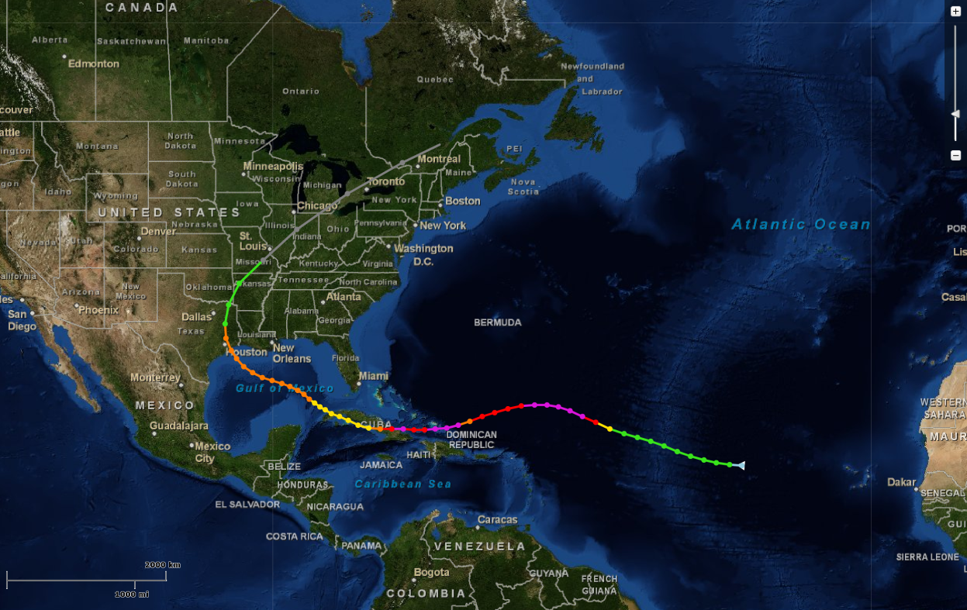
Hurricane Ike
28 deaths, $1 billion in property damage

Slide 9
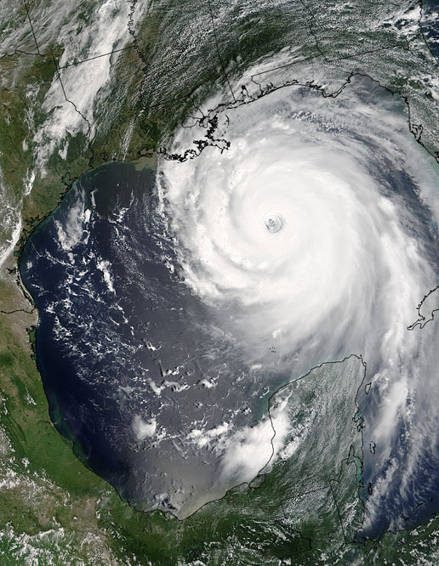
Instant Communications
The Gulf Coast of Texas is highly susceptible to tropical storms and hurricanes.
Since 1980, 17 major storms have ravaged the region.
Communications with the public during an emergency, especially the traveling public is essential.
Clear Channel’s network of digital units provide time-sensitive changeable messaging to the public.

Slide 10
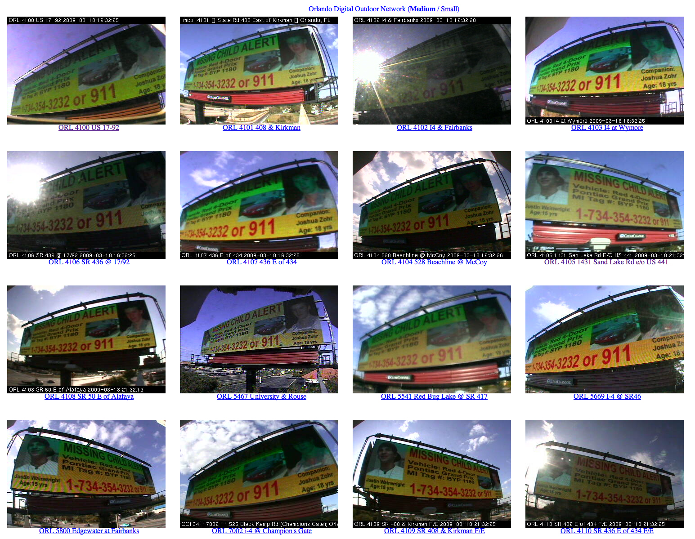
Network Protocol
Clear Channel builds and maintains these units at no cost to any municipality or other governmental agency.
Clear Channel provides time on units for periodic preparedness messages.
During a major emergency, messages are coordinated with the area county emergency management coordinator.
Emergency management coordinators in four counties have adopted the protocols for when and what is communicated during a regional crisis. Local emergency messaging is coordinated with counties and cities.

Slide 11
Emergency Network Protocol
Level 1 – Hazardous and dangerous conditions exist and are direct
threat to life/property. Pre-emption of advertising rotation.
Level 2 – Hazardous or dangerous conditions exist or and are
imminent and pose a significant threat to life/property.
Insert emergency messages into rotation.
Level 3 – Hazardous conditions exist and may pose an imminent
threat to life/property. Insert emergency messages into
rotation as space allows.

Slide 12
Activation Requests
Area Emergency Coordinator will provide timing and content of messaging.
Emergency Coordinator determine geographic location messages or those of a regional basis.
Clear Channel Outdoor will provide messages in specific locations or throughout the network.
Clear Channel will place the message into the proper template and return to the Emergency Coordinator to proof.
Once approved, message will be posted on the network or appropriate units.
Local City request will follow these same protocols.

Slide 13
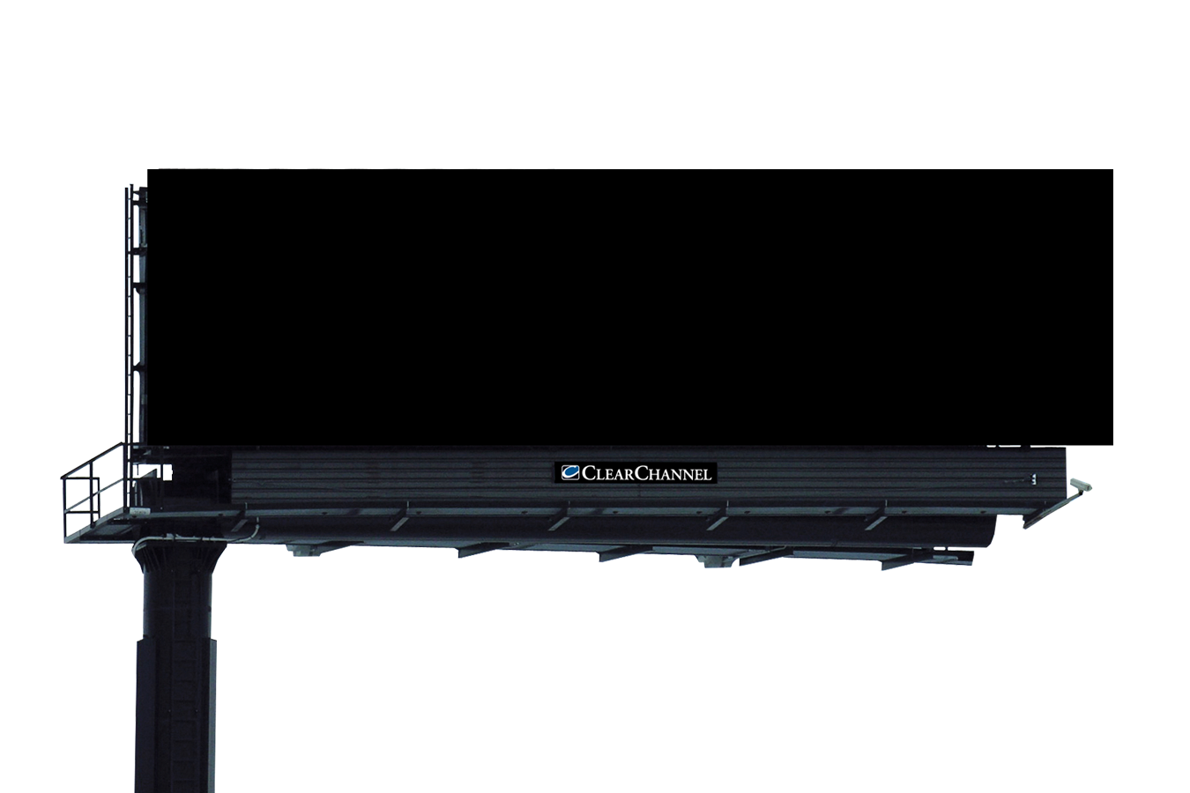

Emergency Network

Slide 14
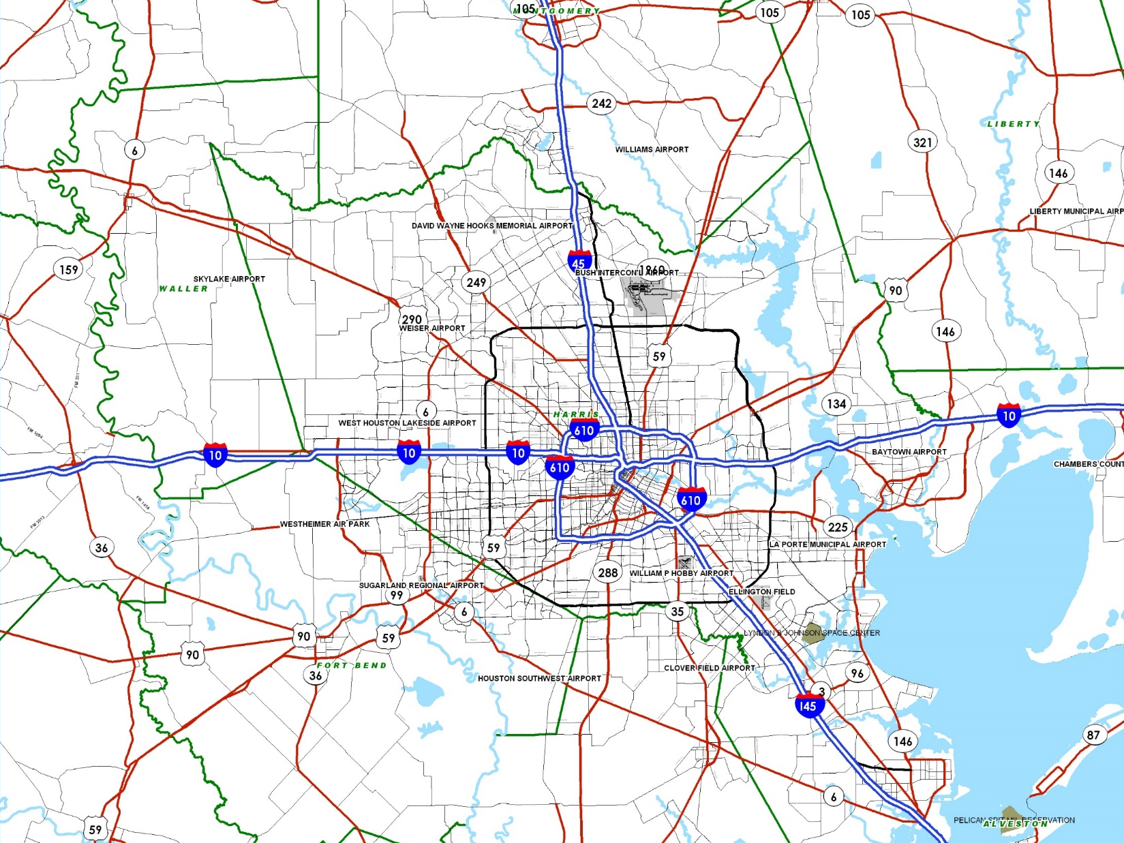




#9935
#9936
Houston Digital Locations
Hwy 59 @ FM 1960: #1023/#1024
I-45 @ Loop 336: #9935/#9936
I-45 @ Calder: #1120/#9502
Hwy 225 @ Red Bluff: #7030
Hwy 225 @ Spooner: #9133
East Belt @ Pasadena Blvd.: #7283/#7284
Hwy 6 @ FM 521: #6485/#6486
I-45 @ Magnolia: #1137/#9524
I-10 @ FM 1458: #8119/#8120
I-10 @ Oates: #8169/#8170
Hwy 146 @ Bel: #8173/8174
Baytown Building Soon
Rosenberg Building Soon
#1023
#1024
#8170
#8169
Building Soon
#8120
#8119
#7030
#9133
#7283
#7284
#6485
#6486
#8173
#1120
#8174
Building Soon
#9502
#9524
#1137

Slide 15
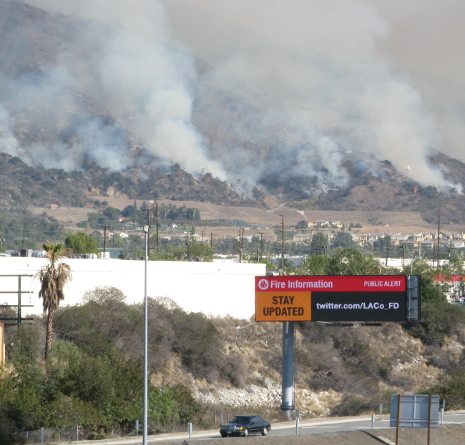
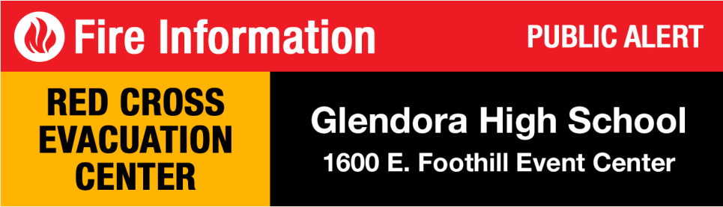
Regional Emergency
Notes:
Los Angeles, January 2014 Glendora Fire
The market had previously worked out the copy template with the areas first responders and just changed the text as updates came in.

Slide 16
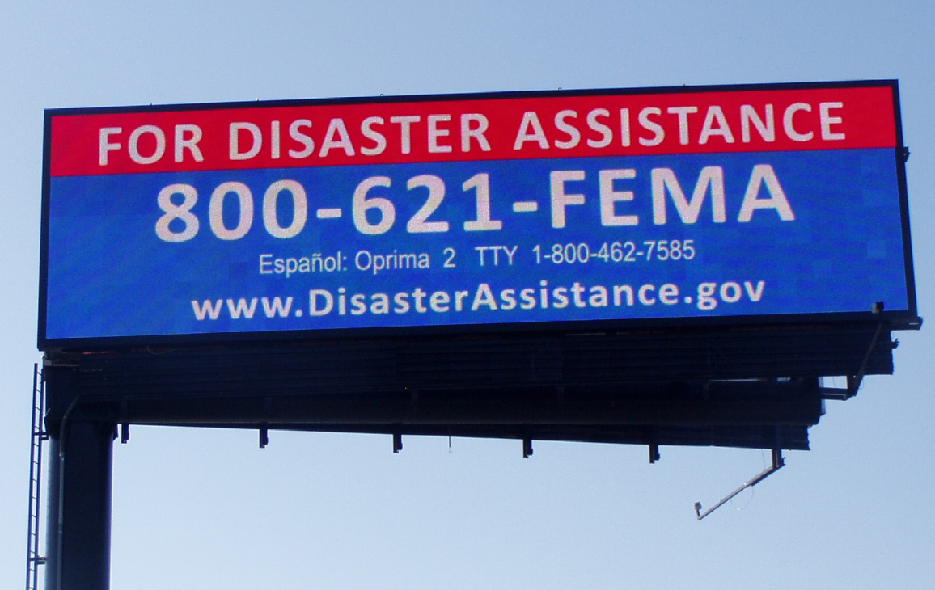
FEMA Annual Test of Alert System
Oct 2012 FEMA and OAAA sign a MOU
Notes:
May 2011, FEMA conducted a test through several Midwest states
October 2012, FEMA and OAAA signed a memorandum of understanding to establish a framework for cooperation regarding the use of digital billboards to display disaster-related messages to the public.
According to the signed agreement, “FEMA and State Emergency Managers were able to provide critical information in a highly visible way that supplemented on-the-ground contact by FEMA’s disaster reservists.”
The agreement says, “In some cases, the digital billboard was the only structure standing and operational after the severe weather had passed.”

Slide 17
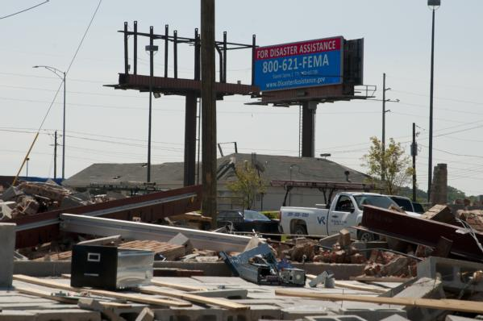

Slide 18
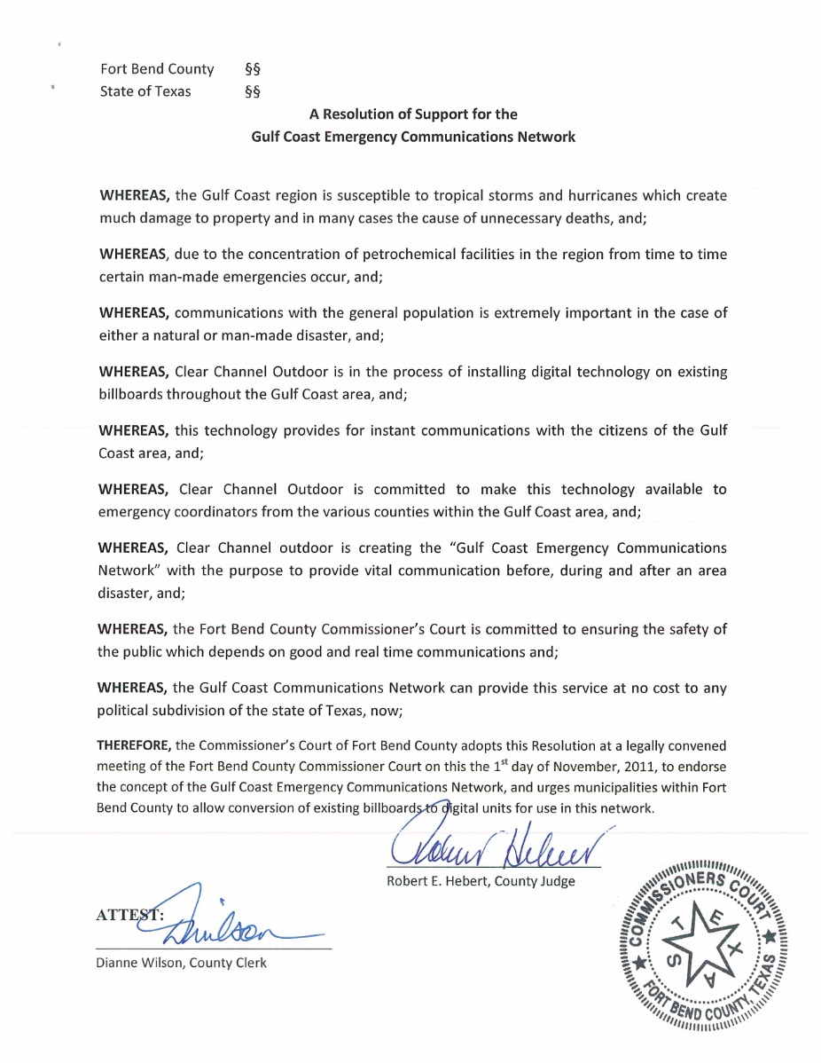
Fort Bend County
Resolution in Support of Gulf Coast Emergency Communications Network

Slide 19
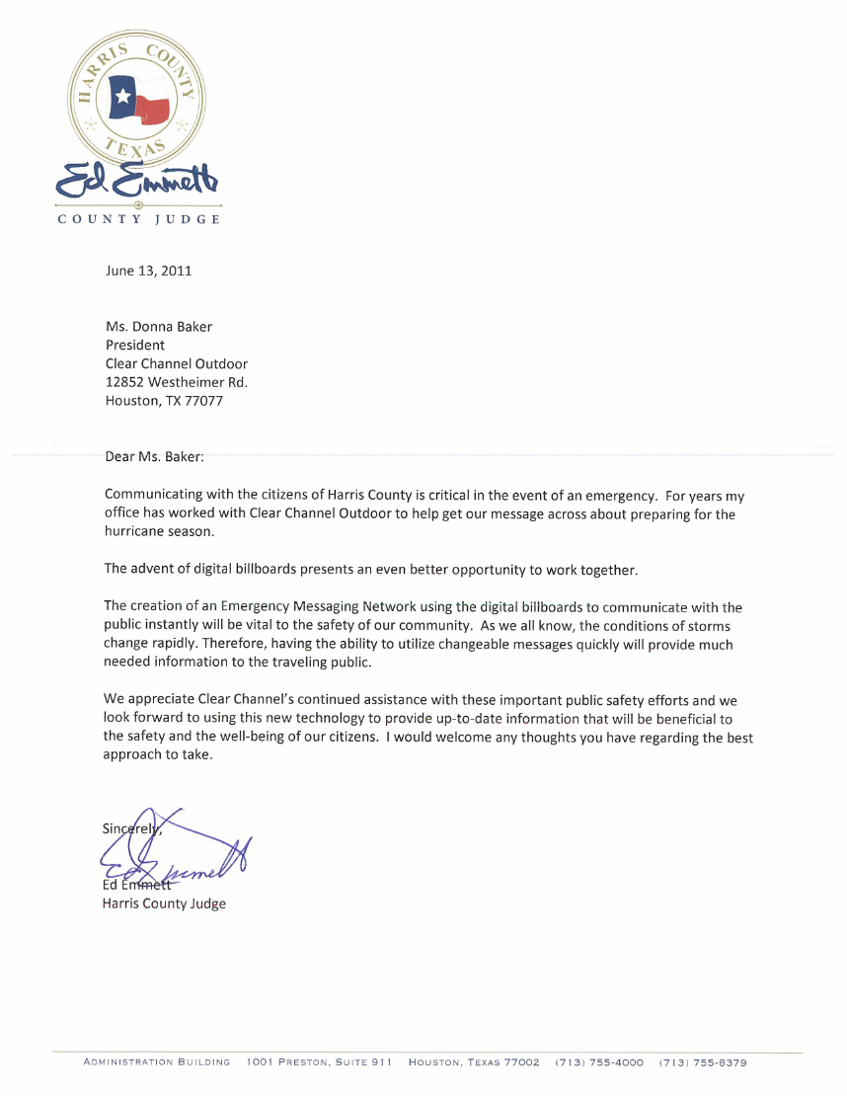
Judge Ed Emmett
endorsement of Emergency Communications Network

Slide 20
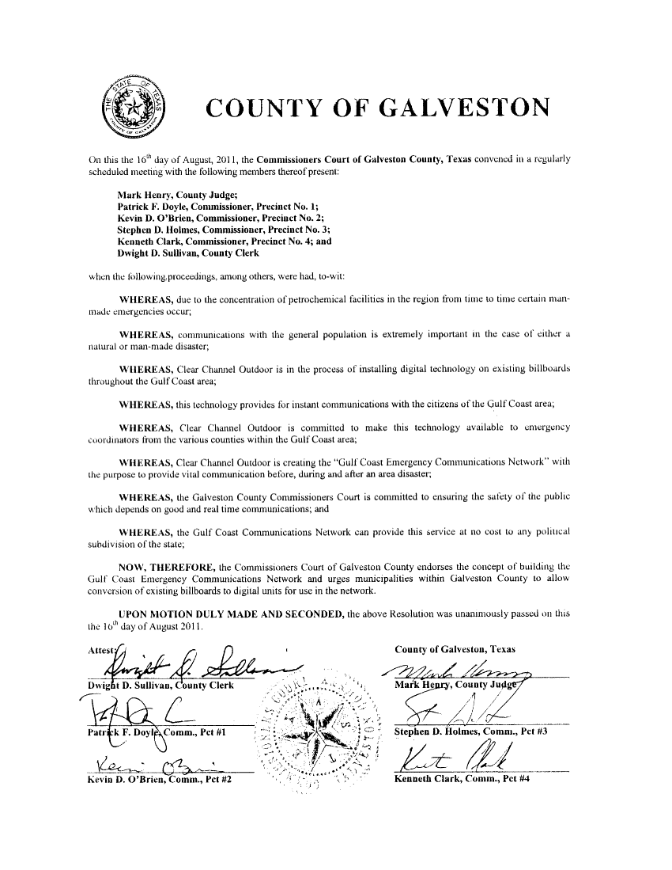
Galveston County
Resolution in Support of Gulf Coast Emergency Communications Network

Slide 21
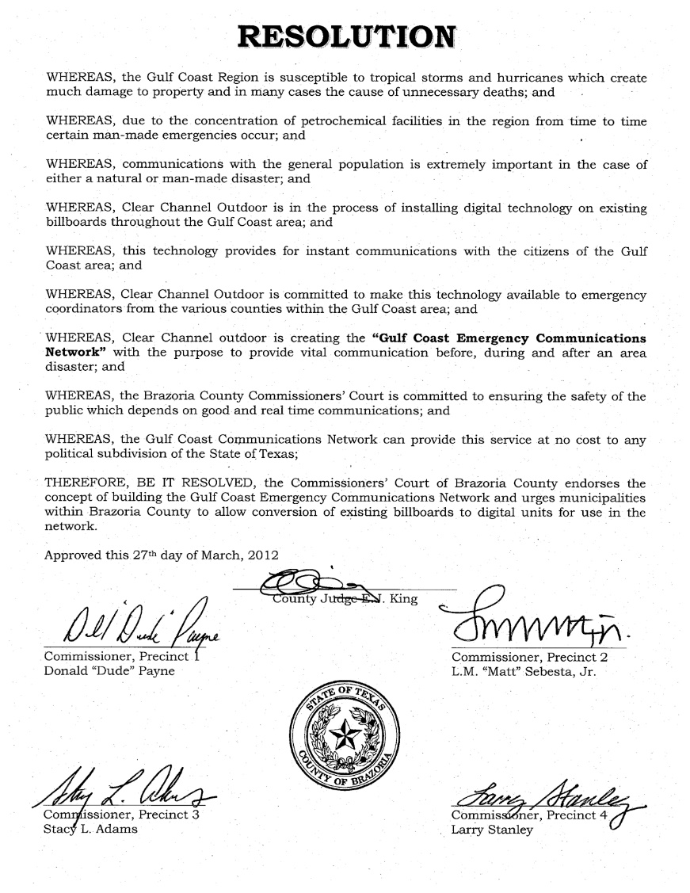
Brazoria County
Resolution in Support of Gulf Coast Emergency Communications Network

Slide 22
Questions?
Lee Vela
Clear Channel Outdoor – Houston
P: 281.588.4222
E: leevela@clearchannel.com

