Slide 1
Housing & Community Affairs Committee
Agenda Items
August 20, 2019

Slide 2
HCDD Agenda Items
I. Call to Order/Welcome
II. Single Family
III. Multifamily
IV. Public Services
V. Public Comments
VI. Director’s Comments

Slide 3
Item II.a. Second Amendment to the Mayberry Homes NSP Loan Agreement (District D)
A second amendment to the Neighborhood Stabilization Program (NSP) loan agreement for developing affordable, single-family homes in HUD NSP 1 and NSP 3 areas and extending the completion dates as follows:
The work completion date is extended to December 19, 2019.
The date by which all 100% of the Grant shall have been drawn and expended is extended to April 20, 2020.
The Maturity Date is extended to end on the earlier of: (1) Developer's sale of all the Properties covered by the Agreement, or (2) April 20, 2020

Slide 4
Item II.a. Second Amendment to the Mayberry Homes NSP Loan Agreement (District D)
The NSP developer loan agreement grants Mayberry Homes Inc. a total of $718,887.81 NSP 1 and NSP 3 funding.
HCDD is requiring Mayberry Homes, Inc. to develop houses for families earning below 120% Area Median Income (AMI), with at least 25% of the projects earmarked for families earning below 50% AMI.
The four homes (all located in Sunnyside) will be approximately 1,400 square feet, have three bedrooms and two baths, and include a variety of energy efficient components.

Slide 5
Item II.b. Inspection Services for Disaster Recovery (All Districts)
An Ordinance authorizing the allocation of $4,647,100.00 for CDBG-DR reimbursement-eligible costs from the previously approved Hurricane Harvey CDBG-DR17 appropriation for the following:
Initial Residential Home Damage Assessment Inspection Services, Asbestos Inspection / Testing Services, Lead Based Paint Inspections / Testing Service and Mold Inspections;
Approval of the Inspection Services Agreement; Approval of inspection services through U.S. General Services Administration-contracted providers and;
The Agreement to be executed between the City and each of the selected providers to be determined by SPD.

Slide 6
Item II.b. Inspection Services for Disaster Recovery (All Districts)
The Agreement will be executed between the City of Houston and Wood Environment & Infrastructure Solutions, Inc. through SPD’s Invitation to Bid (ITB) process to serve homeowners through all Harvey Disaster Recovery Programs.
The Agreement contains an initial three (3) year contract term with two (2) one-year options for renewal for a maximum five (5) year contract.
HCDD is requesting approval of this Ordinance to support the operation of disaster-related programs outlined in the City’s Local Action Plan in response to Hurricane Harvey.

Slide 7
Item III.a. Motion to Hold a Public Hearing for Dancy Estates and The Hollows (ETJ)
A motion establishing a date for a Public Hearing to provide a Resolution of No Objection for two applicants seeking 4% Housing Tax Credits (HTCs) for multifamily developments in the City’s extraterritorial jurisdiction (ETJ):
Property Applicant Units Location
Dancy Estates LDG Tanner, LP 240 Beltway 8 and Tanner
The Hollows LDG Channelview, LP 192 Wallisville and Dell Dale

Slide 8
Item III.a. Motion to Hold a Public Hearing for Dancy Estates and The Hollows (ETJ)
HCDD has performed a threshold review and recommends a Resolution of No Objection for the following reasons:
Poverty rate is less than 25%
Not located in a floodway or 100-year floodplain
None of the zoned schools are on the Texas Education Agency Improvement Required List
A public hearing on this Resolution was held on September 11, 2019.

Slide 9
Item III.b. Resolution of No Objection for Dancy Estates and The Hollows (ETJ)
HCDD recommends Council approve a Resolution of No Objection for two applicants seeking 4% Housing Tax Credits (HTCs) for the multifamily developments listed below:
Property Applicant Units Location
Dancy Estates LDG Tanner, LP 240 Beltway 8 and Tanner
The Hollows LDG Channelview, LP 192 Wallisville and Dell Dale

Slide 10
Item IV. 2020 TDHCA Award Acceptance Homeless Housing Services Program (All Districts)
An Ordinance authorizing the City of Houston to enter into a contract with the Texas Department of Housing and Community Affairs (TDHCA) for an award of Homeless Housing Services Program (HHSP) funds.
The proposed 2020 HHSP general allocation amount is $1,355,777.00
An additional amount of $415,034.00 is being awarded to address youth homelessness.
This item is a procedural, administrative matter required by the State of Texas for the City to receive the funds awarded.

Slide 11
Item IV. 2020 TDHCA Award Acceptance Homeless Housing Services Program (All Districts)
Allowable HHSP activities include but are not limited to:
Construction, development, or procurement of housing for homeless persons;
Rehabilitation of structures targeted to serving homeless persons or persons at-risk of homelessness;
Provision of direct services and case management to homeless persons or persons at-risk of homelessness.

Slide 12
Questions

Slide 13
MONTHLY PRODUCTION

Slide 14
Single Family - Home Repair
59 Homes Completed from July 2018 – June 2019
Total expenditures (all sources) for this period: $22,988,352.80
Total Administrative Costs: $654,485.17 (2.8%)

Slide 15
Single Family – New Development
17 Homes Completed from July 2018 – June 2019
Total expenditures (all sources) for this period: $3,569,827.20
Total Administrative Costs: $235,882.85 (6.6%)

Slide 16
Down Payment Assistance
163 Clients served from July 2018 – June 2019
Total expenditures (all sources) for this period: $4,419,266.98
Total Administrative Costs: $341,383.00 (7.72%)

Slide 17
Multifamily Projects
HCDD Restricted Units Completed for July 2018 – June 2019: 842
Total Units Completed for July 2018 – June 2019: 1149
Total expenditures for this period: $15,960,995.52
Total Administrative Costs: $1,213,986.35 (7.6%)

Slide 18
Public Facilities Projects
Average number of projects in progress per month for July 2018 – June 2019: 212
Total expenditures (all sources) for this period: $3,259,736.23
Total Administrative Costs: $314,875.42 (9.66%)

Slide 19
Public Services Programs
33,787 Clients served from July 2018 – June 2019
Total expenditures (all sources) for this period: $20,665,474.70
Total Administrative Costs: $1,104,722.03 (5.35%)

Slide 20
Letters of Agreement with other City Depts.
Health Department: July 2018 – June 2019
Total Expenditures for this period: $617,989.97
Total Admin for this period: $38,578.27 (6.24%)
Total clients served: 3,382
Elderly Services Programs: 2,359 clients served
HIV/AIDS Education: 942 clients served
Re-Entry: 49
Mental Health Services: 32
Lead Based Paint: 0

Slide 21
Disaster Recovery Update
Two-year anniversary review
Multifamily Round 1 summary
Homeowner Assistance Program update
What’s next

Slide 22
Harvey Anniversary – Aug 25
Since Harvey:
Local control over $1+ billion for an equitable recovery
Identified additional $2 billion in unmet housing need
Community engagement to inform Houston’s Local Action Plan – 18 meetings in 2 months
Build Houston Better Workforce Protection Measures
Staff capacity: 93 new staff hired in the last year
Launched 3 programs for housing recovery:
Homeowner Assistance Program
Harvey Multifamily Program
Harvey Public Services Program

Slide 23
Multifamily Round 1
Round 1 of 3 funding rounds opened in Feb; final awards expected by late Aug. Next round will open in 2020.
56 applications for funding reviewed
11 developments selected for funding so far
$91m in awards announced so far
1,029 total affordable rental homes to be created so far
$350m total program budget

Slide 24
HoAP: Timeline
January program outreach launched
March first invitations to apply
April first home repairs started
August first reconstruction started and finished

Slide 25
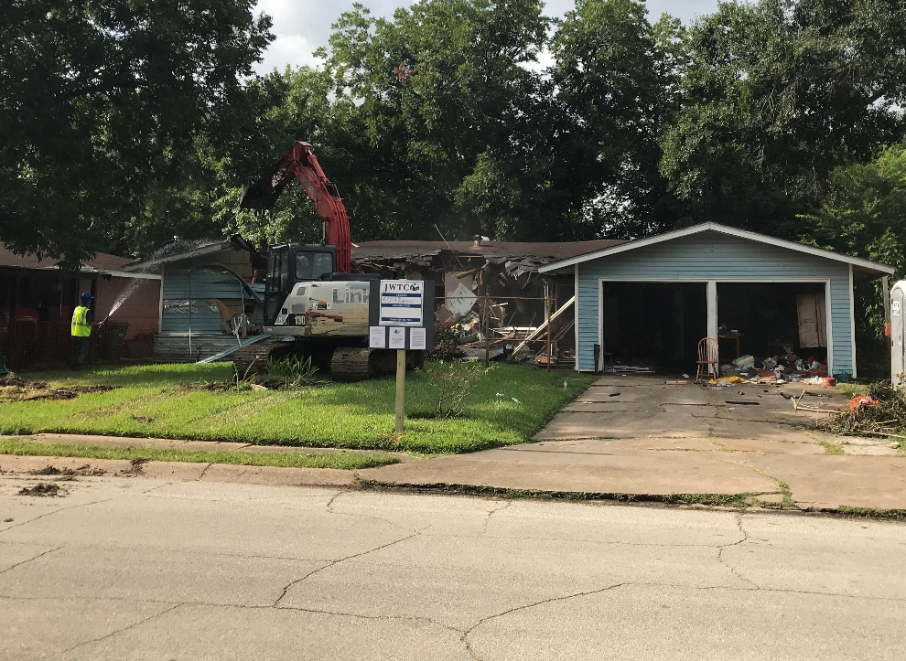
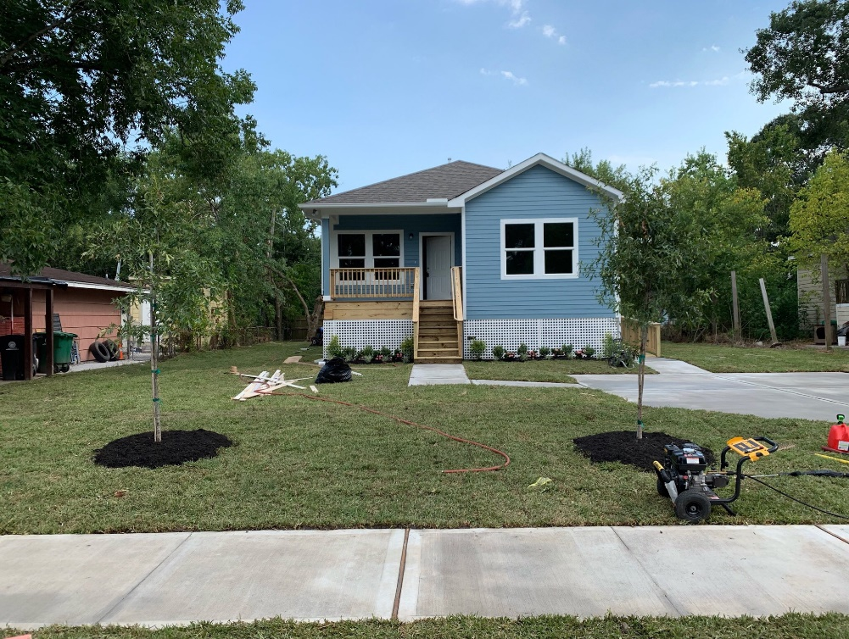
HoAP: First Reconstruction
Home went from demolition to reconstruction in two weeks

Slide 26
HoAP Reporting and Data
First Situation & Pipeline Report to be released this week
Will be published monthly going forward
Highlights:
Survey and application data
Demographic data
Geographic breakdown
Recovery.houstontx.gov/reports

Slide 27
HoAP Key Stats: Survey + Intake
19,642 total number of survey respondents
15,605 potentially eligible for HoAP
4,919 application invitations sent
1,961 submitted applications

Slide 28
Homeowner Assistance Program Step-by-Step
As of August 19 (3 pm)
Approved by GLO
Loan closing complete
NTP or reimb. check
4,919
Invited to apply
1,961
Document collection complete
267
Applicant eligibility review complete
92
Sent to GLO for review
27
16
13
65
11
3
Scheduling loan closings
Awaiting NTP or check
175
Completing property eligibility review & scope walk
In Progress for GLO Approval
2,958
Working to collect documents or deciding to apply
1,694
Applicant eligibility review ongoing
Step 1
Phased invitation to apply
Step 2
Work with applicants to collect documents
Step 3
Applicant eligibility review
Step 4
Property eligibility review; submit to GLO
Step 5
GLO approval
Step 6
Loan closing
Step 7
Notice to Proceed or reimbursement check

Slide 29
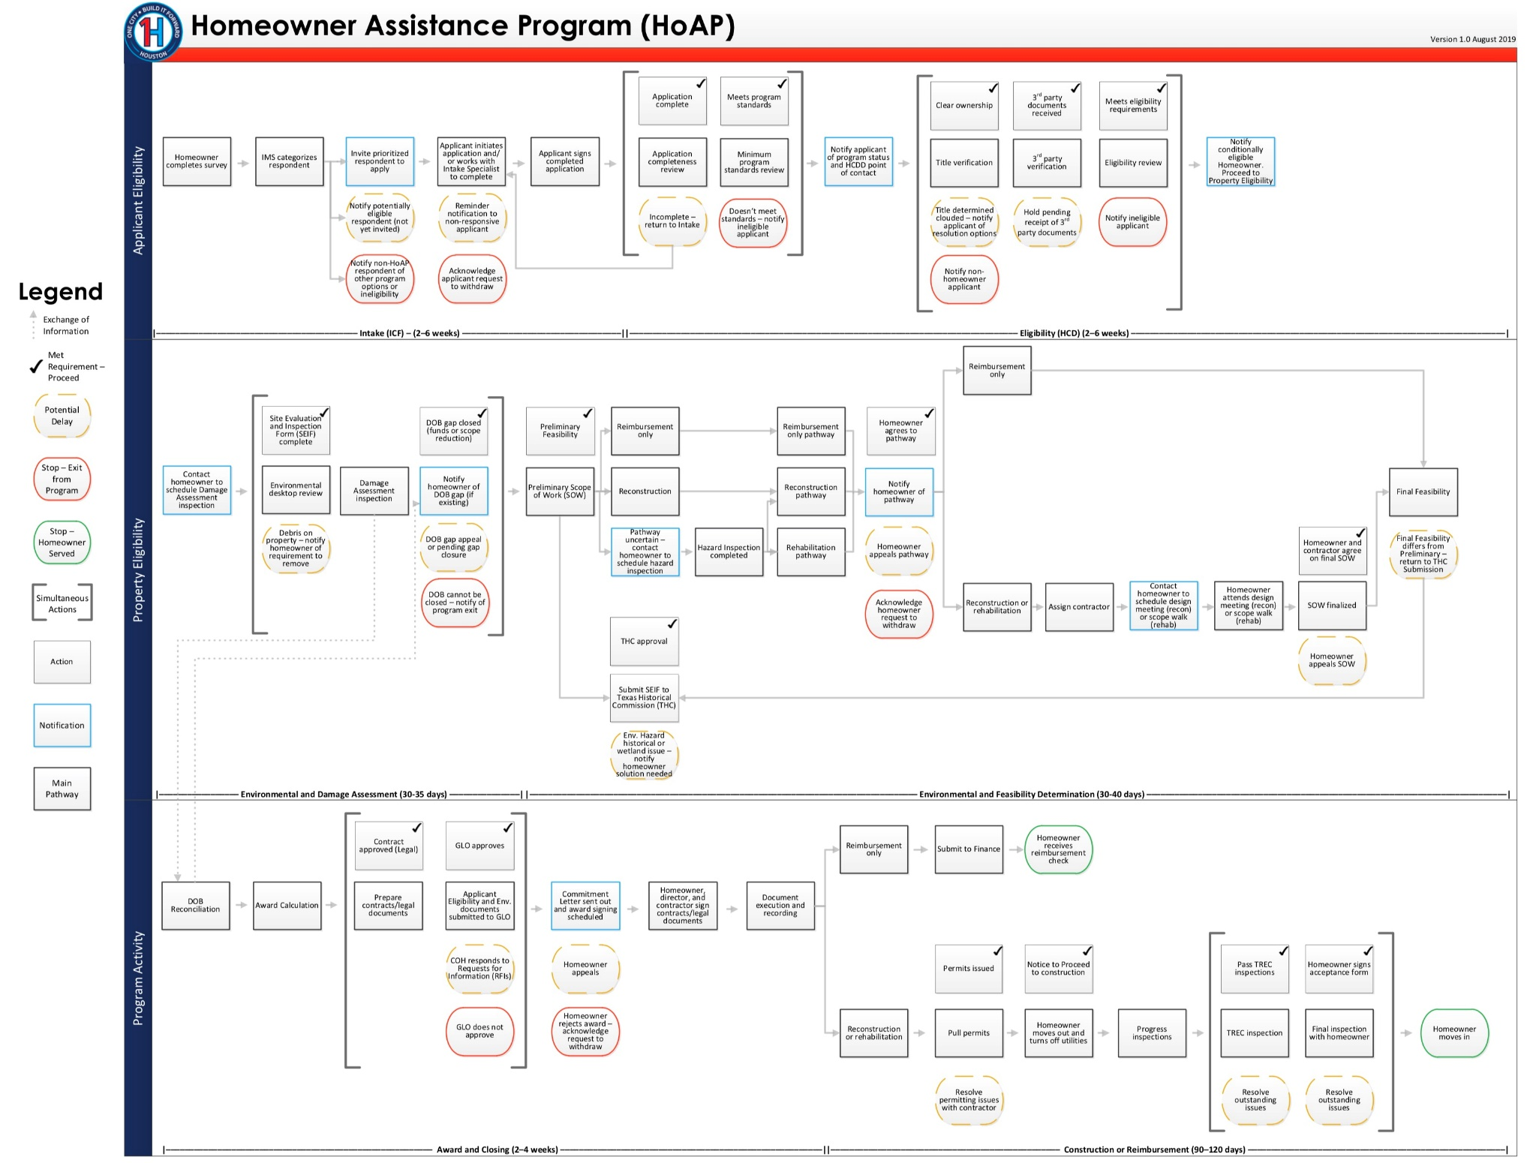

Slide 30
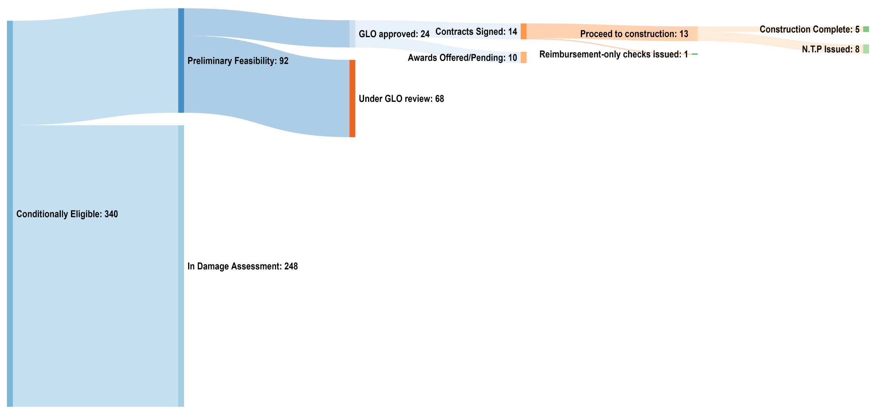
HoAP Key Stats

Slide 31
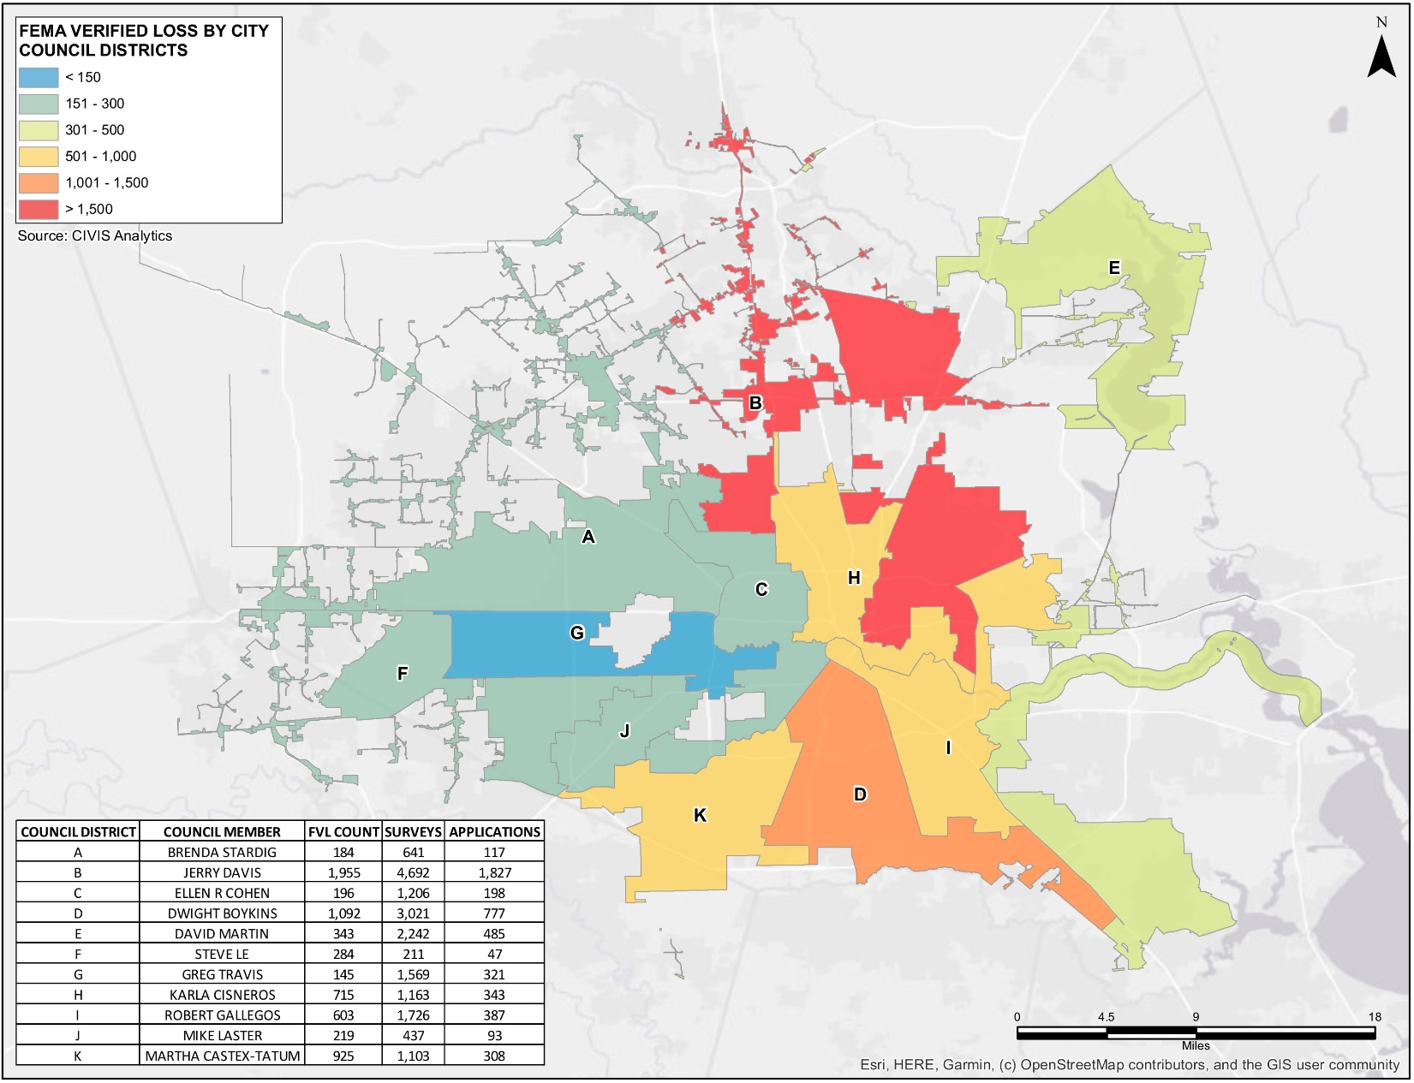
Key Stats by Council District

Slide 32
Comments

